Slide 1
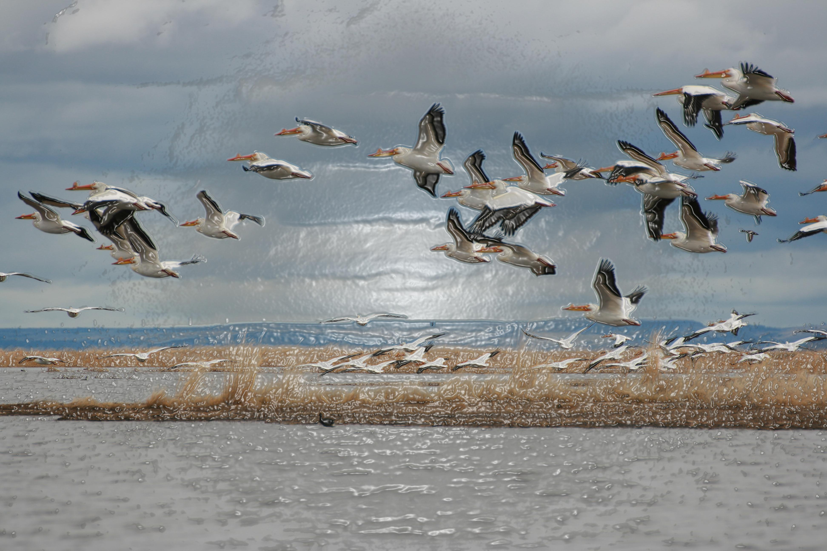
Federal Lands Transfer Peer Exchange
U.S. Fish and Wildlife Service
June 13, 2019

Slide 2
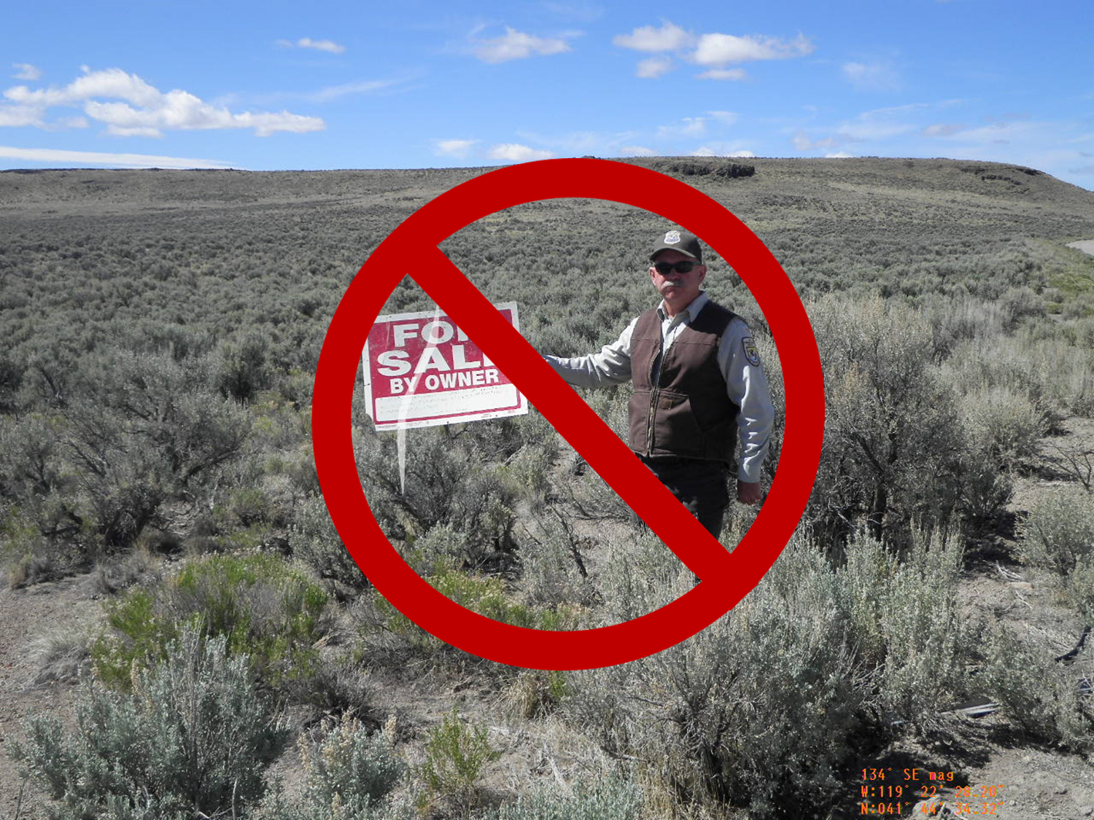
National Wildlife System Administration Act 16 USC 668dd
Notes:
Refuge System lands and waters are managed according to the authorities of the National Wildlife Refuge System Administration Act of 1966 (Administration Act; 16 U.S.C. 668dd–668ee), as amended by the National Wildlife Refuge System Improvement Act of 1997 (Improvement Act; Pub. L. 105–57)
The Service does not have disposal authority and will typically only convey an easement interest by exchange. There are specific regulations regarding exchanges, not described here.
The Service issues Right of Way (ROW) Permits under 50 CFR 29.21. This regulation is currently being revised and will likely be published in the Federal Register later this year. This will be followed by a revised Policy Chapter and training to be offered to Service Personnel.

Slide 3
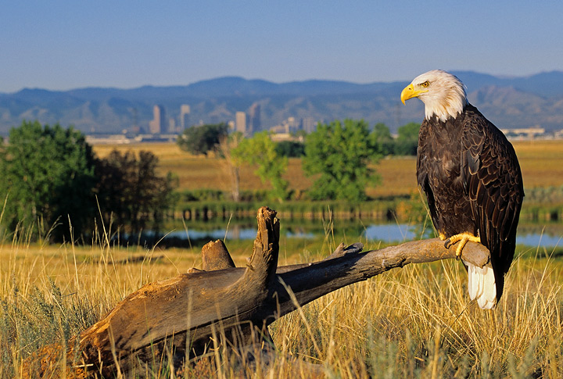
ROW Regulations found at 50 CFR 29.21
Notes:
The proposed use MUST BE COMPATIBLE refuge purposes
Test: Use will not materially interfere with or detract from the fulfillment of the mission of the Refuge System or the purpose(s) of the refuge.
Process: “compatibility determination” is a determination that a use is compatible or not compatible with that Refuge’ purpose.
There are 567 refuges, each with different establishing authorities, purposes, habitat types, wildlife species, and public uses.
Public safety/human safety NOT considered in analysis
Compatibility regs found at 50 CFR 26.41.

Slide 4
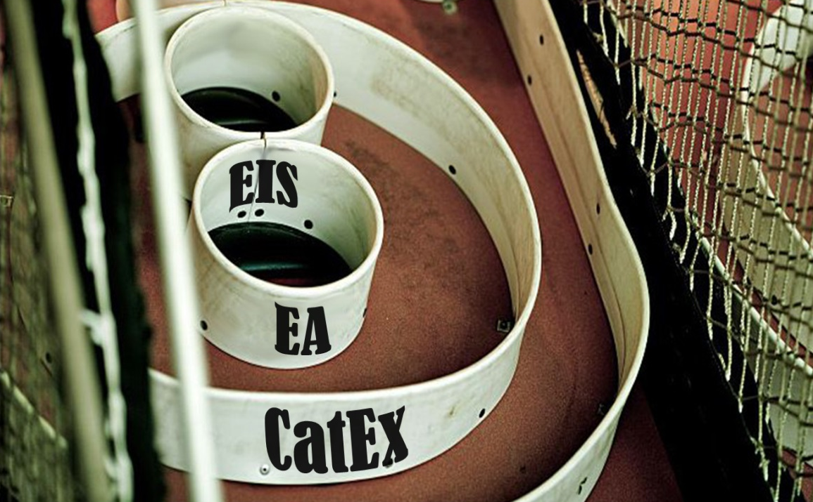
NEPA
Notes:
If the project passes compatibility:
Service must assess the effects of the proposed use:
As required by the National Environmental Policy Act of 1969 (NEPA; 42 U.S.C. 4321 et seq.);
The Endangered Species Act of 1973 (ESA; 16 U.S.C. 1531 et seq.), as amended;
The National Historic Preservation Act of 1966 (NHPA; 54 U.S.C. 300101 et seq.); and
Other applicable laws and Executive Orders.

Slide 5
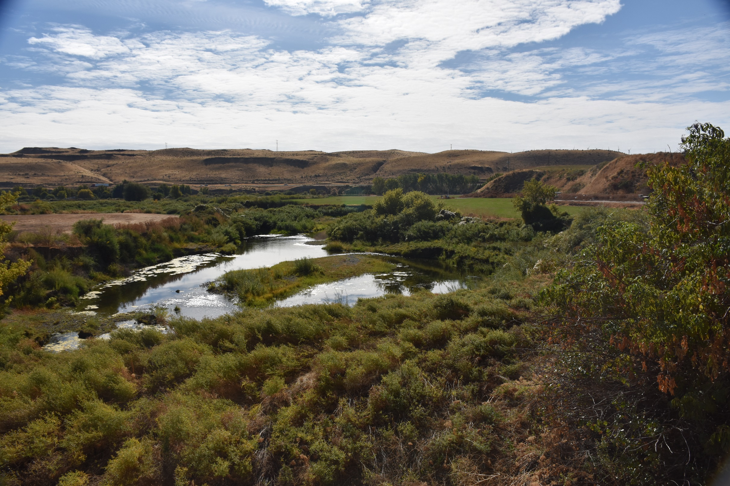
De Minimis Impact:
Stipulations in Compatibility Determination
Required to create Net Benefit for Refuge
Notes:
De Minimis Impact
Handled through stipulations in the compatibility determination
Net Benefit for refuge
Example: seeding surrounding area with native vegetation and invasive weed treatments on surrounding land
Fees
Application, Monitoring, Processing fees waived
Required to pay fair market value for occupation by NWRSA
Timing
Case-by-Case for compatibility and NEPA
Permit processing usually within 90 days

