Slide 1
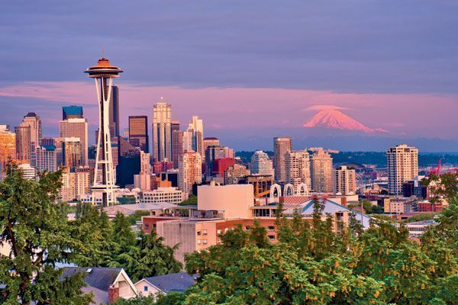
Federal Land Transfers
Notes:
This presentation will highlight a state-funded project in Washington where the state requested, and FHWA concurred in, a decision that this project had a strong Federal transportation interest and should be processed through FHWA.

Slide 2
Federal Land Transfers
Topic: Determining a “strong Federal transportation interest” in a project with no FHWA funding
Project: Wildcat Creek Bridge on US-12
WSDOT: Heather Lindstrom
FHWA: Dave Leighow
Notes:
The project that this presentation covers is the Wildcat Creek Bridge replacement project on SR/US-12. The presenters will be Heather Lindstrom of WSDOT and Dave Leighow of the FHWA WA Division Office.

Slide 3
Wildcat Creek Bridge Project
Existing Wildcat Creek Bridge

Slide 4
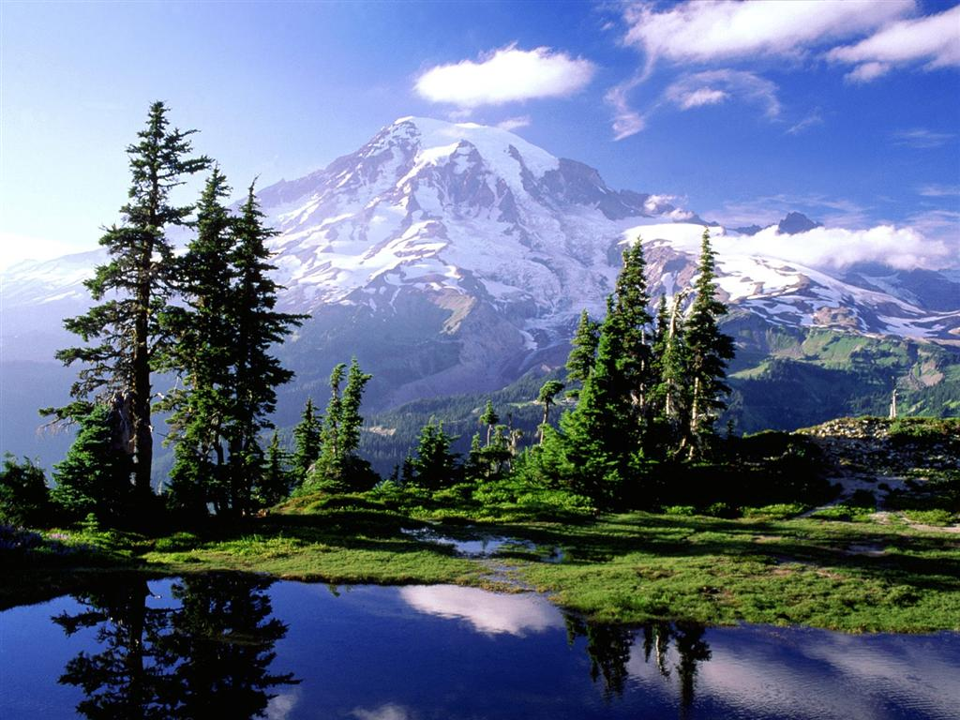
Strong Federal Transportation Interest
Highway project is in the Okanogan-Wenatchee Nat’l Forest
No FHWA funding in project
To process under 23 USC 317, must demonstrate a “strong Federal transportation interest”
Option—State processes directly with U.S. Forest Service
Notes:
Project Description (please see attached for further description).
The Wildcat Creek Bridge is located in central Washington on US 12 (National Highway System) at milepost 166, approximately 25 miles west of the town of Naches, and 15 miles east of the White Pass summit. The bridge was constructed in 1936 and has undergone multiple repairs including bridge rail retrofit, curb repair and continuous structural repair. So far, this year, we have spent approximately $50,000 to repair various structural problems including blow-through’s of the deck. The Wildcat Creek Bridge is a multi-span bridge consisting of a concrete deck, three spans; two timber trussed approach spans and a center steel girder span, concrete columns and concrete spread footings. WSDOT is currently contemplating a speed reduction and one lane configuration until additional repairs can be made or the bridge is replaced.
US 12 is an important high-speed two-lane rural highway for long-distance travel and is a valuable year-round mountain pass highway that provides a vital connection between the Yakima Valley and the I-5 corridor. US 12 also serves the irrigated agricultural and rural-residential land uses near Naches and throughout the Yakima Valley. It also provides connections to SR 410, Chinook Pass, Cayuse Pass, and Mount Rainier National Park. US 12 is a secondary freight route, but has an important statewide freight function as an alternative to I-90 Snoqualmie Pass and is one of only 4 cross state routes open year round.
From SR 123 to SR 410, US 12 is designated as a National Scenic Byway. It is also important for access to numerous recreational areas including national forest lands and wilderness areas as well as National Parks and Nation Monuments. It also provides access to the recently expanded White Pass Ski Area.

Slide 5
Making the Case
US 12--important high-speed, two-lane rural highway
A valuable year-round mountain pass highway that provides a vital connection between the Yakima Valley and the I-5 corridor
Serves the irrigated agricultural and rural-residential land uses near Naches and throughout the Yakima Valley
Provides connections to SR 410, Chinook Pass, Cayuse Pass, and Mount Rainier National Park
US 12 is a secondary freight route, but has an important statewide freight function as an alternative to I-90 Snoqualmie Pass
One of only 4 cross state routes open year round; also designated as a National Scenic Byway

Slide 6
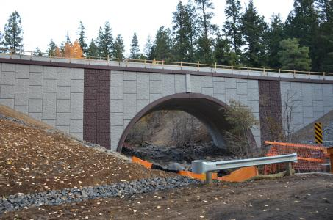
Successful Ending
The “rest of the story” is that FHWA concurred in the determination this project had a “strong Federal transportation interest”
The project is constructed and open to traffic

