Slide 1
US General Services Administration
Office of Real Property Utilization and Disposal
presented by
Angela LaMonica
Deputy Director

Slide 2
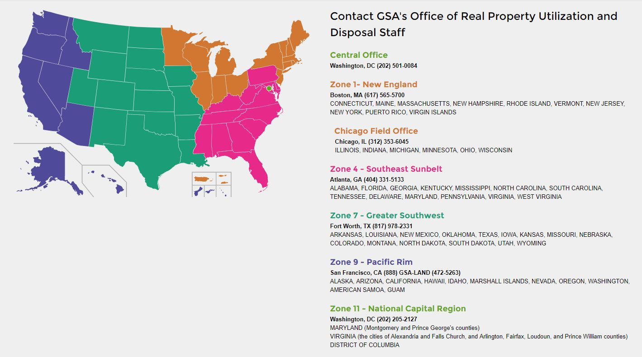
GSA Office of Real Property Utilization & Disposal
Where is my nearest Regional Office?
https://disposal.gsa.gov/s/contactus

Slide 3
US General Services Administration
Office of Real Property Utilization & Disposal
Mission: To lead the Federal Government in optimizing its real property portfolio through effective disposition and utilization strategies
The Federal Property and Administrative Services Act (Property Act): Gave GSA the authority to be the Government's real property disposal agent.
The Office of Real Property Utilization & Disposal (RPUD) has evolved from solely the Property Act disposal agent to a customer-centric government wide realty services provider

Slide 4
GSA Office of Real Property Utilization & Disposal
Federal Agency Realty Assistance
Realty Services provided:
Real Property Disposals under the Property Act
Real Property Valuation (appraisals, highest and best use analysis)
Due Diligence (title survey, environmental characterization, condition assessments, targeted asset reviews)
Transactional Services (brokerage services, comprehensive repositioning, community/stakeholder coordination, relocation, exchange, outlease, auction)
Marketing Services (advertising, open houses, website, industry days)
NEPA Services (catex, EA, EIS, land use planning, historic review)
Targeted portfolio and market reviews
Training

Slide 5
Property Act:
Reporting Real Property Excess
Why submit a Report of Excess (ROE)?
Property is no longer mission critical
“Right Size” the portfolio through asset management
Cost savings on security, operation, and maintenance costs
Cost avoidance on capital re-investments for major repairs and replacements
Meet Executive Order 13327 and OMB Memo guidelines to freeze/reduce the footprint, such as consolidate/co-locate
Disposing of property provides an offset to allow for new space
Increase space utilization by instituting new space saving office configurations, such as teleworking and hoteling.
Contribute to socio-economic programs through Public Benefit Conveyances (PBCs)

Slide 6
Property Act:
ROE Due Diligence Requirements
Land Holding Agency (LHA) Due Diligence Requirements as outlined in the Excess Real Property Checklist:
Title: Includes LHA Attorney’s Report on Title, acquisition of the title, title exceptions, past actions, jurisdiction, screening of property, etc.
Environmental: Includes information on a variety of environmental issues including the current or historical presence of certain substances, the presence of natural features that may impact the property, etc.
Additional Property Information: Continued Federal occupancy, homeless suitability determination, known public body interest, etc.

Slide 7
Property Act:
How to submit an ROE?
LHAs complete and submit the ROE electronically, via GSA’s Report of Excess (ROE) Portal
An ROE includes:
  Standard Form (SF) 118
  Excess Real Property Checklist
The GSA Regional Office (based on the property’s location) is glad to offer assistance in compiling the documents for the SF118 and the Checklist, and completing/submitting the ROE electronically via the Report of Excess Portal
For SF118 and Checklist Forms, and ROE Portal: https://disposal.gsa.gov/s/FAA

Slide 8
GSA Disposal Process Flowchart
Concurrent Planning & Execution
Landholding Agency internal decision to dispose
Report of Excess Submitted
Suitable Determination
Federal Transfer or continue to Surplus Phase
Combined McKinney/Surplus
Screening
2-Step McKinney Application
Assign to HHS or continue
to Surplus Phase
Federal
Screening
Application Review by HHS
30 Days
30 Days
130 Days
15 Days
HUD Determination for McKinney Suitability
Unsuitable Determination
Federal
Screening
Federal Transfer or continue to Surplus Phase
Surplus Screening
Transfer all, or portion, of the Property via Public Benefit Conveyance or Negotiated Sale to Public Body
Public Sale via Oral Outcry, Sealed Bid, or Online Auction
30 Days
30 Days
HUD Determination for McKinney Suitability
Due Diligence Activities Develop & Execute Marketing Strategy
Regulatory Compliance (NEPA, Historic Preservation, etc.)
Community Consultation
Notes:
On average, it takes 6 - 12 months to dispose of a Property once GSA accepts an ROE.

Slide 9
Property Act:
What is a Public Benefit Conveyance (PBC)?
States and local government bodies and certain nonprofit institutions may acquire surplus property at discounts of up to 100% for various types of public use. These uses include:
Negotiated Sale
Homeless
Airport
Correctional
Educational
Highway
Historic Monument
Public Road Widening
Park & Recreation
Port
Public Health
Law Enforcement
Wildlife Conservation
Emergency Management
Self-Help Housing
Power Transmission Lines

Slide 10
Property Act:
Which PBCs may be of interest to FHWA?
PUBLIC BENEFIT PROGRAM | AUTHORITY | ELIGIBLE PUBLIC AGENCY or NONPROFIT | SPONSORING AGENT | DIS- COUNT | USE RESTRICTION | TIME RESTRICTION | PROCEDURE OUTLINE | COMPLIANCE
NEGOTIATED SALE (required) | 40 USC 545(b)(8) | PUBLIC BODY OR TAX SUPPORTED INSTITUTIONS | NONE, GSA FACILITATES NEGOTIATION | 0 | NO EXCESS PROFITS ALLOWED | NONE | GSA NEGOTIATES FMV: GSA SUPPLIES DEED | ADMINISTRATOR OF THE GENERAL SERVICES
HOMELESS (required if Suitable) | 42 U.S.C. 11411 | STATE AND LOCAL AGENCIES AND NON-PROFIT ORGANIZATIONS PROVIDING SERVICES TO THE HOMELESS | DEPARTMENT OF HEALTH AND HUMAN SERVICES | 100 | HOMELESS- RELATED ONLY | 30 YEARS | HHS SUPPLIES APPLICATION & DEED: GSA SUPPLIES ASSIGNMENT LETTER TO HHS | SECRETARY OF HEALTH AND HUMAN SERVICES
HIGHWAY | 23 U.S.C. 107 & 23 U.S.C. 317 | STATE WHEREIN THE PROPERTY IS SITUATED | DEPARTMENT OF TRANSPORTATION- FEDERAL HIGHWAY ADMINISTRATION | 100 | HIGHWAY USE RELATED TO INTERSTATE HIGHWAY NETWORK | PERPETUITY | FHWA SUPPLIES APPLICATION & DEED: GSA SUPPLIES ASSIGNMENT LETTER TO FHWA | ADMINISTRATOR OF THE FEDERAL HIGHWAY ADMINISTRATION
WIDENING OF PUBLIC ROADS | 40 USC 1304(b) | PUBLIC BODY | HEAD OF THE DISPOSAL AGENCY | 0-100 | HIGHWAY USE RELATED TO INTERSTATE HIGHWAY NETWORK | PERPETUITY | DISPOSAL AGENCY SUPPLIES APPLICATION & DEED | DISPOSAL AGENCY
Notes:
Title 23 sections 107 and 317 of the United States Code authorize the conveyance of lands, or interests in lands, owned by the United States, to any State for the purpose of interstate construction, reconstruction, improvement, maintenance, right of way or materials source. Property being conveyed for these uses must be requested by the Secretary of Transportation and must be authorized by the Secretary of the Department supervising the administration of such lands or the interests in such lands. The conveyance of such property shall be made to the state transportation department or such political subdivision thereof as its laws may provide, in the form of purchase, donation, condemnation or other form so long as it complies with the laws of the United States
Title 40 U.S.C. 1304(b) provides for the conveyance of lands or interest in such lands, with or without consideration to such state or political subdivision for the purposes of highway, street or alley widening.

Slide 11
Property Act:
Sponsoring Agency role in a PBC?
Publicize programs to communities with the Disposal Agency (i.e. State DOTs)
Determine whether the surplus property fits a specific program
Review applications
Receive assignment and write the deed, where applicable
Ensure compliance, where applicable
HIGHWAY PBC:
Title 40 U.S.C. 1304(b) provides for the conveyance of lands or interest in such lands, with or without consideration to such state or political subdivision for the purposes of highway, street or alley widening
FHWA supplies Application
GSA supplies Assignment Letter to FHWA
FHWA executes Deed
Notes:
Title conveyed by a Quitclaim Deed
Covenants that may limit the use of the property to the Sponsoring Agency’s program are incorporated in the deed.
Other covenants and notices frequently included are: CERCLA, historic preservation, non-discrimination, lead-based paint, and asbestos.
The case is closed except for future compliance inspections to ensure the grantees’ compliance with covenant restrictions.
The Sponsoring Agency conducts the compliance inspection.
If the Grantee violates the covenant, the property may be reverted to Government ownership.

Slide 12
GSA Office of Real Property Utilization & Disposal
The Closing Process
GSA’s process differentiates from a private real estate closing as follows:
Grantee pays purchase price in advance, then GSA delivers the deed
Only Quitclaim Deeds due to Anti-Deficiency Act
Grantee is responsible for the deed recordation
For Public Sales, GSA may require (in the IFB) the buyer hire a title/closing agent/attorney to ensure the deed is recorded timely
If there a land use control (LUC) (restrictive covenant) in the deed, GSA seeks to have enforcement responsibilities be given to a non-Federal organization

Slide 13
Granting Easements
When can agencies grant easements? Agencies may grant easements in, on, or over Government-owned real property upon determining that the easement will not adversely impact the Government’s interests.
What must agencies consider when granting easements? Agencies must— (a) Determine the easement’s fair market value; and (b) Determine the remaining property’s reduced or enhanced value because of the easement.
What happens if granting an easement will reduce the value of the property? If the easement will reduce the property’s value, agencies must grant the easement for the amount by which the property’s fair market value is decreased unless the agency determines that the Government’s best interests are served by granting the easement at either reduced or without monetary or other consideration.

Slide 14
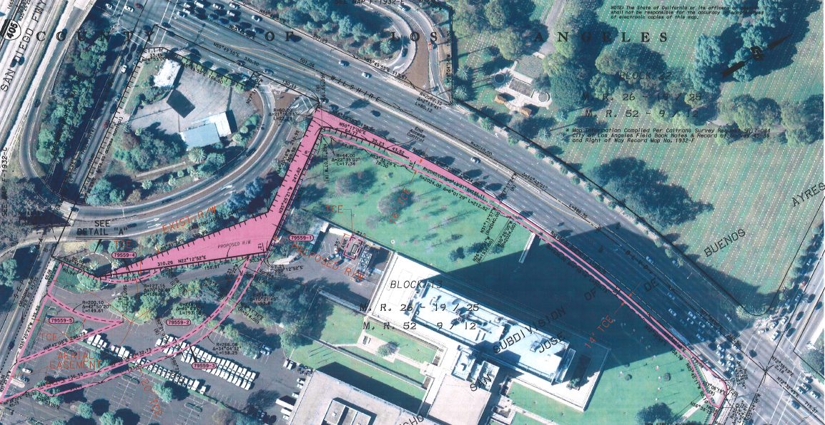

Case Study
11000 Wilshire Los Angeles, CA
The California Department of Transportation (Caltrans) and the LA Metropolitan Transit
Authority (Metro) sought to acquire permanent and temporary easements at the 11000
Wilshire Federal Building (Federal Site) located in Los Angeles, California, for incorporation into their I-405 Sepulveda Pass Widening Project (Project).

Slide 15

Angela LaMonica
Deputy Director
U.S General Services Administration
Real Property Utilization & Disposal
Region 9 and Region 10
415.522.3430
angela.lamonica@gsa.gov

