Slide 1
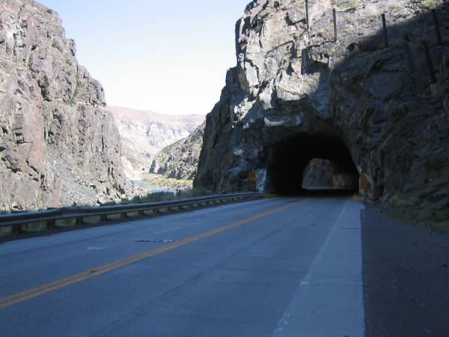

Wyoming Division ROW Program
Walt Satterfield, Planning and ROW Program Manager
Federal Highway Administration
Wyoming Division

Slide 2
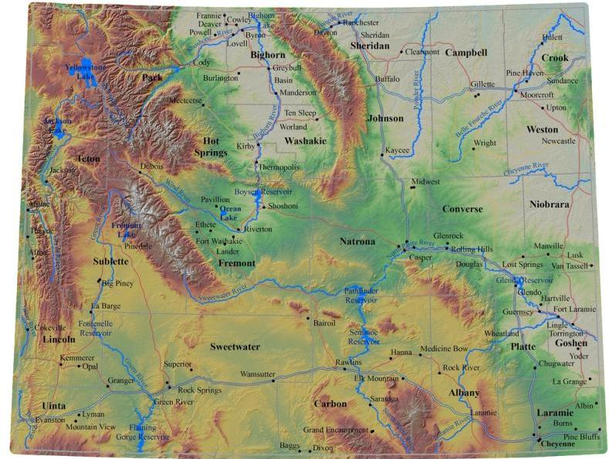
Wyoming
9th largest state by area
Smallest state by population
Least densely populated state in Continental U.S.
48% of land owned by the U.S. Government
Two cities with populations over 50K

Slide 3
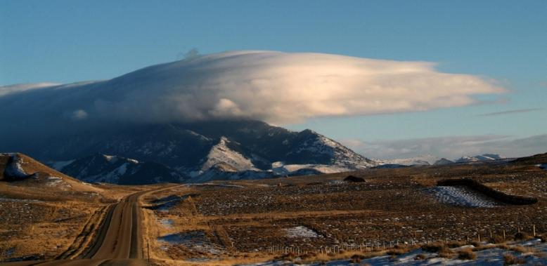
Wyoming Transportation
29,666 miles of public roads
913 miles of Interstate
1,652 bridges, 312 culverts
9 commercial airports
1,762 miles of railroads

Slide 4
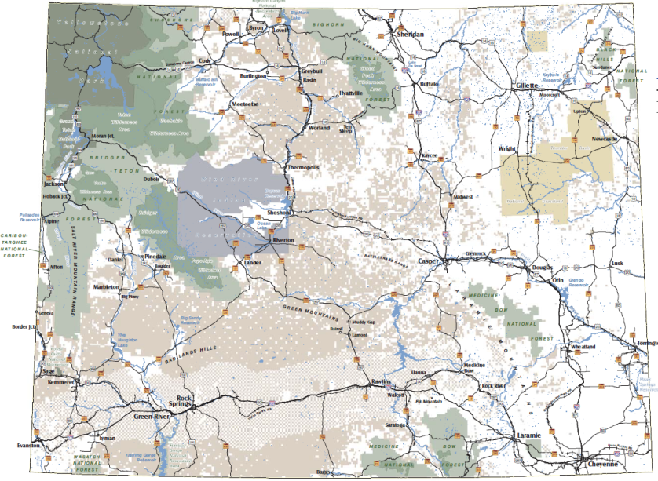
Federal Land Transfers
Federal Land Transfers are very common in Wyoming
Different federal agencies with their own regulatory procedures
WYDOT/FHWA MOU’s:
  USFS 2015
  BLM 2007 (2012)
BLM | 17.5 million acres
USFS | 9.2 million acres
NPS | 2.4 million acres
BOR | 954,680 acres
USFWS | 81,293 acres

Slide 5
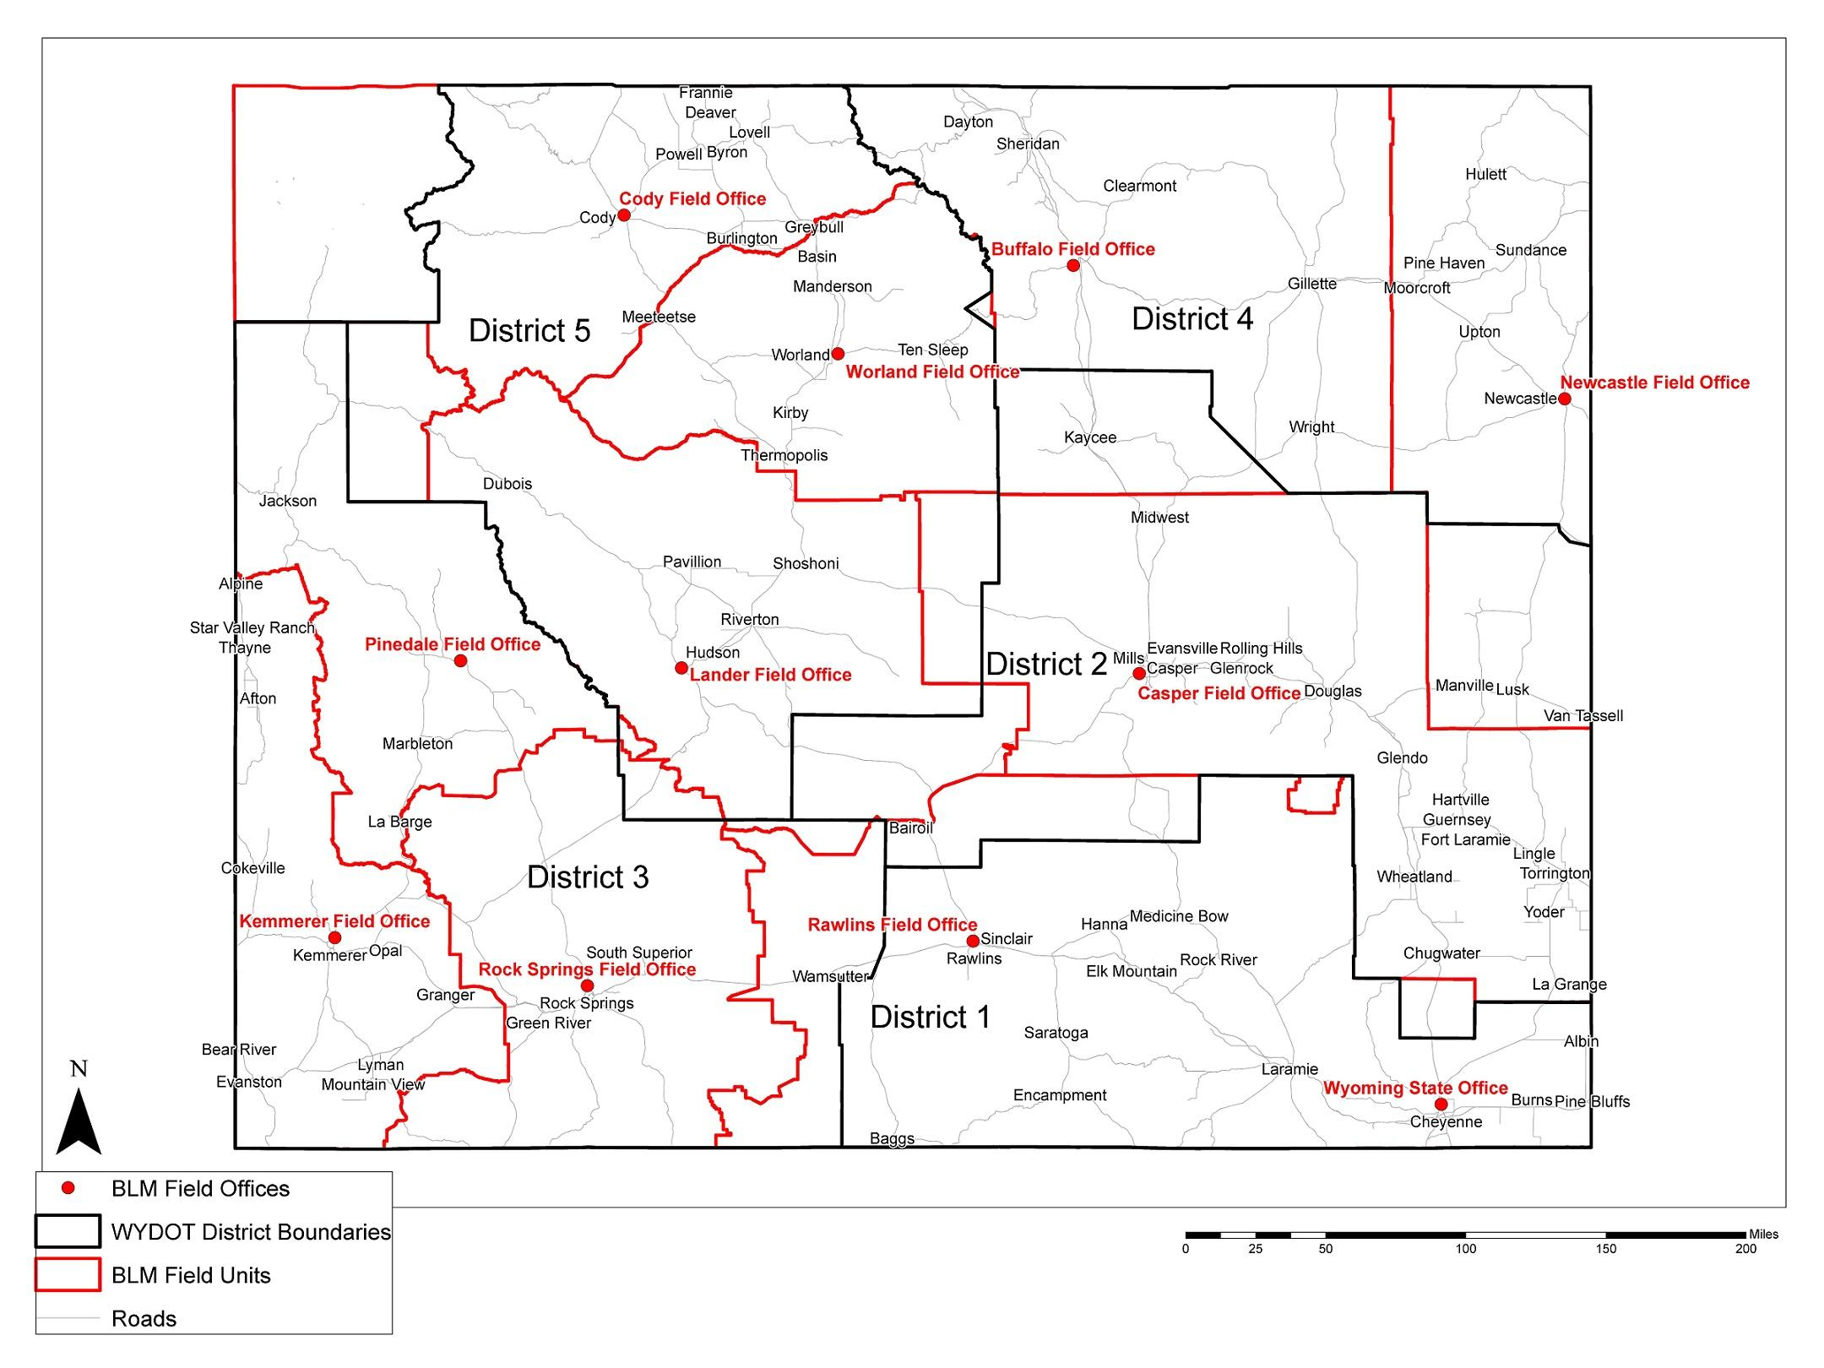
BLM MOU Update
Scoping
NEPA
Application
BLM Letter of Consent
Deed
Execution
Notes:
Scoping
WYDOT consults with BLM for scoping comments on NEPA and environmental issues
On-the-ground meetings may be scheduled by WYDOT or BLM
BLM provides WYDOT with any environmental concerns/conditions/stipulations within 30 days of receipt of scoping letter
NEPA
WYDOT/FHWA complete all reports/studies required for NEPA compliance
WYDOT/FHWA completes documentation of CE, EA or EIS
Additional scoping may be required at the discovery of potentially substantial deviations or new conditions to the project
Application
WYDOT files application requesting concurrence with FHWA setting forth its need for public lands
BLM reviews application to ensure project is consistent with NEPA and BLM land use plans
BLM is asked to concur and specify any conditions in the form of a LOC
BLM Letter of Consent
BLM provides written notification to WYDOT that the application is complete, which starts the 120 day period
BLM concurrence will specify any terms and conditions in the LOC
BLM sends LOC to FHWA and the WYDOT ROW Program
Deed
WYDOT drafts deed with the agreed-upon conditions and State Counsel certifies deed as legally sufficient
WYDOT submits deed for FHWA counsel and Division review
FHWA Division Administrator signs deed on behalf of FHWA
Execution
FHWA transmits deed to WYDOT for acceptance, signature, and recording
WYDOT sends a copy of recorded deed to FHWA Division and BLM
WYDOT will invite BLM to attend pre-construction meeting upon request

Slide 6
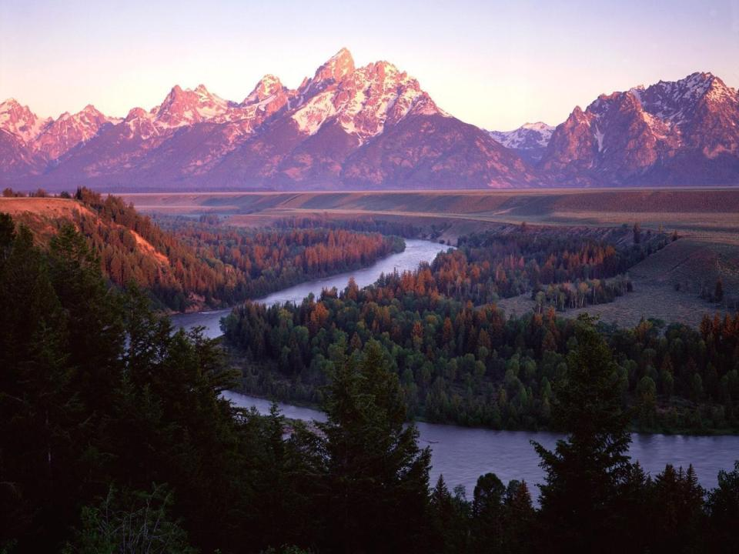
Thank you!
Federal Highway Administration
Wyoming Division

