Slide 1
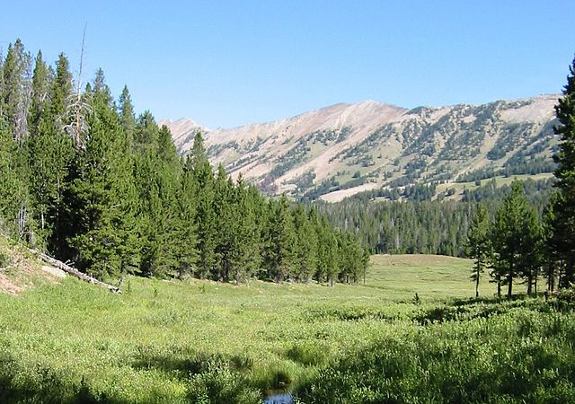
Federal Land Transfers
Notes:
This presentation will focus on six topics specific to the Federal land transfer process.

Slide 2
Acronyms
Some acronyms that will be encountered are:
FLT – acronym for Federal Land Transfer
FLMA – acronym for Federal Land Management Agency; common FLMAs are the Forest Service, GSA, and the Bureau of Land Management
HED – Highway Easement Deed, the most common conveyance document for FLTs
LOC – Letter of Consent is requested from the FLMA
RoE – a right of entry, which allows the state to proceed to construction while waiting for the completion of the HED
Notes:
Some of the acronyms used in this presentation

Slide 3

Topics for Federal Land Transfers
Which process do I follow?
Ask, and you might receive?
Easement? Is that all?
Not an FHWA project?
Wait! I only want gravel.
Legally sufficient? Who knows?
Notes:
This presentation will look at some of the issues that can arise with requests for, and processing of, federal land transfers. The issues this session will focus on are:
When 23 USC 317 and 107(d) apply, and when the Federal land management agency’s (FLMA) process applies;
When, and why, do I ask for a right of entry from the FLMA;
Are there other types of property interests besides a Highway Easement Deed (HED) that can be obtained;
What if there is no federal funding in the project that requires an FLT;
What if the project only requires materials from the FLMA;
What is the requirement for a determination of legal sufficiency, and who makes it.

Slide 4

Which process to follow?
For projects w/FHWA funding, 23 CFR 601 is typically used
A state DOT may choose to work directly with the Federal Land Management Agency & use their process, but with some potential risk
The FLMA may prefer to follow 23 CFR
Notes:
The process that is typically used for Federal land transfers is the process that is statutorily established in 23 USC 317 and 107(d), and codified in 23 CFR 601. If the FLT follows this process, the state will make application to the FHWA Division Office for the transfer, the Division Office will request a Letter of Consent (LOC) from the FLMA, and once the LOC is received and the Highway Easement Deed is determined to be legally sufficient by both the State and FHWA, the deed is executed by the Division Administrator or designee.
Alternatively, if the FLMA has its own process for FLTs the SDOT may work directly with the FLMA rather than follow the 23 USC/CFR process. However, there are some risks involved, primarily with the processing time.

Slide 5

Right of Entry
The State may request FHWA to ask the FLMA for a Right of Entry
This is useful and enables the SDOT to begin construction while waiting for the Highway Easement Deed to be signed
May not be needed
Notes:
The SDOT may ask FHWA to request a right of entry from the FLMA. The FLMA is not required to grant the RoE, but they frequently do, sometimes with conditions attached. The value of obtaining a RoE is that it enables the state to start construction while waiting on the completion of the HED. However, an historical problem we have encountered is constructing roads on federal lands with a RoE and not following through with execution of the HED. Some states are currently working with FHWA to perfect title to some of these federal lands.

Slide 6

Acquisition by Highway Easement Deed
Property interests from the U.S. via Federal land transfer are typically by Highway Easement Deed
Acquisition in fee is rare and would likely only happen when the FLMA has no interest in retaining the property
Note, however, GSA might be interested in retention
Notes:
Except for the acquisition of materials from a FLMA materials site, the acquisition of property interests from the U.S. via the FLMA is typically by HED. Acquisition of a fee interest would be very rare—even in those instances where a FLMA may not be interested in continuing to maintain the property, it is still a federal decision whether to move it out of federal ownership.

Slide 7
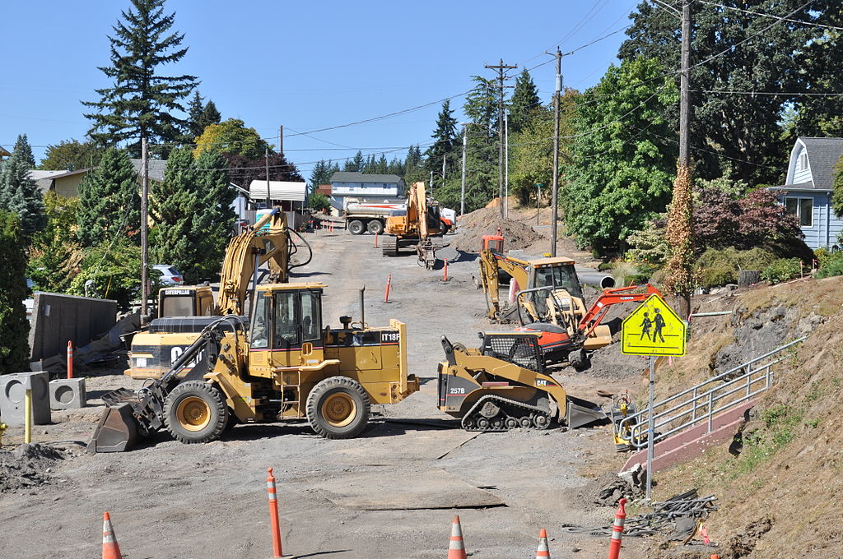
Not a Federal Project?
If no FHWA funds in project, must determine a “strong Federal transportation interest”
Requires HQ concurrence
If not, FHWA involvement not required
Notes:
Unless the SDOT works directly with a FLMA on a transfer, the FHWA process will be used under either of two conditions:
If there is FHWA funding participation in the project;
If not FHWA funded, SDOT must request FHWA concurrence that the project has a “strong Federal transportation interest.”
The regulation specifically addresses FLTs when there is federal funding in a project or when there is no federal funding, but FHWA finds that a “strong Federal transportation interest” exists. If neither of these two situations applies, there is not regulatory language that specifically.provides for processing an FLT for the SDOT.

Slide 8
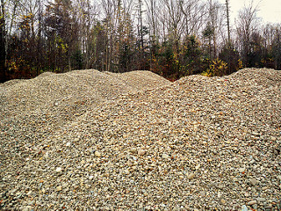
But I just want materials!!
If the SDOT needs both land and materials from an FLMA, they should be included in the request for an LOC
If materials only are needed, it might be more efficient to obtain access via an FLMA permit
Request for materials should be specific, both to the need and the project(s)
Notes:
In cases where the SDOT needs both an easement AND materials from an FLMA, they should be included in the SDOT’s application to FHWA and the Division Office will request them from the FLMA. If only materials are needed, an FLT could still be used, but it might be more efficient for the SDOT to obtain a permit for such materials directly from the FLMA.
The SDOT needs to understand, and be clear in their request, what project or projects the materials will be needed for, and the projected length of that need. Lacking such specifics in the deed or permit, the SDOT might assume they can use such materials at any time for any project; unless otherwise agreed to by the FLMA, that is contrary to the intent of the transfer or permit.

Slide 9
Determination of Legal Sufficiency
The HED must be determined to be legally sufficient both by the State’s legal division and FHWA
While a draft copy of the HED may be circulated for concurrent legal review, the determination of legal sufficiency by the State will precede such determination by FHWA-HCC
Notes:
Time can be saved in the FLT process by providing copies of a draft HED to both the SDOT’s and FHWA’s legal staff for review. That can be done when the request for an LOC is sent to the FLMA. However, since the FLMA may provide conditions they want in the HED, it is typically more efficient to send the document for concurrent legal review once it contains the stipulations agreed to and/or acceptable to the SDOT ROW staff and the FHWA Division Office.

Slide 10
Questions about Federal Land Transfers
Questions?

