Slide 1
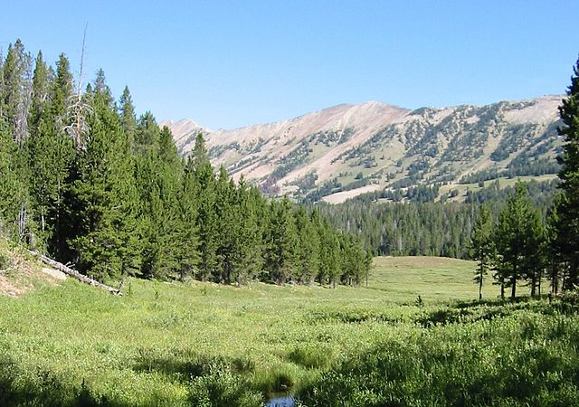
Federal Land Transfers

Slide 2
Acronyms
Some acronyms that will be encountered are:
FLT – acronym for Federal Land Transfer
FLMA – acronym for Federal Land Management Agency; common FLMAs are the Forest Service, GSA, and the Bureau of Land Management
HED – Highway Easement Deed, the most common conveyance document for FLTs
LOC – Letter of Consent is requested from the FLMA
Notes:
Some of the acronyms used in this presentation

Slide 3
Background
FHWA is authorized to transfer lands under the jurisdiction of federal agencies to State DOTs to construct, operate and maintain highways, or to obtain materials for such purposes.
A manual describing the process, referred to as the “Attorney’s Manual for Public Transfer and Federal Condemnation” (Attorney’s Manual), Publication No. FHWA-CC-89-006, was issued in 1989.
The 2009 document, entitled Manual for Federal Land Transfers for Federal-Aid Projects, updated and superseded chapter 1 of the 1989 manual.
https://www.fhwa.dot.gov/real_estate/flt/toolkit/guidance/flt_manual/
https://www.fhwa.dot.gov/real_estate/flt/toolkit/

Slide 4
Statutory Authority
23 U.S.C. 107(d) provides for the transfer of federal lands to a State or others for an Interstate facility.
23 U.S.C. 317 provides for the transfer of federal lands to a State or others for the right-of-way of any highway. The statute also provides a time frame for processing FLT requests and reversion language.

Slide 5
Regulatory Authority
As noted in the previous slide, sections 107(d) and 317 of Title 23, U.S.C., provide for land transfers from the U.S. to States or their nominees.
The regulations in 23 CFR 710.601 define the process for such transfers.
These regulations apply to projects with FHWA funding and those with no FHWA funds but with a strong Federal interest.

Slide 6

Key Points
The FHWA does not take title to the land, nor does it bring it under FHWA control.
Some federal controlling agencies deal directly with the State for transfers.
Transfers are generally for projects with FHWA funding.
If no FHWA funds in project, must establish a strong federal transportation nexus.

Slide 7

Which process to follow?
For projects w/FHWA funding, 23 CFR 710.601 is typically used
A state DOT may choose to work directly with the Federal Land Management Agency & use their process, but with some potential risk
The FLMA may prefer to follow 23 CFR 710.601
Notes:
The process that is typically used for Federal land transfers is the process that is statutorily established in 23 USC 317 and 107(d), and codified in 23 CFR 601. If the FLT follows this process, the state will make application to the FHWA Division Office for the transfer, the Division Office will request a Letter of Consent (LOC) from the FLMA, and once the LOC is received and the Highway Easement Deed is determined to be legally sufficient by both the State and FHWA, the deed is executed by the Division Administrator or designee.
Alternatively, if the FLMA has its own process for FLTs the SDOT may work directly with the FLMA rather than follow the 23 USC/CFR process. However, there are some risks involved, primarily with the processing time.

Slide 8

Summary of the Process
Step 1: DOT files application with FHWA.
Step 2: FHWA reviews. If o.k., then Step 3.
Step 3: FHWA requests Letter of Consent from Controlling Agency.
Step 4: If Controlling Agency concurs, they provide conditions of transfer and, if requested and approved, a right of entry.
Notes:
This presentation will look at some of the issues that can arise with requests for, and processing of, federal land transfers. The issues this session will focus on are:
When 23 USC 317 and 107(d) apply, and when the Federal land management agency’s (FLMA) process applies;
When, and why, do I ask for a right of entry from the FLMA;
Are there other types of property interests besides a Highway Easement Deed (HED) that can be obtained;
What if there is no federal funding in the project that requires an FLT;
What if the project only requires materials from the FLMA;
What is the requirement for a determination of legal sufficiency, and who makes it.

Slide 9
Summary of the Process cont’d
Step 5: State sends deed to FHWA for legal sufficiency.
Step 6: FHWA Division and Legal review, determine legal sufficiency.
Step 7: If legally sufficient, FHWA Division executes deed.
Step 8: State records deed and sends copy to FHWA Division.
Notes:
This presentation will look at some of the issues that can arise with requests for, and processing of, federal land transfers. The issues this session will focus on are:
When 23 USC 317 and 107(d) apply, and when the Federal land management agency’s (FLMA) process applies;
When, and why, do I ask for a right of entry from the FLMA;
Are there other types of property interests besides a Highway Easement Deed (HED) that can be obtained;
What if there is no federal funding in the project that requires an FLT;
What if the project only requires materials from the FLMA;
What is the requirement for a determination of legal sufficiency, and who makes it.

Slide 10

Acquisition by Highway Easement Deed
Property interests from the U.S. via Federal land transfer are typically by Highway Easement Deed
Acquisition in fee is rare and would likely only happen when the FLMA has no interest in retaining the property
Note, however, GSA might be interested in retention
Notes:
Except for the acquisition of materials from a FLMA materials site, the acquisition of property interests from the U.S. via the FLMA is typically by HED. Acquisition of a fee interest would be very rare—even in those instances where a FLMA may not be interested in continuing to maintain the property, it is still a federal decision whether to move it out of federal ownership.

Slide 11
Determination of Legal Sufficiency
The HED must be determined to be legally sufficient both by the State’s legal division and FHWA
While a draft copy of the HED may be circulated for concurrent legal review, the determination of legal sufficiency by the State will precede such determination by FHWA-HCC
Notes:
Time can be saved in the FLT process by providing copies of a draft HED to both the SDOT’s and FHWA’s legal staff for review. That can be done when the request for an LOC is sent to the FLMA. However, since the FLMA may provide conditions they want in the HED, it is typically more efficient to send the document for concurrent legal review once it contains the stipulations agreed to and/or acceptable to the SDOT ROW staff and the FHWA Division Office.

Slide 12
Questions about Federal Land Transfers
Questions?
Carolyn Winborne James
Federal Highway Administration
Office of Real Estate Services
National Program Lead Federal Land Transfers
1200 New Jersey Avenue, SE
Washington,DC 20590
202-493-0353
Carolyn.James@dot.gov

