Slide 1
Security and
Emergency Management -
An Information Briefing
for
Executives and Senior Leaders
of
State Departments of Transportation
Notes:
Security and Emergency Management for State Departments of Transportation
This briefing was researched and produced as a project by Excalibur Associates, Inc. in support of prime contractor SAIC under Federal Highway Administration Transportation Pooled Fund Study 5(161), Transportation Security and Emergency Preparedness Professional Capacity Building (PCB). Research included a survey of several State Departments of Transportation (DOTs) and an assessment of responses. State DOTs and other agencies contributing to the pooled fund were California, Florida, Georgia, Kansas, Mississippi, Montana, New York, Texas, Wisconsin, and the U.S. Department of Homeland Security Transportation Security Administration.
Representatives of contributors to the Pooled Fund were concerned about the need for a standard overview to assist in briefing new appointees or senior leaders, especially those that perceive they have no security and emergency management responsibilities or those with little or no experience in those areas, about typical DOT roles, missions, and organizational structures.
This briefing is intended to introduce executives and senior leaders to plans, concepts, and terminology used by the security and emergency management community. It can also serve as a checklist for use in determining the organizational structure, degree of preparedness, and response capabilities of your organization. If you prefer to look at this briefing offline or keep it for reference it might be more convenient for you to print the PDF version.

Slide 2
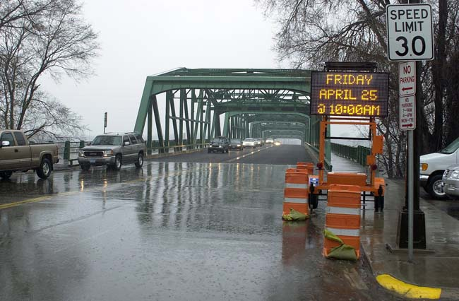
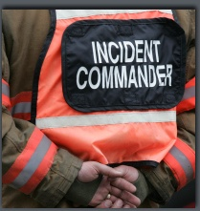
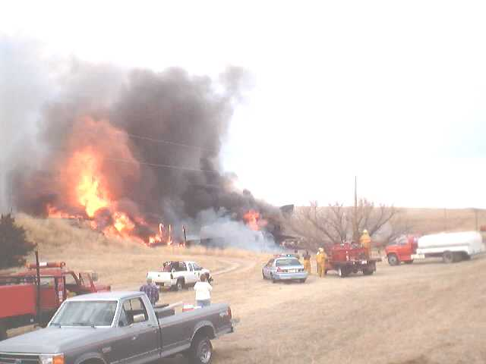
Welcome
Notes:
Topics
Topics covered are:
Emergency Management;
Emergency Operations Plans;
National Response Framework;
Emergency Support Function 1, Transportation;
National Incident Management System;
Incident Command System;
Operations Centers;
Obtaining Resources;
Organizing a State Emergency Management Program;
Leadership; and,
Resource Materials.

Slide 3
What Is Emergency management?
Emergency management involves preparing for, responding to, and recovering from a disaster or emergency.
Notes:
What is emergency management?
Understanding a common definition of emergency management is the first step. It encompasses all actions to prepare for, respond to, and recover from a disaster or emergency. Sometimes you will hear about emergency preparedness or emergency response. Remember, these are emergency management functions, not stand alone activities.

Slide 4
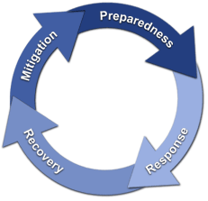
emergency management process
Emergency management is a process
Mitigation
Preparedness
Response
Recovery
Notes:
Emergency Management Process
Stated in another way, emergency management is the continuous process by which all individuals, agencies, and levels of government manage hazards in an effort to avoid or reduce the impact of disasters resulting from the hazards. There are four (4) phases:
Mitigation – Mitigation is action taken to prevent hazards from developing into disasters, or to reduce the effects or mitigate the consequences of disasters when they occur. The mitigation phase differs from the other emergency management phases because it focuses on long-term measures for reducing or eliminating risk. Mitigation activities can occur prior to a disaster as an element of preparedness, or as a part of recovery when rebuilding following a disaster. Mitigation activities can be structural, as in retrofitting bridges to better withstand earthquakes, or non-structural, as in passing legislation to establish flood zones to prevent building in a risk area.
Preparedness – In the preparedness phase, emergency managers develop plans of action for implementation when a disaster strikes. Common preparedness measures include:
Conducting risk assessment to focus efforts toward the greatest hazards/threats;
Taking action to reduce vulnerability and mitigate consequences;
Developing emergency response plans describing how an entity will organize to conduct and manage response operations;
Training individuals and teams to conduct response operations;
Conducting exercises to test response plans and validate training; and,
Incorporating lessons learned from exercises and actual events to improve the level of preparedness.

Slide 5
emergency management process
Emergency management is a process
Mitigation
Preparedness
Response
Recovery
Notes:
Emergency Management Process
Response – In the response phase, governments take direct action to save lives, protect property, care for victims, and mitigate the amount of damage. Response operations begin at the local level with emergency services, including police, fire and/or emergency medical activities and public works. If the disaster or emergency impacts a large area, such as a wildland fire or flood, people may be displaced and require emergency shelter. Transportation infrastructure and systems also play a role in response operations: highways are designated as evacuation routes from areas threatened by hurricanes, aviation and rail assets can move people out of danger; ferries and other watercraft can be instrumental in rescue efforts such as those that occurred after the ditching of US Air Flight 1549 in the Hudson River.
Recovery – Recovery efforts are primarily concerned with actions that involve rebuilding destroyed property, re-employment, and the repair of other essential infrastructure. During recovery, mitigation means rebuilding in such a way as to reduce the probability of the same consequences occurring from a similar event. Recovery and mitigation of transportation infrastructure is generally the responsibility of infrastructure owners with the support of state agencies and Federal assistance. In terms of time, response is relatively short, whereas recovery can take years depending on the extent of damage.
State DOTs have a role in all four (4) phases of emergency management.

Slide 6
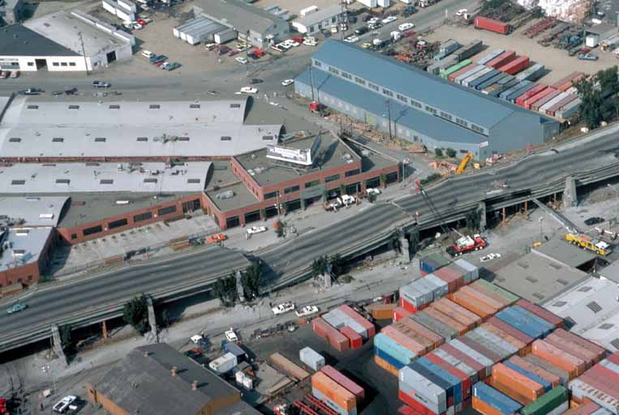
mitigation
What is it?
Who does it?
Notes:
Mitigation
The Federal Emergency Management Agency (FEMA) has a hazard mitigation assessment and planning process for local officials to use in conducting hazard assessments and creating plans for mitigating the hazards.
It is important that these assessments and plans include transportation infrastructure. Funding for transportation infrastructure mitigation will normally come from sources other than FEMA. Transportation infrastructure should be integrated into overall hazard mitigation assessment and mitigation plans because of the interdependencies of transportation infrastructure with non-transportation infrastructure such as highway bridges carrying communications lines or rail lines carrying fuel for power plants.
Mitigation of transportation infrastructure may occur under the oversight of the State DOT, depending on the state and the type of infrastructure. In most cases, it will be done by private contractors, but under contracts managed by the State DOT.

Slide 7
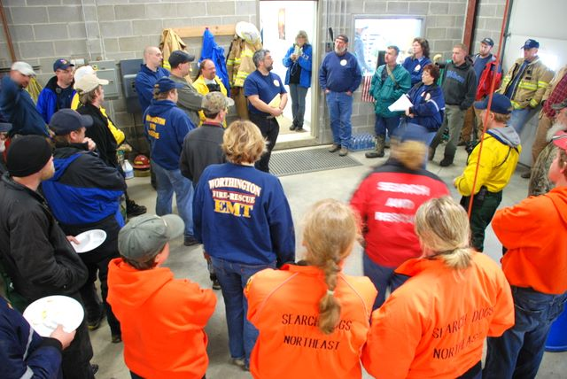
preparedness
Identify hazards/threats
Planning
Training
Exercising
After Action Improvement
Notes:
Hazard Identification
The first step in preparing is identifying the threats and hazards that a state faces. This step provides the answer to the question: What is the basis for planning? For example, Southern coastal states are particularly vulnerable to hurricanes, while Midwest states are vulnerable to floods and tornadoes, the West Coast and Midwest must plan for earthquakes, and most Northern states face severe winter storms. All states face the threat of terrorist- or criminal-caused incidents and accidents causing chemical spills or contamination from nuclear power plants.
The State DOT responsibility is to identify hazards and threats facing the state’s transportation infrastructure. Transportation infrastructure is particularly vulnerable to a variety of hazards and threats, including:
Earthquakes – weakening and collapse of bridges;
Floods – erosion of bridge supports and roadbeds;
Accidents – damage caused by large vehicles;
Fires– weakening bridge supports and roads; and,
Terrorism – bridges and tunnels can be damaged/destroyed by explosions or the cutting of cables.

Slide 8
preparedness
Identify hazards/threats
Planning
Training
Exercising
After Action Improvement
Notes:
Planning
Governments take an all-hazards approach when planning. Response activities tend to be the same regardless of the event – life-saving, minimizing damage to infrastructure, caring for peoples’ needs. However, because there are small differences depending on the specific hazard, States develop plans describing how they will respond to the affects of particular hazards/threats when they occur.
States plan to support local government response efforts because initial response occurs at the local level and local governments do not have extensive resources to support response operations. States also plan to support other states. No state agency can respond completely independent of other organizations and preparedness efforts must be coordinated between agencies.
States also need to plan to receive and use resources provided by other states and the Federal government during response operations.
The State DOT will coordinate planning efforts with other state agencies, such as the State Emergency Management Agency; county highway departments; various agencies of the U.S. Department of Transportation; and DOTs from other states to ensure response activities can be easily integrated when necessary and to prepare for regional disasters or emergencies.

Slide 9
preparedness
Identify hazards/threats
Planning
Training
Exercising
After Action Improvement
Notes:
Training
Once plans are developed, individuals and teams need to be trained to execute the various aspects of the plan. Generally, individuals are trained in their tasks, then teams are brought together to train on integrated tasks.
Training may be in a classroom, at the DOT or another location; on-line through the Federal Emergency Management Agency or other organization; or may occur on the job to build depth.
Exercising
Exercises are controlled activities conducted under realistic conditions to provide an opportunity to test one or more parts of response plans. They are also used to validate the effectiveness of training of individuals and teams. Exercises are conducted using scenarios based on identified threats and hazards so results can be examined in depth to determine what changes, if any, need to occur.
After Action Improvement
Information is collected during and following actual response operations and exercises to determine how well the plan worked and what future training may be needed. The planners take the information, analyze it and make changes to plans and training curricula to ensure better response operations in the future.

Slide 10
Emergency operations plans
What is an Emergency Operations Plan?
Who Responds
And How
Emergency
Operations/
Response
Plans
Where to Obtain
Resources
Notes:
Emergency Operations Plans
Planning is the cornerstone of preparedness.
Your State DOT will either have a stand alone emergency operations plan or the DOT plan will be an annex, appendix, or supplement to the State Emergency Operations Plan.
Once threats and hazards have been identified, plans can be written. Plans generally address:
Operations: how we execute our mission and responsibilities;
Resources: where and how to obtain them;
Training: how we get people ready;
Exercising: how we validate the plan and individual and team training; and,
Post-response activities: how do we incorporate improvements.
All levels of government – local, tribal, State and Federal – as well as their departments and agencies, prepare formal Emergency Operations Plans (EOP) to establish responsibilities, authorities and procedures on how the entity or organization will operate in response to an emergency or disaster. Some states may use Emergency Response Plans, instead of EOP.
Operations or response plans address:
Who will respond and how they will be prepared to respond;
When response operations will commence and how they will be conducted;
How to obtain additional resources;
How coordination will occur;
Communications plans;
Chain of command;
Organizational structures;
How response operations will terminate; and,
How improvements will be made.

Slide 11
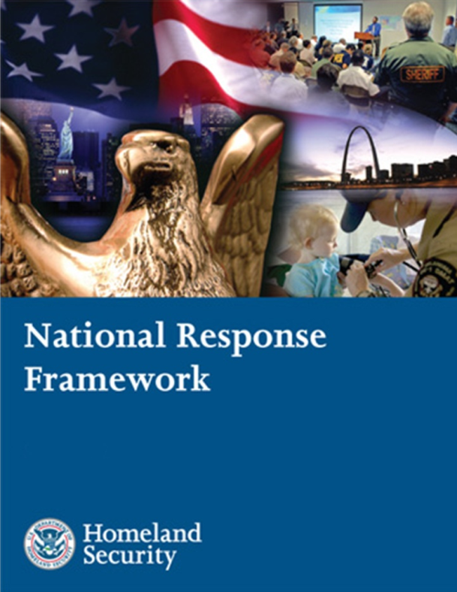
National response framework
Guides how the nation conducts all hazard incident response.
Notes:
National Response Framework
The National Response Framework (NRF) is a guide for how our nation conducts national all-hazard incident response, not just a Federal response.
It incorporates lessons learned from real world operations for natural disasters and other threats, such as the 2005 Hurricane Season, special events, and the London bombings, as well as from national, state and local exercises.
It is focused on response; not on prevention, protection, or long-term recovery.
It is a guide – not a plan.

Slide 12
National response framework
Key Concepts
Aligns key roles and responsibilities across jurisdictions
Links all levels of government (local tribal State, Federal), private sector, and nongovernmental organizations in a unified approach to emergency management
Always in effect: can be partially or fully implemented
Coordinates Federal Assistance without need for formal trigger
Builds on the National Incident Management System (NIMS) with its flexible, scalable, and adaptable coordinating structures
Notes:
National Response Framework
NRF guides by integrating the first three key concepts:
Better than any predecessor document, the NRF defines and aligns the roles of individual citizens; the private sector; non-governmental organizations; local elected or appointed officials; (the Mayor or city manager with his or her local emergency manager and department and agency heads); the Governor with his or her State Homeland Security Manager, State Emergency Manager and department and agency heads; with the Federal government starting with the President and describing the roles of the Homeland Security Council (HSC), National Security Council (NSC), the Secretary of Homeland Security, the Attorney General, the Secretary of Defense, the Secretary of State, the Director of National Intelligence and all other departments and agencies. And, it describes these roles in a response framework that is always in effect – able to be partially or fully implemented – as the incident requires – and without need for a formal trigger or permission to become involved.
The NRF is not about bureaucracy or rigidity. It is about leaning forward in organized partnership with defined roles and responsibilities to contribute to an effective national response to incidents of all types.
The National Incident Management System (NIMS) is an organizational system of positions, interactions, language, and processes that already exists and is well understood by the emergency management community at the local, State and Federal levels. It is a foundational building block of the NRF. We will discuss NIMS later in the briefing.

Slide 13
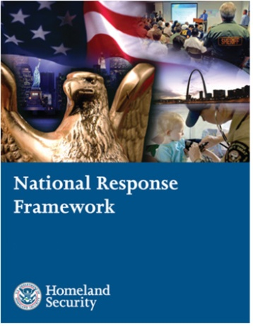
How the Framework is Organized
Core Document
Doctrine, organization, roles and responsibilities, response actions and planning requirements that guide national response
Emergency Support
Function Annexes
Mechanisms to group and provide Federal resources and capabilities to support State and local responders
Support
Annexes
Essential supporting aspects of the Federal response common to all incidents
Incident
Annexes
Incident-specific applications of the Framework
Partner Guides
Next level of detail in response actions tailored to the actionable entity
www.fema.gov/nrf
Notes:
National Response Framework
The NRF is comprised of two integrated parts: a printed core component and an on-line component.
The printed core document: The core document (http://www.fema.gov/pdf/emergency/nrf/nrf-core.pdf) is the heart of the Framework. It describes response doctrine and guidance; roles and responsibilities; primary preparedness and response actions; and core organizational structures and processes.
The on-line component: The NRF Resource Center (www.fema.gov/nrf), contains supplemental materials including annexes, partner guides, and other supporting documents and learning resources. This information is more dynamic and will change and adapt more frequently as we learn lessons from real world events, incorporate new technologies, and adapt to changes within our organizations.
Emergency Support Functions (ESFs): The 15 ESFs provide a mechanism to bundle Federal resources/capabilities to support Federal, State, tribal, and local responders. Examples of functions include transportation, communications and energy. Each ESF has a coordinating and primary agency(ies), and support agencies that work together to coordinate and deliver the full breadth of Federal capabilities.
Support Annexes: The eight (8) Support Annexes describe supporting aspects of Federal response common to all incidents: among them are Critical Infrastructure, Financial Management, Public Affairs, Volunteer and Donations Management; Private Sector Coordination, and Worker Safety and Health.
Incident Annexes: The seven (7) Incident Annexes describe how the Framework will be applied in specific types of incidents: among them are Biological, Cyber, Food and Agriculture, Mass Evacuation, Nuclear/Radiological, and Terrorism. Each Incident Annex has a Coordinating Agency and Cooperating Agencies.
Partner Guides: The Partner Guides provide more specific “how to” handbooks tailored specifically to four (4) areas: local governments; State and tribal governments; the Federal government; and the private sector and nongovernmental organizations.
We will focus on ESF 1, Transportation, later in the briefing.

Slide 14
National response framework
Written for two audiences
Senior elected and appointed officials
Emergency management practitioners
Emphasizes roles of the local and tribal governments, States, NGOs, individuals and the private sector
Establishes Response Doctrine
Engaged partnership
Tiered response
Scalable, flexible, and adaptable operational capabilities
United of effort through unified command
Readiness to act
Establishes planning as a critical element of effective response
Notes:
National Response Framework
The NRF is written with you in mind – a senior government executive, one who has a responsibility to provide for an effective response – as well as for the emergency management practitioner.
For the first time, the Framework describes five (5) elements of Response Doctrine:
Engaged Partnerships: Avoid dominoes of sequential failure. Layered, mutually supporting capabilities; plan together; understand strengths/weaknesses, know where gaps are. Develop shared goals; align capabilities so none allows another to be overwhelmed;
Tiered Response: Incidents must be managed at the lowest possible jurisdictional level and supported by additional response capabilities when needed;
Scalable, Flexible and Adaptable Operational Capabilities: As incidents change in size, scope, and complexity, the number, type, and source of responses must be able to expand to meet requirements;
Unity of Effort through Unified Command: Effective unified command indispensable to all response activities; requires clear understanding of roles and responsibilities; shared objectives. Each agency maintains its own authority, responsibility, and accountability; and
Readiness to Act: Readiness to act balanced with an understanding of risk; requires clear, focused communications; disciplined processes, procedures, systems; from individuals, families, communities to local, State, and Federal agencies, national response depends on instinct and ability to act.
Planning - a critical element of effective response.
Plan to respond rather than react to a disaster or emergency.

Slide 15
Applying the framework
Most incidents wholly managed locally
Some require additional support
Small number require Federal support
Catastrophic requires significant Federal support
State Governor must request Federal support
Minor event might be initial phase of larger, rapidly growing threat
Accelerate assessment and response
Federal department/agency, acting on own authority, may be initial Federal responder
Integrated, systematic Federal Response intended to occur seamlessly
Notes:
Applying the Framework
Key concept is that the NRF is always in effect and operational elements can be partially or fully implemented.
In most cases, incidents are managed locally with existing resources. Where a gap in local capability develops, cities and counties have mutual aid agreements with nearby cities and counties to provide additional fire trucks and crews, ambulances and crews, law enforcement and other forms of assistance. When local governments anticipate shortages of local resources, they request assistance from the State.
States have a tremendous level of capability with the National Guard and other resources. When a state anticipates a gap, it has an alternative to coordinate through Emergency Management Assistance Compacts (EMAC) before requesting Federal assistance. For example, the State of Florida has a standing EMAC agreement with the State of North Carolina to employ North Carolina National Guard C-130 aircraft to evacuate residents from the Florida Keys when threatened by a hurricane.
A small number of incidents require Federal support. Even fewer would be considered catastrophic, where the typical pull of Federal resources from a state would be reversed to initiate a push of resources toward the state.
Governors must request Federal support. Governors are encouraged to make early decisions when they can. For example, a Governor requests a Pre-Landfall Declaration prior to a hurricane. Once approved by the President, the door is opened for positioning Federal support such as Department of Health and Human Services (HHS) medical teams; Department of Defense (DoD) aircraft; and activating a Federal ambulance contract – all in advance of landfall.
It is not always obvious at the outset whether a seemingly minor event might be the initial phase of a larger, rapidly growing threat. Hurricane Katrina was a normal hurricane event until the levies were breached and the flooding occurred, turning it into a much more complex event.
The Framework provides the coordinating mechanism for sharing information, ensuring rapid assessment and seamlessly integrating Federal support.

Slide 16
Stakeholder responsibilities
State Governments
Governors have responsibility for public safety and welfare.
States coordinate resources and capabilities and obtain support from other States and the Federal government.
States supplement and facilitate local efforts before, during , and after incidents.
State key roles and responsibilities
Governor
Homeland Security Advisor
Director, State Emergency Management Agency
State Coordinating Officer
State & Tribal
Governments
Local
Governments
NRF
Federal
Government
Private Sector
& NGO
Notes:
Stakeholder Responsibilities
The Governor:
Is responsible for coordinating State resources and providing the strategic guidance needed to prevent, mitigate, prepare for, respond to, and recover from incidents of all types.
May be able to make, amend, or suspend certain orders or regulations in support of the response.
Communicates to the public and helps people, businesses, and organizations cope with the consequences of any type of incident.
Commands the state military forces.
Coordinates assistance from other states through interstate mutual aid and assistance compacts, such as the Emergency Management Assistance Compact.
Requests Federal assistance including, if appropriate, a Stafford Act Presidential declaration of an emergency or disaster, when it becomes clear that state capabilities will be insufficient or have been exceeded.
Coordinates with impacted tribal nations within the state and initiates requests for a Stafford Act Presidential declaration on behalf of an impacted tribe when appropriate.
State Homeland Security Advisor (HSA). The State HSA serves as an advisor to the Governor on homeland security issues and may serve as a liaison between the Governor’s office, the State homeland security structure, DHS, and other organizations both inside and outside of the state. The advisor often chairs a committee comprised of representatives of relevant state agencies.
Director, State Emergency Management Agency. The Director of the State Emergency Management Agency ensures that the state is prepared to deal with large-scale emergencies and is responsible for coordinating the state response in any emergency or disaster.
State Coordinating Officer (SCO). The individual appointed by the Governor to coordinate state disaster assistance efforts with those of the Federal government. The SCO plays a critical role in managing the state response and recovery operations following Stafford Act declarations. The Governor of the affected state appoints the SCO, and lines of authority flow from the Governor to the SCO, following the state's policies and laws.
State Departments, Bureaus, and Agencies. Plan for providing and obtaining support in accordance with State Emergency Operations/Response Plans.

Slide 17
State response structures
The local incident command structure directs on-scene emergency management activities and maintains command and control of on-scene incident operations.
State EOCs are activated to support local EOCs.
The State EOC is the central location from which State-supported off-scene activities are coordinated.
Elected and appointed state officials are located at the State EOC, as well as personnel supporting core functions.
A key function of the State EOC is to ensure that those who are located at the scene have resources required for the response.
State Officials and Emergency Operations Center (EOC)
Local Officials and Emergency Operations Center
Incident Command Post (ICP)
Notes:
State Response Structures
State and tribal officials typically take the lead to communicate public information regarding incidents occurring in their jurisdictions. It is essential that immediately following the onset of an incident, the State or tribal government, in collaboration with local officials, ensures that:
Communication lines with the media are open, questions receive prompt responses, and false rumors are refuted before they spread.
Information about where to receive help is communicated directly to victims and victims’ families.

Slide 18
Federal leadership and the framework
NRF implements Post-Katrina Emergency Management Reform Act provisions with regard to key Federal incident response leadership positions.
It outlines roles, responsibilities, and interfaces among the:
Secretary of Homeland Security
FEMA Administrator
Principal Federal Official
Federal Coordinating Officer
It outlines roles of and relationships with and among other key Federal and State leaders
State &
Tribal
Governments
Local
Governments
NRF
Private Sector
& NGO
Federal
Government
Notes:
Federal Leadership and the Framework
Key Federal players are:
Secretary of Homeland Security is the principal Federal official for domestic incident management;
FEMA Administrator is the principal advisor to the President, Secretary of the Department of Homeland Security (DHS) and National Security Council regarding emergency management;
Principal Federal Official (PFO) is the Secretary of DHS’s primary representative to ensure consistency of Federal support as well as the overall effectiveness of Federal incident management for catastrophic or unusually complex incidents requiring extraordinary coordination,
Interfaces with Federal, State, tribal, and local officials regarding Federal incident management strategy,
Primary Federal spokesperson for coordinated public communications;
Federal Coordinating Officer (FCO) is for events supported by Presidential declarations, the primary Federal representative that interfaces with the State Coordinating Officer (SCO) and other Federal, State, tribal, and local response officials to determine the most urgent needs and set objectives; and,
Federal departments and agencies play primary, coordinating, and support roles based on authorities and resources, and the nature of the threat or incident.

Slide 19
Private sector, ngos and the framework
The Framework systematically incorporates public sector agencies at all levels with:
Private sector organizations (business and industry), and
Nongovernmental organizations that play key roles in response.
State &
Tribal
Governments
Local
Governments
NRF
Private Sector
& NGO
Federal
Government
Notes:
Private Sector and Nongovernmental Organizations (NGOs)
The private sector supports community response, organizes business to ensure resiliency, and protects and restores critical infrastructure and commercial activity.
NGOs perform vital service missions such as:
Assisting individuals who have special needs;
Coordinating volunteers;
Assisting with the management and distribution of donated goods;
Providing services to those responding to the incident; and,
Interfacing with government response officials at all levels.

Slide 20
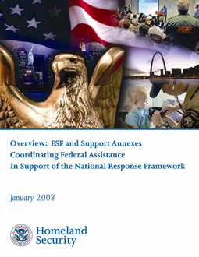
Emergency support functions
There are the 15 Emergency Support Functions (ESFs) identified in the NRF.
What is an ESF?
Notes:
Emergency Support Functions
The Federal government and many State governments organize much of their resources and capabilities – as well as those of certain private-sector and nongovernmental organizations – under 15 Emergency Support Functions (ESFs). ESFs align categories of resources and provide strategic objectives for their use. ESFs utilize standardized resource management concepts such as typing, inventorying, and tracking to facilitate the dispatch, deployment, and recovery of resources before, during, and after an incident. ESF coordinating and primary agencies are identified on the basis of authorities and resources. Support agencies are assigned based on the availability of resources in a given functional area. ESFs provide the greatest possible access to Federal department and agency resources regardless of which organization has those resources.
During a Federal response, Federal ESFs at all levels are coordinated by the Federal Emergency Management Agency (FEMA) through its National Response Coordination Center (NRCC), Regional Response Coordination Center (RRCC), and/or Joint Field Office (JFO). During a Federal response, ESFs are a critical mechanism to coordinate functional capabilities and resources provided by Federal departments and agencies, along with certain private-sector and nongovernmental organizations. They represent an effective way to bundle and funnel resources and capabilities to local, tribal, State, and other responders. These functions are coordinated by a single agency but may rely on several agencies that provide resources for each functional area. The mission of the ESFs is to provide the greatest possible access to capabilities of the Federal government regardless of which agency has those capabilities.
The ESFs serve as the primary operational level mechanism to provide Federal assistance.

Slide 21
Esf 1, transportation
DOT is the lead agency for ESF #1, Transportation
According to the NRF, the U.S. DOT is responsible for: | As the State ESF 1 primary agency, your DOT might do these types of activities:
Monitoring and reporting the status of, and damage to, the transportation system and infrastructure | Inspect or assist in inspecting bridges, roads, rails and/or airfields after a severe flood or earthquake
Identifying temporary alternative solutions that can be implemented to ensure that the movement of people and materials can be continued during the response | Establish detours and set up alternate route signs on state highways; clear state highways of debris; clear runways for movement of aircraft; and assist with traffic control and contra-flow
Performing activities conducted under the direct authority of the DOT | Close roads, harbors or airfields
Coordinating the restoration and recovery of transportation system and infrastructure | Replace bridges and railroad tracks; dredge harbors
Coordinating and supporting preparedness, response, recovery and mitigation activities among transportation stakeholders | Participate in training and exercises; work with local governments to rebuild or retrofit infrastructure
Notes:
ESF 1, Transportation
The U.S. Department of Transportation is the lead Federal agency for ESF 1, Transportation.
The State DOT usually has the leadership role within the state for all matters relating to transportation: infrastructure, including roads, tunnels and bridges; transit systems; airfields; canals; and railroads; as well as for all preparedness activities, response operations, and recovery and mitigation activities related to transportation resources. The ESF lead agency coordinates planning efforts and the use of resources from other state agencies that may be identified to provide support. Your State DOT may support some of the other ESF lead agencies.
At the Federal level Emergency Support Function 1, Transportation, is NOT the primary agency responsible for the movement of goods, equipment, animals or people. However, as each state is organized differently, your State DOT may be involved in these transportation activities to some degree.

Slide 22
ESFs 1-8
ESF | Title
1 | Transportation
2 | Communications
3 | Public Works and Engineering
4 | Firefighting
5 | Emergency management
6 | Mass Care, Emergency Assistance, housing and Human Services
7 | Logistics Management and Resource Support
8 | Public Health and Medical Services
Notes:
Emergency Support Functions
The first eight (8) Emergency Support Functions and Primary Federal Agencies for the Federal government are:
ESF 1 – Transportation Department of Transportation
ESF 2 – Communications National Communications System and Federal Emergency Management Agency (FEMA) – both from the Department of Homeland Security (DHS)]
ESF 3 – Public Works and U.S. Army Corps of Engineers, Department of Defense (DoD)
Engineering FEMA, DHS
ESF 4 – Firefighting Forest Service, Department of Agriculture
ESF 5 – Emergency Management FEMA, DHS
ESF 6 – Mass Care, FEMA, DHS
Emergency Assistance,
Housing, and
Human Services
ESF 7 – Logistics Management FEMA, DHS; General Services Administration
and Resource Support
ESF 8 – Public Health and Department of Health and Human Services
Medical Services

Slide 23
ESF 9-15
ESF | Title
9 | Search and rescue
10 | Oil and Hazardous Materials Response
11 | Agriculture and Natural Resources
12 | Energy
13 | Public Safety and Security
14 | Long-Term Community Recovery
15 | External Affairs
Notes:
Emergency Support Functions
The remaining Emergency Support Functions and Primary Federal Agencies for the Federal government are:
ESF 9 – Search and Rescue FEMA, DHS; U.S. Coast Guard (USCG), DHS; DoD
ESF 10 – Oil and Hazardous U.S. Coast Guard, DHS; Environmental Protection Agency
Materials Response
ESF 11 – Agriculture and USDA; Department of Interior
Natural Resources
ESF 12 – Energy Department of Energy
ESF 13 – Public Safety and Department of Justice
Security
ESF 14 – Long-Term FEMA, DHS
Community Recovery
ESF 15 – External Affairs FEMA, DHS
The same ESFs will be identified in most State Emergency Operations Plans (EOP). While the concept of ESFs has been around for a long time, it was primarily a purview of the Federal government. However, with the publishing of the National Response Plan, which was superseded by the NRF, states have begun organizing along the same framework. Some states have identified additional ESFs for their EOPs, so you may hear about ESFs 16, 17 or higher. Some states do not call them by the ESF number; instead, they use the name of the ESF such as Transportation, Communications, or Public Safety. Your state might use some other form of organizing capabilities for response activities.

Slide 24
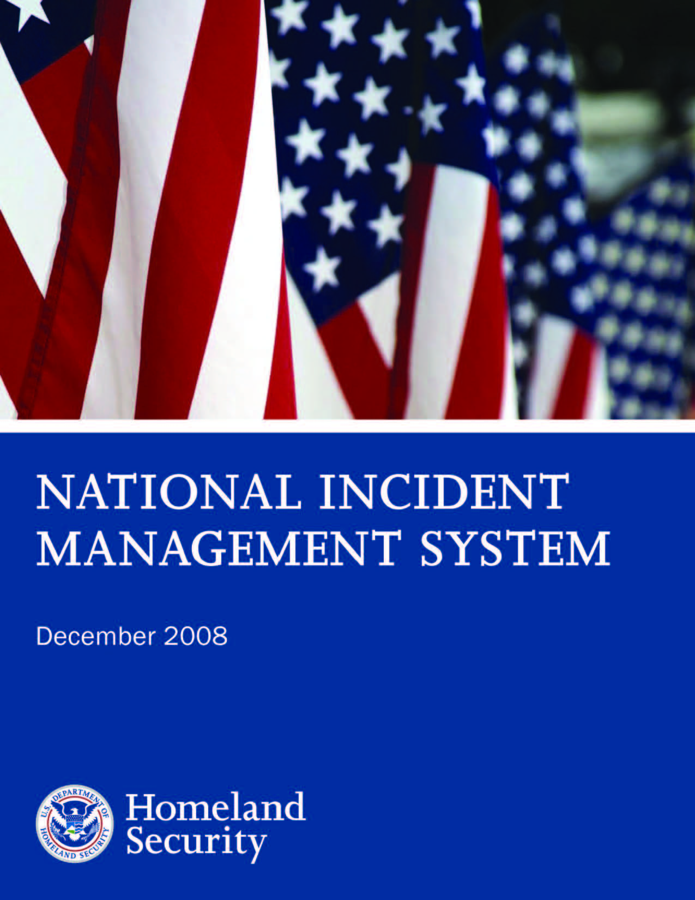
National incident management system
Notes:
National Incident Management System
Having learned about the framework for national response, it is time to examine how incidents are managed.
The National Incident Management System (NIMS) is a companion document to the National Response Framework (NRF). The NIMS provides a systematic, proactive approach to guide departments and agencies at all levels of government, nongovernmental organizations (NGOs), and the private sector to work seamlessly to prevent, protect against, respond to, recover from, and mitigate the effects of incidents, regardless of cause, size, location, or complexity, in order to reduce the loss of life and property and harm to the environment.
Together the National Incident Management System (NIMS) and the National Response Framework (NRF) have a common goal – the efficient management of incidents and use of resources. NIMS provides the template for the management of incidents, while the NRF provides the structure and mechanisms for national level policy for incident management.
The NIMS is intended to:
Be used in response to all types of incidents, hazards and emergencies regardless of cause, size, location or complexity;
Improve coordination and cooperation between public and private entities in a variety of incident management activities; and,
Provide a common organizational structure and language for incident management.
In other words, the NIMS is intended make sure all organizations are on the same page when responding to all types of emergencies.
The NIMS provides the template for the management of incidents, while the NRF provides the structure and mechanisms for the National policy for incident management.

Slide 25
NIMS
Consistent use
Common approach
Working together
Intent
Notes:
Why is there a National Incident Management System?
Homeland Security Presidential Directive (HSPD)-5, Management of Domestic Incidents, directed the development and administration of NIMS. NIMS provides a consistent nationwide template to enable Federal, State, tribal, and local governments, NGOs, and the private sector to work together to prevent, protect against, respond to, recover from, and mitigate the effects of incidents, regardless of cause, size, location, or complexity.
NIMS was originally published in March 2004 and received its first true test during the response to and management of the Hurricane Katrina Disaster. Using lessons learned from Hurricane Katrina and other events, a revised NIMS was published in 2008.

Slide 26
NIMS
Consistent use
Common approach
Working together
Intent
Notes:
Intent
Consistent use of NIMS lays the groundwork for response to all emergency situations, from a single agency responding to a fire, to many jurisdictions and organizations responding to a large natural disaster or act of terrorism.
An important effect of NIMS is that it creates a common approach in both pre-event preparedness and post-event response activities that allow responders from many different organizations to effectively and efficiently work together at the scene of an incident.
Under NIMS, responders from a wide variety of jurisdictions and agencies know what to expect and what to do when they arrive at an incident scene. NIMS is a comprehensive, national approach to incident management that is applicable at all jurisdictional levels and across functional disciplines regardless of cause, size, location, or complexity in order to reduce the loss of life and property and harm to the environment.
The NRF and NIMS are companion documents that were created to improve the nation’s incident management and response capabilities. Together, the NRF and NIMS provide for the effective integration of the capabilities and resources of various governmental jurisdictions, NGOs, and the private sector incident management and emergency response disciplines into a cohesive, coordinated and seamless national framework for incident response.

Slide 27
Nims components
Preparedness
Communications and Information Management
Resource Management
Command and Management
Ongoing Management and Maintenance
Notes:
NIMS Components
NIMS has five (5) components. Four (4) of these and what they mean to a State DOT are:
1. Preparedness. Preparedness is the collective term for pre-event activities that, literally, prepare individuals and organizations to be able to respond to an incident. Some of the activities are:
Developing emergency operations plans that describe how States and their departments and agencies, including the State DOT and its subordinate elements and organizations, should respond to an incident;
Providing standards for accreditation, licensure, or certification – these are standards that require certain measurable knowledge and other capabilities, for example, having a valid driver’s license; training and drilling individuals and teams in job fundamentals to ensure everyone can accomplish the tasks identified for them in the emergency operations plan; participating in exercises that test and evaluate whether the emergency operations plan is adequate and if everyone can do their job in an emergency response; and,
Correcting shortfalls in planning and training identified during exercises or real events.
2. Communications and Information Management. The concept of using normal words instead of code words helps to ensure that when DOT workers talk to other emergency workers on the job, individuals, and teams from one organization will be able to understand the other; that is, State and county or other local transportation workers will be less likely to misunderstand each other; and, provides rules for the easy sharing of important response-related information and for providing a common operating picture to all agencies and teams, so everyone knows the same information at the same time.
3. Resource Management. Individuals, teams, and material are valuable resources during an emergency response. Making sure the right resources are working in the right areas where they are most effective, and making sure responders have the tools to do their assigned task ensures efficient and effective resource management.
4. Command and Management. Under NIMS, command and control processes are designed to enable efficient and effective management and coordination of resources, including State DOT workers. NIMS identifies a standardized incident management system, consisting of three (3) major parts: Incident Command System (ICS) [see next slide], Multi-agency Coordination Systems and Public Information. Under Command and Management, everyone knows exactly where in the command structure they will be.
The fifth component is Ongoing Management and Maintenance, which is simply the process of ensuring continued coordination and oversight of the program by an element of DHS.

Slide 28
Incident command system
Most important NIMS concept
Common IC structure
All levels of government use it
Notes:
Incident Command System
The Incident Command System (ICS) is the NIMS element with which you should become most familiar. ICS provides a standardized, yet flexible, management process to ensure all resources committed to a response, whether the resources are provided from different organizations within or outside a single jurisdiction, or, for complex incidents with national implications, are used in the best way possible. When an incident requires response from multiple local response agencies, effective cross-jurisdictional coordination using common processes and systems is critical to an effective response and for the safety of the responders.
ICS allows responders from outside a local jurisdiction or state to volunteer or be sent to another incident scene and still understand the terminology and operations being used. Your people could be sent to an area other than the one they report to on a daily basis, especially during a regional or statewide incident or when those who would normally respond are affected by the situation and external resources need to be brought in to help.
State and Federal governments and departments/agencies also use principles of ICS. This is generally seen in the organizational structures that have common elements to facilitate coordination both vertically – from local to State to Federal – and horizontally – local to local, State to State and between Federal departments and agencies.

Slide 29
WHY ICS?
Weaknesses/problems prior to ICS:
Lack of accountability
Poor communication
Lack of orderly, systemic planning
Lack of common management structure
Lack of effective integration methods
Notes:
Why is there an Incident Command System?
ICS was developed in the 1970s following a series of catastrophic fires in California's wildlands. What were the lessons learned? Surprisingly, studies found that response problems were far more likely to result from inadequate management than from lack of resources or tactics. Weaknesses were often due to:
Lack of accountability, including unclear chains of command and supervision;
Poor communication due to both inefficient use of available communications systems and conflicting code words and terminology;
Lack of an orderly, systematic planning process;
Lack of a common, flexible, predesigned management structure that enables commanders to delegate responsibilities and manage workloads efficiently; and
Lack of predefined methods to effectively integrate interagency requirements into the management structure and planning process.

Slide 30
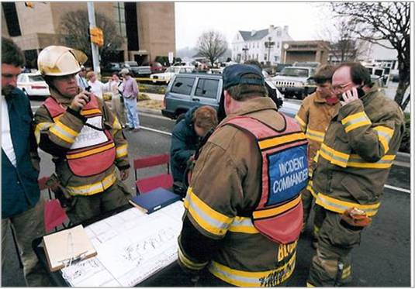
What is ICS?
ICS is:
A proven management system based on successful business practices.
The result of lessons learned in the organization and management of emergency response to incidents.
Notes:
What is ISC?
ICS is designed to:
Meet the needs of incidents regardless of cause or size;
Allow personnel from a variety of agencies to meld rapidly into a common operational structure;.
Provide logistical and administrative support to you and other operational staff; and
Be cost effective by avoiding duplication of effort.
ICS has been tested and proved effective in more than 30 years of emergency and non-emergency applications, by all levels of government and the private sector.
ICS is comprised of procedures for managing personnel, facilities, equipment, and communications resources. It is a system designed to be used from the beginning to the end of an incident.
As a system, ICS is extremely useful; not only does it provide an organizational structure for incident management but it also guides the process for planning, building, and adapting that structure. Using ICS for every incident or planned event helps hone and maintain skills needed for the large scale incidents.

Slide 31
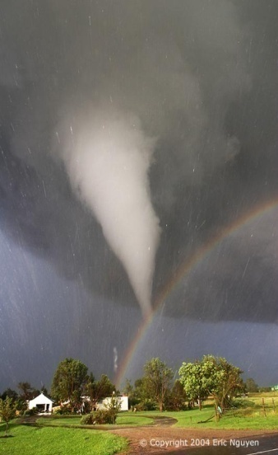
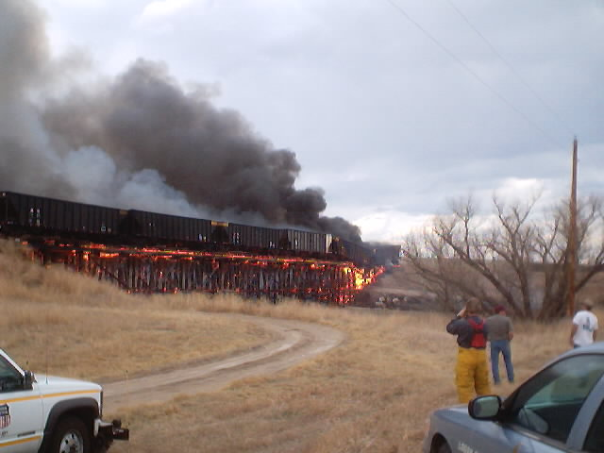
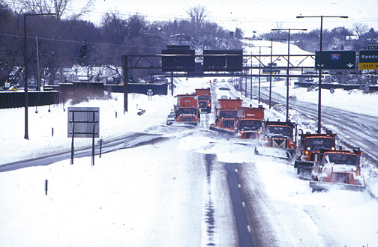
incidents
Definition
Examples
Notes:
Incidents
Definition: An incident is an occurrence, regardless of cause, that requires response actions to prevent or minimize loss of life, or damage to property and/or the environment.
Examples include:
Structural and wildland fires;
Incidents, including crashes on roadways, that result in closures, detours, repairs;
Natural disasters, such as hurricanes, tornadoes, floods, ice storms or earthquakes;
Human and animal disease outbreaks;
Search and rescue operations;
Hazardous materials incidents, such as chemical spills;
Criminal acts and crime scene investigations;
Terrorist incidents, including the use of weapons of mass destruction;
National Special Security Events, such as the Olympics, Presidential visits, or the Super Bowl; and
Other planned events, parades or demonstrations.

Slide 32
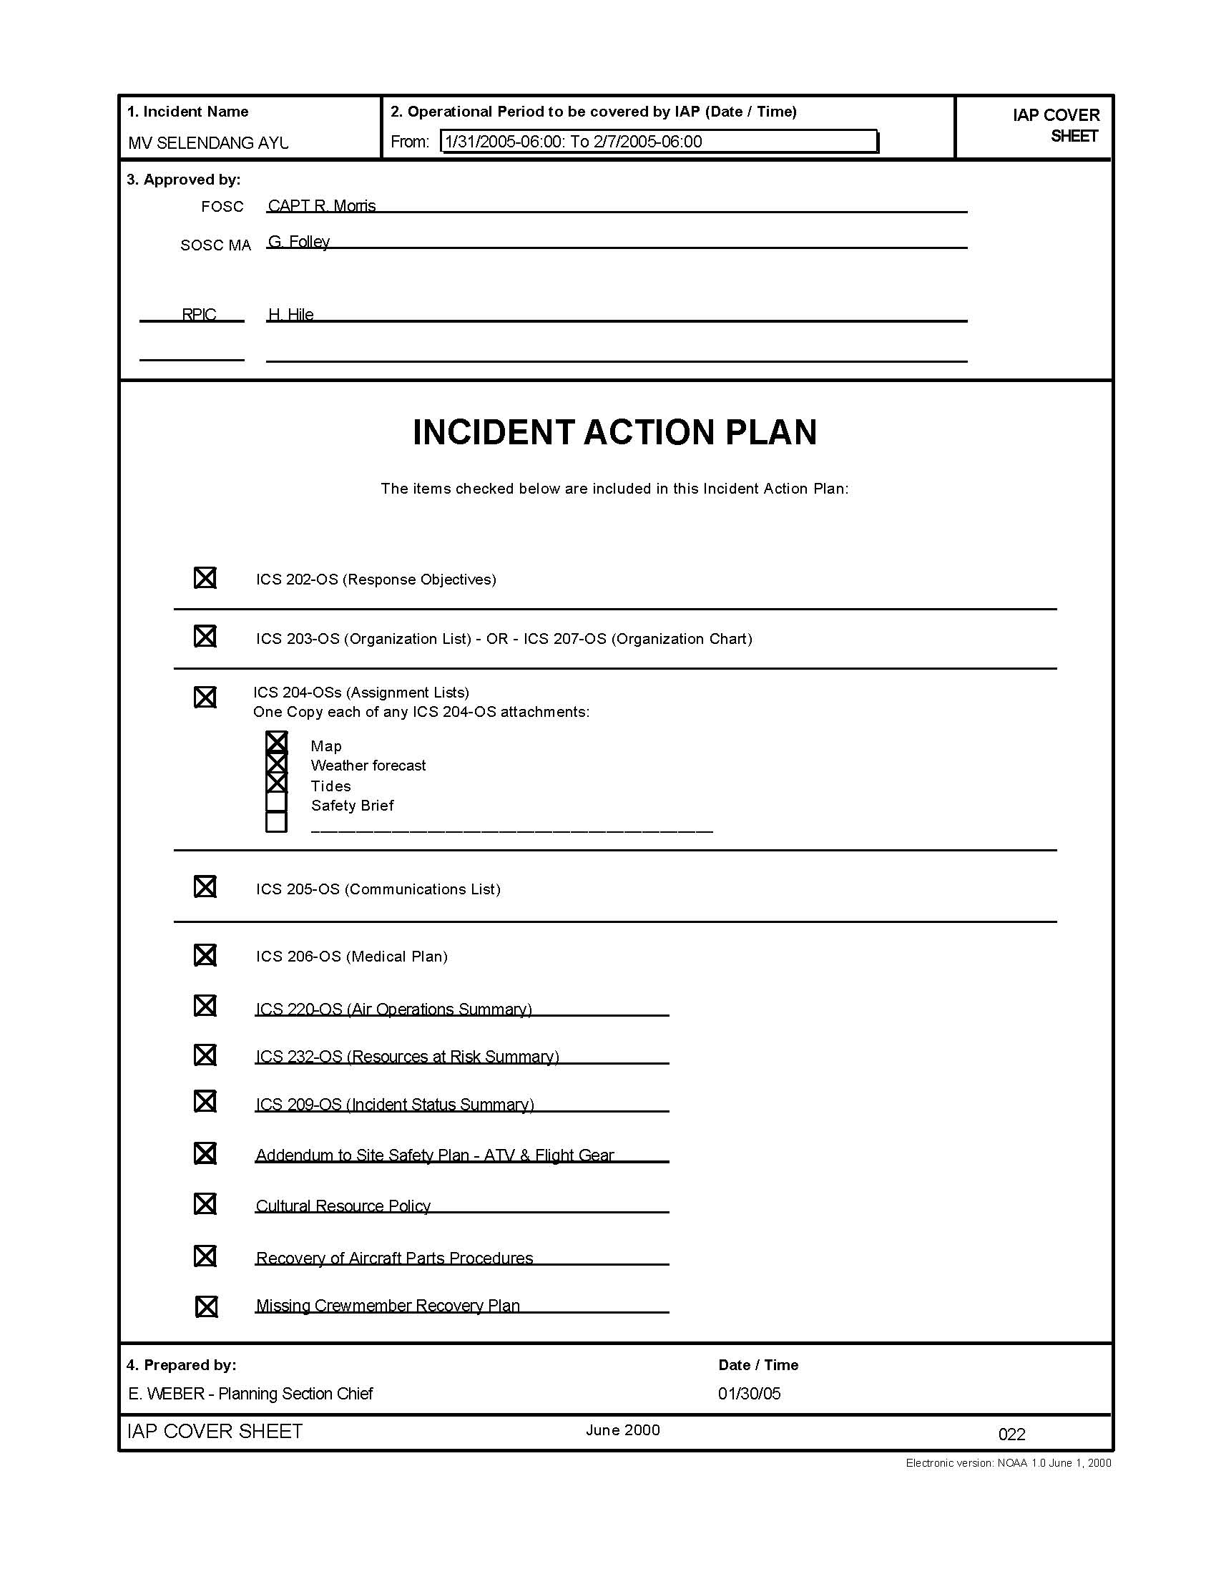
ICS Management Characteristics
Common Terminology
Modular Organization
Management by Objectives
Incident Action Planning
Notes:
There are 14 ICS Management Characteristics
Common Terminology. ICS establishes common terminology that allows diverse incident management and support organizations to work together across a wide variety of incident management functions and hazard scenarios. This common terminology covers the following:
Organizational Functions: Major functions and functional units with incident management responsibilities are named and defined. Terminology for the organizational elements is standard and consistent.
Resource Descriptions: Major resources – including personnel, facilities, and major equipment and supply items – that support incident management activities are given common names and are “typed” with respect to their capabilities, to help avoid confusion and to enhance interoperability.
Incident Facilities: Common terminology is used to designate the facilities in the vicinity of the incident area that will be used during the course of the incident.
Incident response communications (during exercises and actual incidents) should feature plain language commands so they will be able to function in a multijurisdictional environment. Field manuals and training should be revised to reflect the plain language standard.
Modular Organization The ICS organizational structure develops in a modular fashion based on the size and complexity of the incident, as well as the specifics of the hazard environment created by the incident. When needed, separate functional elements can be established, each of which may be further subdivided to enhance internal organizational management and external coordination. Responsibility for the establishment and expansion of the ICS modular organization ultimately rests with Incident Command, which bases the ICS organization on the requirements of the situation. As incident complexity increases, the organization expands from the top down as functional responsibilities are delegated. Concurrently with structural expansion, the number of management and supervisory positions expands to address the requirements of the incident adequately.
Management by Objectives Management by objectives is communicated throughout the entire ICS organization and includes:
Establishing overarching incident objectives;
Developing strategies based on overarching incident objectives
Developing and issuing assignments, plans, procedures, and protocols;
Establishing specific, measurable tactics or tasks for various incident management functional activities, and directing efforts to accomplish them, in support of defined strategies; and
Documenting results to measure performance and facilitate corrective actions.
Incident Action Planning Centralized, coordinated incident action planning should guide all response activities. An Incident Action Plan (IAP) provides a concise, coherent means of capturing and communicating the overall incident priorities, objectives, and strategies in the contexts of both operational and support activities. Every incident must have an action plan. However, not all incidents require written plans. The need for written plans and attachments is based on the requirements of the incident and the decision of the Incident Commander of Unified Command. Most initial response operations are not captured with a formal IAP. However, if an incident is likely to extend beyond one operational period, become more complex, or involve multiple jurisdictions and/or agencies, preparing a written IAP will become increasingly important to maintain effective, efficient, and safe operations.

Slide 33
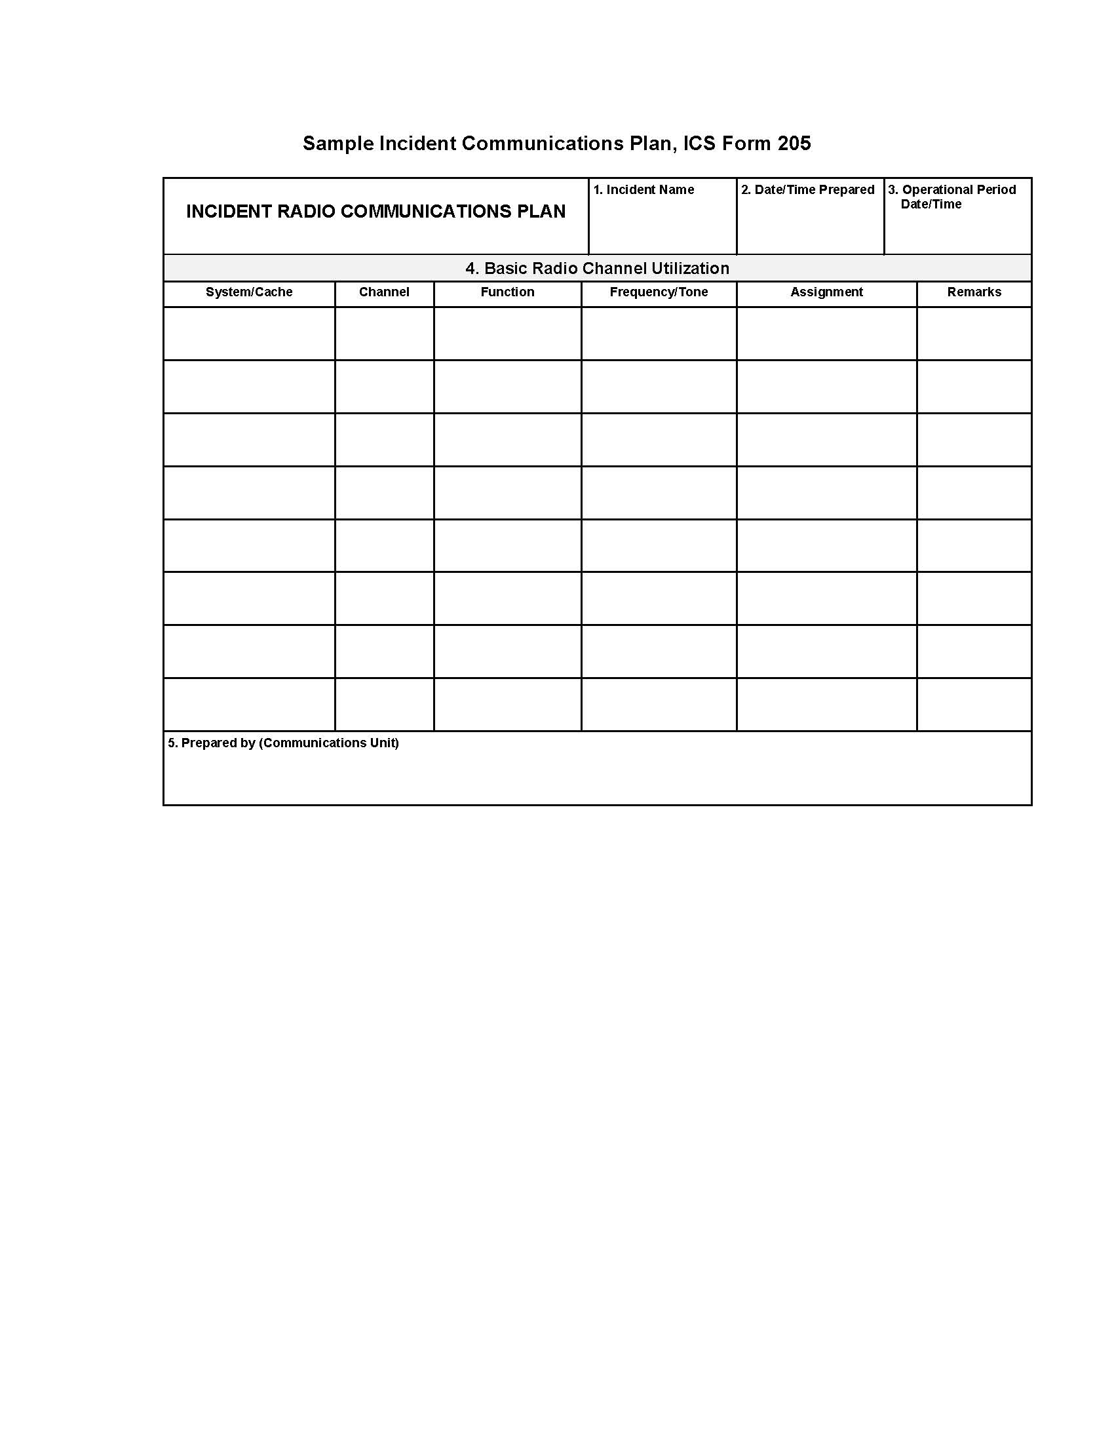
ICS Management Characteristics
Manageable Span of Control
Incident Facilities and Locations
Comprehensive Resource Management
Integrated Communications
Notes:
There are 14 ICS Management Characteristics
Manageable Span of Control. Span of control is key to effective and efficient incident management. Supervisors must be able to adequately supervise and control their subordinates, as well as communicate with and manage all resources under their supervision. In ICS, the span of control of any individual with incident management supervisory responsibility should range from three (3) to seven (7) subordinates, with five (5) being optimal. During large scale law enforcement operations, eight (8) to 10 subordinates may be optimal. The type of incident, nature of the task, hazards and safety factors, and distance between personnel and resources all influence span of control.
Incident Facilities and Locations. Various types of operational support facilities are established in the vicinity of an incident, depending on its size and complexity, to accomplish a variety of purposes. The Incident Command will direct the identification and location of facilities based on the requirements of the situation. Typically designated facilities include Incident Command Posts, Bases, Camps, Staging Areas, mass casualty triage areas, point-of-distribution sites, and others as required.
Comprehensive Resource Management. Maintaining an accurate and up-to-date picture of resource utilization is a critical component of incident management and emergency response. Resources to be identified in this way include personnel, teams, equipment, supplies, and facilities available or potentially available for assignment or allocation.
Integrated Communications. Incident communications are facilitated through the development and use of a common communications plan and interoperable communications processes and architectures. The ICS 205 form is available to assist in developing a common communications plan. This integrated approach links the operational and support units of the various agencies involved and is necessary to maintain communications connectivity and discipline and to enable common situational awareness and interaction. Preparedness planning should address the equipment, systems, and protocols necessary to achieve integrated voice and data communications.

Slide 34
ICS Management Characteristics
Establishment and Transfer of Command
Chain of Command and Unity of Command
Unified Command
Notes:
There are 14 ICS Management Characteristics
Establishment and Transfer of Command. The command function must be clearly established from the beginning of incident operations. The agency with primary jurisdictional authority over the incident designates the individual at the scene responsible for establishing command. When command is transferred, the process must include a briefing that captures all essential information for continuing safe and effective operations.
Chain of Command and Unity of Command.
Chain of Command: Chain of Command refers to the orderly line of authority within the ranks of the incident management organization.
Unity of Command: Unity of Command means that all individuals have a designated supervisor to whom they report at the scene of the incident. These principles clarify reporting relationships and eliminate the confusion caused by multiple, conflicting directives. Incident managers at all levels must be able to direct the actions of all personnel under their supervision.
Unified Command. In incidents involving multiple jurisdictions, a single jurisdiction with multiagency involvement, or multiple jurisdictions with multiagency involvement, Unified Command allows agencies with different legal, geographic, and functional authorities and responsibilities to work together effectively without affecting individual agency authority, responsibility, or accountability.

Slide 35
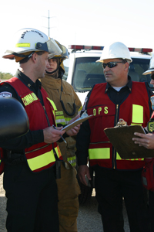
ICS Management Characteristics
Accountability
Dispatch/Deployment
Information and Intelligence Management
Notes:
There are 14 ICS Management Characteristics
Accountability. Effective accountability of resources at all jurisdictional levels and within individual functional areas during incident operations is essential. Adherence to the following ICS principles and processes helps to ensure accountability:
Resource Check-In/Check-Out Procedures;
Incident Action Planning;
Unity of Command;
Personal Responsibility;
Span of Control; and,
Resource Tracking.
Dispatch/Deployment. Resources should respond only when requested or when dispatched by an appropriate authority through established resource management systems. Resources not requested must refrain from spontaneous deployment to avoid overburdening the recipient and compounding accountability challenges.
Information and Intelligence Management. The incident management organization must establish a process for gathering, analyzing, assessing, sharing, and managing incident related information and intelligence.

Slide 36
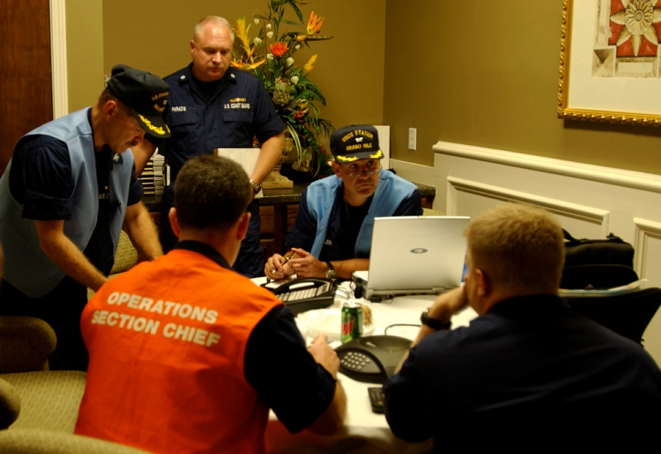
Standardized organization
Incident Command Organizational Structure
Notes:
Standardized Organization
ICS organization is standardized and easy to understand. There is no correlation between the ICS organization used for incident response and the day-to-day administrative structure of any single agency or jurisdiction, with the possible exception of the military. This is deliberate, because confusion over different position titles and organizational structures has been a significant stumbling block to effective incident management in the past. For example, one of your supervisors or managers during normal operations, would likely not hold that title when
working under the ICS structure.
On the next slide you will see a diagram for a “full up” ICS structure. Remember, the ICS structure begins with appointment of an incident commander. ICS is modular so the incident commander then builds the organization depending on the size, complexity, and requirements of the incident.

Slide 37
Ics organization
Command Staff
General Staff
Notes:
Command Staff. The Command Staff is comprised of the Public Information Officer, Safety Officer, and Liaison Officer. They report directly to the Incident Commander.
Section. Has functional responsibility for primary segments of incident management (Operations, Planning, Logistics, Finance/Administration). Section leaders report to the Incident Commander.
Branch. Has functional, geographical, or jurisdictional responsibility for major parts of the incident operations. The Branch level is organizationally between Section and Division/Group in the Operations Section, and between Section and Units in the Logistics Section. Branches are identified by the use of Roman Numbers, by function, or by jurisdictional name.
Division. That organizational level having responsibility for operations within a defined geographic area. The Division level is organizationally between the Strike Team and the Branch.
Group. Groups are established to divide the incident into functional areas of operation. Groups are located between Branches (when activated) and Resources in the Operations Section.
Unit. That organization element having functional responsibility for a specific incident planning, logistics, or finance/administration activity.
Task Force. A group of resources with common communications and a leader that may be pre-established and sent to an incident, or formed at an incident.
Strike Team. Specified combinations of the same kind and type of resources, with common communications and a leader.
Single Resource. An individual piece of equipment and its personnel complement, or an established crew or team of individuals with an identified work supervisor that can be used on an incident.

Slide 38
ICS General Staff
Incident
Commander
Operations
Planning
Logistics
Finance/ Administration
Notes:
ICS General Staff
There are major management functions that are the foundation upon which the ICS organization develops. These functions apply whether the incident is a routine emergency, is organizing for a major non-emergency event, or when managing a response to a major disaster. The major management functions are:
Incident Command. The Incident Commander establishes the incident objectives, strategies, and priorities, and has overall responsibility for the incident or event. The four (4) functional areas that report to the Incident Commander are:
Operations: Conducts tactical operations to carry out the plan; that is, develops the tactical objectives and organization, and directs all tactical resources.
Planning: Prepares and documents the Incident Action Plan to accomplish the objectives, collects and evaluates information, maintains resource status, and maintains documentation for the incident.
Logistics: Provides support, resources, and all other services needed to meet the operational objectives.
Finance/Administration: Monitors costs related to the incident; provides accounting, procurement, time recording, and cost analyses.
You may hear these referred to C-FLOP. This is an easy way to remember the first letter of each of the functions: Command, Finance, Logistics, Operations, and Planning.

Slide 39
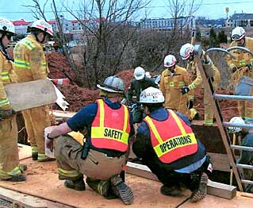
ICS Command staff
Public Information Officer
Safety Officer
Liaison Officer(s)
Notes:
ICS Command Staff
Depending upon the size and type of incident or event, it may be necessary for the Incident Commander to designate personnel to provide information, safety, and liaison services for the entire organization. In ICS, these personnel make up the Command Staff and consist of the:
Public Information Officer who serves as the conduit for information to internal and external stakeholders, including the media or other organizations seeking information directly from the incident or event.
Safety Officer who monitors safety conditions and develops measures for assuring the safety of all assigned personnel.
Liaison Officer(s) that serve as the primary contact for supporting agencies assisting at an incident.
The Command Staff reports directly to the Incident Commander.

Slide 40
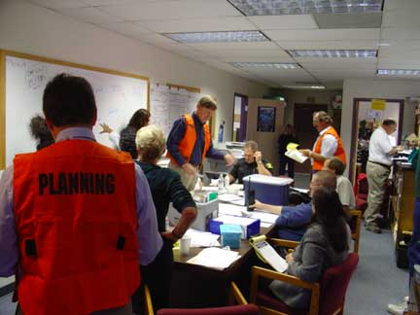
Emergency operations centers
Coordination
Focal point
Communication Hub
Operations and Planning
Notes:
Emergency Operations Centers
An Emergency Operations Center (EOC) is a central command and control facility responsible for carrying out the principles of emergency preparedness and emergency management, or disaster management functions at a strategic level in an emergency situation.
An EOC is found at all levels except at the Incident Commander’s location. The Incident Commander’s operation center is called the Incident Command Post.
States have operations centers that have either robust staffing from agencies such as the DOT or have representatives from these agencies. Many state agencies also have responsibilities for responding to the State EOC and obtaining and directing resources. Where there is not a robust DOT presence in the State EOC, it is usually necessary for the State DOT have a stand-alone EOC.

Slide 41
Typical EOC structure
Public Information Officer
Command Staff: The Command Staff provides information, safety and liaison services for the entire organization.
EOC Leader
Safety Officer
Liaison Officer(s)
General Staff: The General Staff provides management functions for the EOC and coordinates with other EOCs and its own field organizations.
Operations
Section
Planning
Section
Logistics
Section
Finance/ Administration
Section
Notes:
Emergency Operations Center Structure
NOTE: The structure depicted is based on ICS, is NIMS-compliant, and is intended to be representative of many State EOCs. Your State EOC may be organized differently.
Your State will have an EOC that is managed by the State Emergency Management Agency. The purpose is to coordinate for and deploy State resources to support local governments. The EOC will also coordinate with other States and with the Federal government for resources.
Federal departments and agencies establish EOCs to manage its resources that are deployed to support incident response operations. The U.S. DOT not only provides ESF 1, Transportation personnel to the National Response Coordination Center (NRCC), the Regional Response Coordination Center (RRCC) and the Joint Field Office (JFO), it manages all aspects of ESF 1, Transportation responsibilities as delineated by the NRF. These Federal ESF 1, Transportation representatives may seek to coordinate directly with State DOT representatives in the State EOC, and maybe directly with the State DOT EOC.
Federal resources are deployed to the vicinity of the incident and managed tactically by the JFO. The JFO (see next slide) is organized like an EOC, but instead of an EOC Leader, it has a Unified Coordination Group representing the Federal and State, and sometimes local, agencies that work together to ensure the right resources get to the right place.

Slide 42
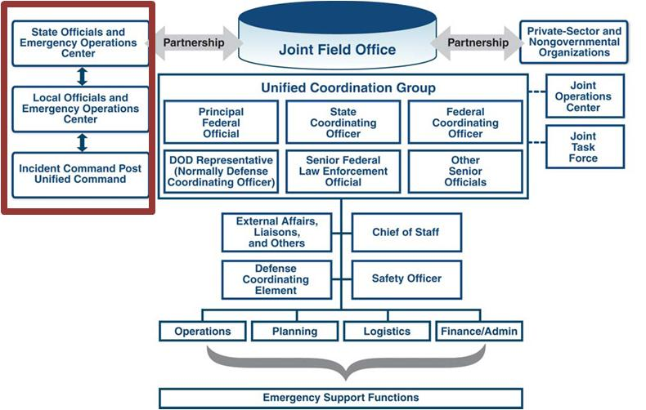
EOC and federal relationships
Notes:
Relationships
The Federal government establishes the National Response Coordination Center (NRCC) at the Headquarters of the Federal Emergency Management Agency (FEMA). The ESF departments and agencies provide experienced personnel to support the General Staff sections. They coordinate the mobilization and deployment of Federal resources to support States responding to disasters and emergencies. The NRCC is organized in the same manner as the EOC shown.
Each of the 10 FEMA Regional Offices establishes a Regional Response Coordination Center (RRCC). The organization is the same. The RRCC coordinates and provides coordination in the very early hours of an incident response. Personnel from regional offices of departments and agencies provide ESF 1, Transportation support to the RRCC under the direction of the FEMA Region.
Each Federal department and agency establishes an EOC to manage its resources that are deployed to support incident response operations. The U.S. DOT not only provides ESF 1, Transportation personnel to the NRCC, the RRCC and the JFO, it manages all aspects of ESF 1, Transportation responsibilities as delineated by the NRF. These Federal ESF 1, Transportation representatives may seek to coordinate directly with State DOT representatives in the State EOC, and maybe directly with the State DOT EOC.
Federal resources are deployed to the vicinity of the incident and managed tactically by the Joint Field Office (JFO). The JFO is organized like an EOC, but instead of an EOC Leader, it has a Unified Coordination Group that works together to ensure the right resources get to the right place.

Slide 43
EOC and federal relationships
Notes:
Coordination
There is a significant amount of coordination that occurs between the JFO and other organizations. The elements in the box to the left of the Joint Field Office (JFO) and Unified Coordination Group depict the relationship between the Incident Command Post, the local government EOC, the State EOC, and reflect the flow of resources (down), and coordination and information (up and down). It is important to note that the Federal government does not appear in the coordination chain between the Incident Commander and the State EOC. This is in keeping with the concept that “all incidents are managed locally.”
A key member of the Unified Coordination Group is the State Coordinating Officer, representing the Governor and a direct coordination link between the JFO and the State EOC.
In looking at vertical and horizontal relationships, your DOT EOC coordinates horizontally – on the same level – as other State agencies, and vertically with the State EOC. Coordination between ESF 1, Transportation representatives can be vertical – up to the RRCC and NRCC, down to the local government EOC, or horizontal – to the JFO Operations Section ESF 1, Transportation representative.

Slide 44
dot presence in EOCs
Notes:
DOT Presence in EOCs
Your state will have an EOC that is managed by the State Emergency Management Agency. The purpose is to coordinate for and deploy state resources to support local governments. The EOC will also coordinate with other states and with the Federal government for resources. There will be personnel from each state agency in the Operations Section. The State DOT will provide one (1) or more people as representatives of ESF 1, Transportation.
The State DOT will most likely also establish an EOC. Your DOT’s EOC will manage DOT resources deployed in support of local government response operations.
Local governments establish EOCs in which the County Highway Department may be the ESF 1, Transportation representative.

Slide 45
Obtaining resources
Mutual Aid
EMAC
Notes:
Provision of Resources
Earlier it was mentioned that resources should be obtained at the lowest level possible. There are two (2) more terms to consider:
Mutual Aid; and,
The Emergency Management Assistance Compact (EMAC).
Mutual Aid is an agreement between local governments and agencies to provide resources during an incident response. The best known of this type of assistance is when a fire department from a neighboring town assists a nearby department battling a large fire.
EMAC is a formal agreement managed by the National Emergency Management Association (NEMA) that facilitates sharing resources between states. During the response to Hurricanes Katrina and Rita in 2005, many states sent resources to Louisiana, Mississippi and Texas. EMAC was the conduit through which these resources were coordinated.
During planning at the local and state level, resources provided by mutual aid and EMAC agreements must be included as available prior to requesting additional capability from the Federal government.

Slide 46
expectations
What is expected of a State DOT?
Establishing an emergency management program
Identify critical tasks
Develop comprehensive plans
Establish training program
Exercises
Incorporate lessons leaned
Notes:
Expectations
What can be expected of a State DOT? Expectations come from several arenas:
The Governor expects DOT to not only handle day-to-day responsibilities, but to be able to effectively simultaneously respond in the event of a disaster or emergency;
Other state agencies rely on DOT to be able to provide support during a large disaster;
Local governments need, and expect, state support if a disaster or emergency occurs in their jurisdiction; and,
The Federal government expects State DOTs to incorporate principles of the NRF and concepts of NIMS in plans and operations.
Agencies and organizations that are successful at responding to emergencies and disasters – and meeting expectations – have several traits in common. They all have a solid understanding of the need for being prepared to execute their emergency responsibilities. They all have at some level:
Established a formal emergency management program;
Identified critical tasks to perform during a response;
Developed comprehensive emergency response and continuity plans;
Established training programs and requirements for all personnel;
Conducted and participated in exercises to test plans and validate training; and,
Incorporated lessons learned into plans and training.
Advocating for a formal emergency management (EM) program sets the idea in the minds of all your employees that emergency preparedness, response, and recovery are important to the organization – and to the state.
What might an emergency management program look like?

Slide 47
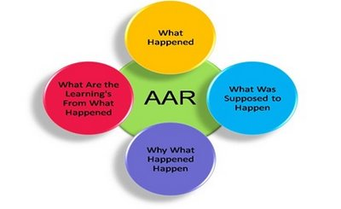
Emergency management Program Functions
Functional Areas
Grants
Planning
Training
Exercises
Corrective Actions
Notes:
Organizational Constructs
One way to organize your emergency management program is around six (6) functional areas.
Grants – prepares submission to request grants to assist in paying for planning workshops, conducting training, and developing and running exercises.
Planning – develops, coordinates and publishes emergency operations and contingency plans for the DOT.
Training – plans training based on the plans developed by the Planning Element, conducts or coordinates the conduct of training classes, records and tracks the training of individuals and teams, and revises training based on changes in plans or lessons learned.
Exercises – plans and conducts exercises to familiarize key leaders with provisions of the plans (tabletop exercises), and uses functional and full-scale exercises to test plans and validate training of individuals and teams.
Corrective Actions – analyzes the outcome of exercises and actual response operations and identifies lessons learned; it then works with other elements to revise plans and training classes and incorporate the lessons learned.

Slide 48
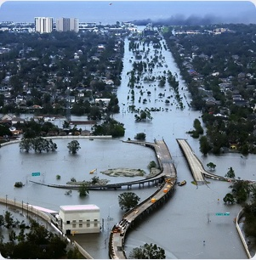
Emergency management Program Factors
Factors to consider:
Size of state
Vulnerabilities
DOT organization
District and regional offices
Funding
Centralized or decentralized
Program leadership
Notes:
Factors Affecting an Emergency Management Program
The decision on the organizational look, number of personnel and level of decentralization of your emergency management program will depend on several factors:
Is your state large or small? A larger state may need a larger emergency management program.
Does every part of your State face the same risks? If there are different risks in different parts of the state, you may want to consider a more robust planning staff.
How is the DOT organized? Is it functionally aligned by modes? Does your State DOT have district or regional offices? If the DOT is functionally aligned, you might want to have a small element in each office to better address differences in the modes. If there is a large number of district or regional offices, it might be appropriate to have a small element in each office to provide more direct coordination.
How robust are the functional, and district or regional offices? If there are a lot of personnel, there may be a large training requirement. Do they have the capability of assigning an individual the additional duty of Emergency Coordinator to manage emergency management functions in the office?
How much funding is available? Will you pursue preparedness grants to assist with emergency management functions? Where could you combine some elements to save money? Is there an effectiveness trade-off if you combine element? With shrinking state budgets, grant moneys become more important, making it favorable to have the Grants Element.
Optimally, you should strive to have individual elements; if that is not feasible, you may need to combine elements.
Centralization or Decentralization
Will your program be centralized or decentralized? A centralized emergency management program retains both policy and implementation responsibilities at the State DOT headquarters. A decentralized program retains policy and oversight, but allows implementation to occur at the regional or district level. The decision depends on the factors discussed above. However, the number of threats and the size of the state will more than likely be overarching factors.
Program Leadership
It is not recommended that program responsibilities be assigned to an existing employee as an additional duty. Emergency management functions are fulltime functions.
Optimally, the responsibility of preparing the State DOT to respond to incidents and manage the response should be the only duty of the Program Manager. Recruiting and hiring an experienced emergency manager to lead the program is one option. Hiring a less experienced individual will require a lengthy period of training and self study for a person to become familiar with concepts and procedures that will create full effectiveness. Lastly, the person’s title and job description should clearly reflect the duties and responsibilities assigned. The best title is the most simple – Agency Emergency Manager responsible for preparing the agency to respond to and recover from emergencies and disasters.

Slide 49
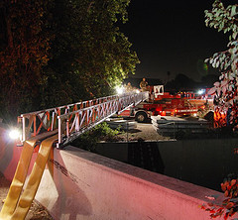
Emergency management placement
Many options available
Two primary considerations
24x7 unfiltered access to top leadership
Organizational perception
Notes:
Emergency Management Placement
The next several pages show some options for the emergency management function in an organization and some benefits or disadvantages of each.
Based upon input from several State DOT representatives, the primary issues in locating the office are ensuring the emergency manager has the freedom of 24x7 contact with the top leaders of the agency and the perception of agency personnel regarding the importance of the emergency management function.
When deciding where to place the emergency management program on the State DOT organization chart, think about how it is to be perceived. If you want everyone to pay attention and work cohesively to build a top-notch response capability, place it close to the most senior leader. The more distant it is from the top, the less people will tend to notice and make the effort necessary to comply with training and exercise requirements.
The bottom line is this: The State DOT emergency management program will only be as viable as the attention and recognition it receives from senior leadership.

Slide 50
Emergency Management Placement
BEST OPTION
Secretary
Office of General Counsel
Communications
Office of IG
Federal
Programs
EM Program
Coordinator
Chief of Staff
Level
1
Fin/Admin
Directorate
Intermodal
Systems
Directorate
Operations and Engineering
Directorate
Notes:
Best Option
This option places the Emergency Manager in position of advisor to the Secretary, thus ensuring all directorate heads will pay attention. This is the highest positioning possible.
Benefits:
Clearly demonstrates the importance of the emergency management program to DOT; and,
Ensures easy access and direct communications link to the Secretary, Deputy and Chief of Staff.

Slide 51
Emergency management placement
SECOND BEST OPTION
Secretary
Chief of Staff
Level
1
Fin/Admin
Directorate
Intermodal
Systems
Directorate
Operations and Engineering
Directorate
EM Program
Office
Notes:
Second Best Option
Establish as separate office reporting to the Secretary, one step below the Secretary, on same line as directorate heads. This option has the many of the same benefits as the previous option.
Benefits:
Clearly demonstrates the importance of the emergency management program to DOT;
Places the coordinator/manager in the position of peer to the directorate heads, helping to ensure cooperation and coordination; and,
Ensures easy access to top officials.
An option:
Make the Emergency Manager a daily direct report to the Chief of Staff, but preserving a direct communication link to the Secretary; and,
Maintain the perception of high level interest.

Slide 52
Emergency management placement
THIRD BEST OPTION
Secretary
Chief of Staff
Level 1
Intermodal
Systems
Directorate
Operations and Engineering
Directorate
Fin/Admin
Directorate
Level
2
EM Program
Office
Notes:
Third Best Option
Two levels below the Secretary, reporting to a directorate head.
While this option retains some benefits from the Best and Second Best, it starts to increase the distance between the Secretary and the program office, and reduces the chance for easy access and ability to communicate directly with the Secretary.
Cons:
Increasing the distance from the Secretary begins to diminish the importance of the emergency management program to DOT and increases the potential for other directorate heads to not fully support the emergency management program; and,
Access to top leadership could become an issue if staff chiefs are not comfortable with lower level employees having direct access to top leaders.
Benefit:
Still shows that the program has some, but not as much, importance to the DOT.

Slide 53
Emergency management placement
WORST OPTION
Secretary
Level
1
Fin/Admin
Directorate
Intermodal
Systems
Directorate
Operations and Engineering
Directorate
Level
2
Operations
Division
Level
3
Highways
Branch
Level
4
Tool Road
Section
Level
5
EM Program
Office
Notes:
Worst Option
Several levels below the Secretary – buried as a subsection of a section of a branch of a division of a directorate
This option has many cons – and no pros.
The placement will clearly demonstrate be perceived as the program having little importance in the DOT;
It is doubtful that directorates, including its own, will do more than pay lip service to emergency management requirements or the Emergency Manager;
Communications between the Emergency Manager and senior leadership will be inhibited due to cultural reasons;
Establishing a budget for the program will be very problematic; and,
Experienced prospective hires will not be apt to accept a position with this structure in place.

Slide 54
Demonstrating Leadership
Notes:
Leadership
It is necessary to say a few words about leadership and emergency management.

Slide 55
Leadership
Stress the importance of preparing for and responding to disasters
Be visible during response operations
Ensure key emergency management positions are filled
Provide adequate funding for training and special equipment
Notes:
Leadership
Success in emergency management is a result of emphasis by top leadership. If an organization and its employees know what is important to the boss it will be important to them.
Prepare yourself. Leaders who have knowledge and understanding of state plans and organizational roles and missions in support of those plans is the best way to demonstrate the important of emergency management.
Provide funding commensurate with other obligations; zeroing out funds for emergency management because is does not visibly deliver services or products to the public is not a good idea.

Slide 56
summary
Memory of events fades with time
Organizations and plans can become stale
Federal support is more robust but dependent on local and state plans
Frequently senior leadership changes reduce availability of practical experience.
Notes:
Summary
This briefing has provided you information about:
Emergency Management;
Emergency Operations Plans;
National Response Framework;
Emergency Support Function 1, Transportation;
National Incident Management System;
Incident Command System;
Operations Centers;
Obtaining Resources;
Organizing a State Emergency Management Program;
Leadership; and,
Resource Materials.
To learn more and conduct additional research, some references are provided on the next slide. If you have comments or questions about this briefing, contact webmaster@dot.gov.

Slide 57
references
NRF http://www.fema.gov/emergency/nrf/.
NIMS http://www.fema.gov/emergency/nims/
On-Line Courses: http://training.fema.gov/IS/
Highway Infrastructure Security and Emergency Management (HIS/EM) Professional Capacity Building (PCB): http://www.fhwa.dot.gov/security/emergencymgmt/profcapacitybldg/
Notes:
References
These are on-line reference sources. You can also contact your State DOT Emergency Coordinator who can give State DOT-specific information. When you start asking questions, your interest may well be interpreted as a desire to work more closely in the area of emergency management and that it is important to you.

