Slide 1
Security and
Emergency Management -
An Information Briefing
for
Supervisors and Managers
in
State Departments of Transportation
Notes:
This briefing was researched and produced as a project by Excalibur Associates, Inc. in support of prime contractor SAIC under Federal Highway Administration Transportation Pooled Fund Study 5(161), Transportation Security and Emergency Preparedness Professional Capacity Building (PCB) Pooled Fund Study. State Departments of Transportation and other agencies contributing to the pooled fund were California, Florida, Georgia, Kansas, Mississippi, Montana, New York, Texas, Wisconsin, and the U.S. Department of Homeland Security Transportation Security Administration.
Representatives of contributors to the Pooled Fund agreed that a general briefing was needed to inform supervisors and managers, especially those that perceive they have no security and emergency management responsibilities of the roles, missions, organizational structures, plans, concepts, and terminology used by the security and emergency management community.
This briefing is directed at newly assigned managers and supervisors, those that have had no security and emergency management training, or those in need of refresher training. It is recommended that all managers and supervisors view this briefing to ensure they are aware of the information provided and the possible impact on them personally, their office, and their staff. If you prefer to look at this briefing offline, or keep it for reference, it might be more convenient for you to print the PDF version.

Slide 2
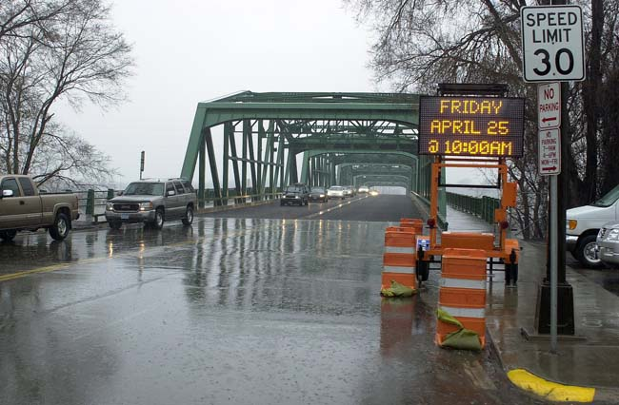
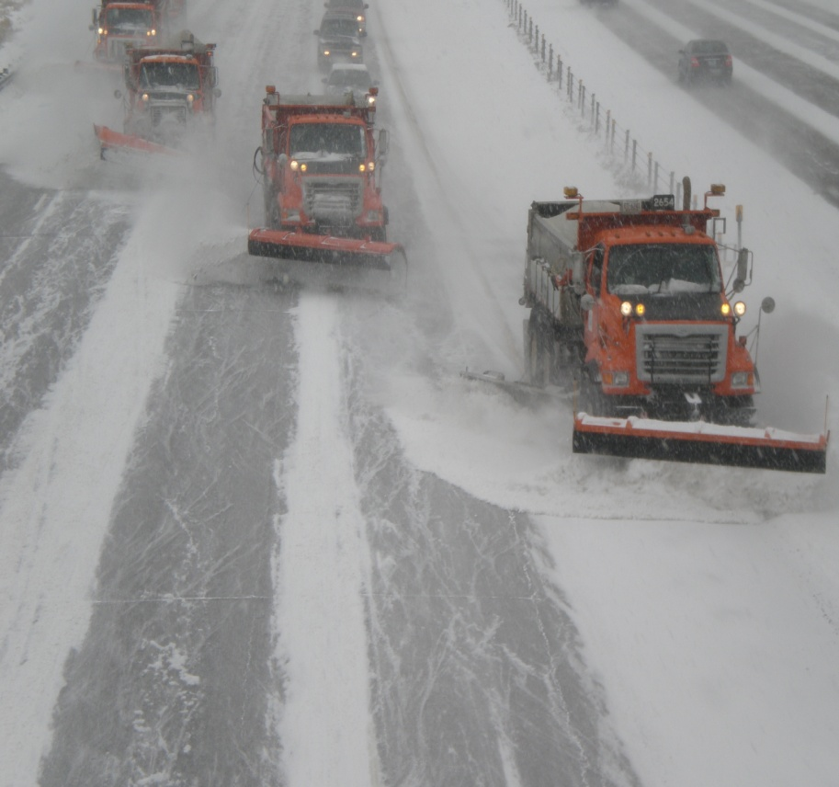
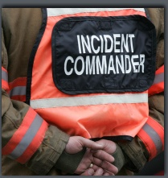
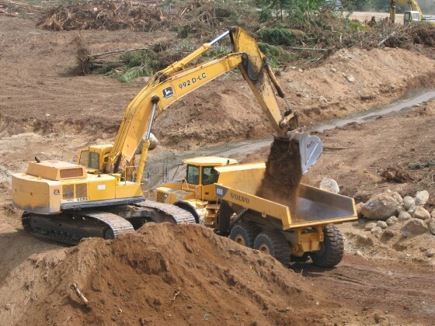
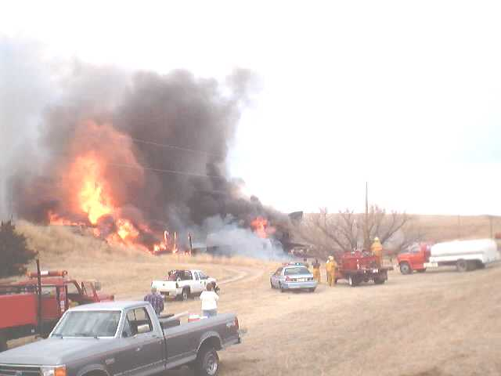
Welcome
Notes:
As a supervisor or manager in a State Department of Transportation (DOT), you may occasionally hear terms that appear to have nothing in common with your office’s day-to-day responsibilities; terms such as:
National Response Framework (NRF),
Emergency Support Function (ESF),
National Incident Management System (NIMS),
Incident Command System (ICS),
Emergency Operations Plan (EOP) or Emergency Response Plan (ERP),
Emergency Management Assistance Compact (EMAC), and
Emergency Operations Center (EOC).
You may have wondered: What are these things and what impact do they have on me and my office?
The purpose of this briefing is to inform supervisors and managers of roles, missions, organizational structures, plans, concepts, and terminology used by Government agencies at all levels and by the private sector in preparing for, responding to, and recovering from emergencies or disasters.
The intent is to provide sufficient information to allow those that go through the briefing to enable them to ask questions and explore their roles or the roles of their offices or staff in emergency management activities.
If you desire more information about any of the terms or concepts, there is a list of references at the end of this briefing.

Slide 3
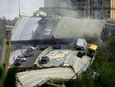
Introduction
Why does a supervisor or manager need to be familiar with emergency management terms and concepts?
Notes:
The role of DOTs in State response operations is evolving. DOTs are assuming a larger role in planning and preparing for response and recovery operations, whereas in the past they usually reacted following an emergency. They now work more closely with the State Emergency Management Agency and other partner agencies on a routine basis prior to as well as during disasters and emergencies. State DOTs are participating more often in statewide training and exercises to become better prepared to execute response operations.
It is important for you to understand that during response to and recovery from emergencies, you, your office and members of your staff may be required to perform other than your normal duties in an organizational structure unlike your day-to-day structure, and working for a supervisor that is not your day-to-day supervisor.
Likewise, because of your expertise, you may be called upon to lead or supervise a team made up of individuals relatively unknown to you.
This briefing is aimed at helping you understand concepts so you can effectively communicate during these times.

Slide 4
contents
Information You Should Know
How You May be Impacted
How Your Office May be Impacted
Notes:
There are two parts to this briefing.
First, Information You Should Know. This takes up the majority of the briefing. The information is presented as an overview to acquaint you with various aspects of emergency management, but is not intended as a complete discussion. You are encouraged to do independent research which will require you to ask questions of your DOT Emergency Coordinator.
With an understanding of the information presented, the remainder of the briefing is intended to generate questions that will cause you to seek out additional information that is specific to your State DOT:
How is emergency management incorporated into the DOT’s plans and processes?
How do people, or workgroups, get selected to serve in the DOT’s Emergency Operations Center (EOC)? Or, the State EOC?
What is involved when a person – you or a member of your office – is selected for or assigned to a response position?

Slide 5
Information You Should Know
Notes:
Let’s begin with a discussion of information you should know.

Slide 6
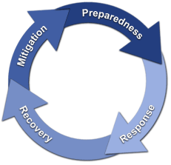
What is emergency management?
The Emergency Management Process
Mitigation
Preparedness
Response
Recovery
Notes:
What is emergency management?
Emergency management involves preparing for a disaster or emergency before it occurs, the response actions taken during a disaster or emergency, and recovering from or rebuilding after a disaster or emergency has occurred.
The Emergency Management Process
Stated in another way, emergency management is the continuous process by which all individuals, agencies, and levels of governments manage hazards in an effort to avoid or reduce the impact of disasters resulting from the hazards. There are four (4) phases:
Mitigation – Mitigation is action taken to prevent hazards from developing into disasters, or to reduce the effects or mitigate the consequences of disasters when they occur. The mitigation phase differs from the other emergency management phases because it focuses on long-term measures for reducing or eliminating risk. As shown in the picture, mitigation activities can occur prior to a disaster as an element of preparedness, or as a part of the recovery process if applied after a disaster occurs. Mitigation activities can be structural, as in retrofitting bridges to better withstand earthquakes, or non-structural, as in passing legislation to establish flood zones to prevent building in a risk area.
Preparedness – In the preparedness phase, emergency managers develop plans of action for implementation when a disaster strikes. Common preparedness measures include:
conducting risk assessment to focus efforts toward the greatest hazards/threats
taking action to reduce vulnerability and mitigate consequences
developing emergency response plans describing how an entity will organize to conduct and manage response operations
training individuals and teams to conduct response operations
conducting exercises to test response plans and validate training
incorporating lessons learned from exercises and actual events to improve the level of preparedness

Slide 7
What is emergency management?
The Emergency Management Process
Mitigation
Preparedness
Response
Recovery
Notes:
Response – In the response phase, governments take direct action to save lives, protect property, care for victims, and mitigate the amount of damage. Response operations begin at the local level with emergency services, including police, fire and/or emergency medical activities and public works. If the disaster or emergency impacts a large area, such as a wildland fire or flood, people may be displaced and require emergency shelter. Transportation infrastructure and systems also play a role in response operations: highways are designated as evacuation routes from areas threatened by hurricanes, aviation and rail assets can move people out of danger; ferries and other watercraft can be instrumental in rescue efforts such as those that occurred after the ditching of US Air Flight 1549 in the Hudson River.
Recovery – Recovery efforts are primarily concerned with actions that involve rebuilding destroyed property, re-employment, and the repair of other essential infrastructure. During recovery, mitigation means rebuilding in such a way as to reduce the probability of the same consequences occurring from a similar event. Recovery and mitigation of transportation infrastructure is generally the responsibility of infrastructure owners with the support of State agencies and Federal assistance.
Your State DOT has a role in all four (4) phases of emergency management.
In terms of time, response is relatively short, whereas recovery can take years depending on the extent of damage.

Slide 8
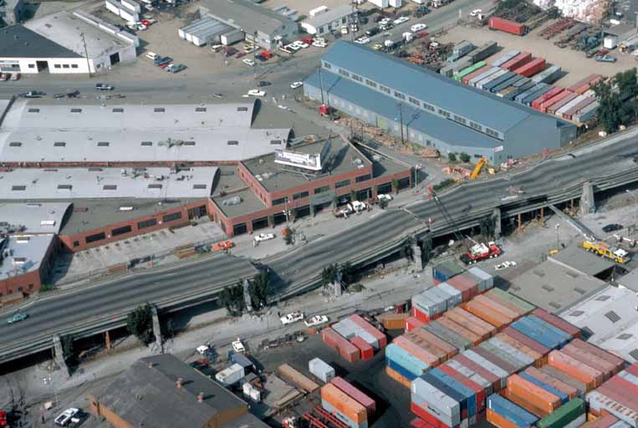
mitigation
What is it?
Who does it?
Notes:
The Federal Emergency Management Agency (FEMA) has a hazard mitigation assessment and planning process for local officials to use to conduct hazard assessments and create plans for mitigating the hazards.
It is important that these assessments and plans include transportation infrastructure. Funding for transportation infrastructure mitigation will normally come from sources other than FEMA resources. Transportation infrastructure should be integrated into overall hazard mitigation assessment and mitigation plans because of the interdependencies of transportation infrastructure with non-transportation infrastructure such as highway bridges carrying communications lines or rail lines carrying fuel for power plants.
Mitigation of transportation infrastructure may occur under the oversight of the State DOT, depending on the State and the type of infrastructure. In most cases, it will be done by private contractors, but under contracts managed by the State DOT.

Slide 9
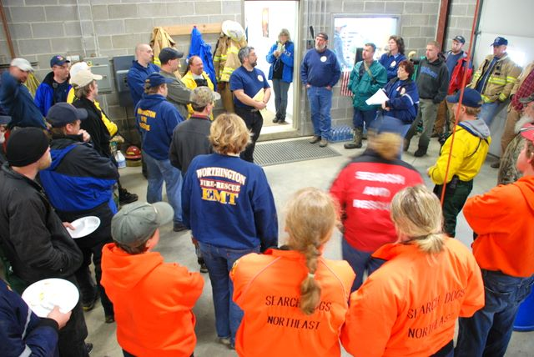
preparedness
Identify hazards/threats
Planning
Training
Exercising
After Action Improvement
Notes:
Hazard Identification
The first step in preparing is identifying the threats and hazards that a State faces. This step provides the answer to the question: What is the basis for the plan? For example, Southern coastal states are particularly vulnerable to hurricanes, while Midwest states are vulnerable to floods and tornadoes, the West Coast and Midwest must plan for earthquakes, and most Northern states face severe winter storms. All states face the threat of terrorist or criminal caused incidents and accidents causing chemical spills or contamination from nuclear power plants.
The State DOT responsibility is to identify hazards and threats facing the State’s transportation infrastructure. Transportation infrastructure is particularly vulnerable to a variety of hazards and threats, including:
earthquakes – weakening and collapse of bridges,
floods – erosion of bridge supports and roadbeds,
accidents – damage caused by large vehicles,
fires – weakening bridge supports and concrete roads, and,
terrorism – bridges and tunnels can be damaged/destroyed by explosions or the cutting of cables

Slide 10
preparedness
Identify hazards/threats
Planning
Training
Exercising
After Action Improvement
Notes:
Planning
Governments take an all-hazards approach when planning. Response activities tend to be the same regardless of the event – life-saving, minimizing damage to infrastructure, caring for peoples’ needs. However, because there are small differences depending on the specific hazard, States develop plans describing how they will respond to the affects of particular hazards/threats when they occur.
States plan to support local government response efforts because initial response occurs at the local level and local governments do not have extensive resources to support response operations. States also plan to support other states. No State agency can respond completely independent of other organizations and preparedness efforts must be coordinated between agencies.
States also need to plan to receive and use resources provided by other States and the Federal government during response operations. Planning is an integrated and coordinated process, vertically and horizontally:
State – local
State – Federal
State – State
Agency – agency
The State DOT will coordinate planning efforts with other State agencies, including the State’s Emergency Management Agency; county highway departments; with various agencies of the U.S. Department of Transportation; and, with DOTs from other States to ensure response activities can be easily integrated when necessary.

Slide 11
preparedness
Identify hazards/threats
Planning
Training
Exercising
After Action Improvement
Notes:
Training
Once the plans are developed, individuals and teams need to be trained to execute the various aspects of the plan. Generally, individuals are trained in their tasks, then teams are brought together to train on integrated tasks.
Training may be classroom, at the DOT or another location; on-line through the Federal Emergency Management Agency or other organization; or may occur on the job to build depth in an Emergency Operations Center (EOC).
Exercising
Exercises are controlled activities conducted under realistic conditions to provide an opportunity to test one or more parts of response plans. They are also used to validate the effectiveness of training of individuals and teams. Exercises are conducted prior to real events so results can be examined in depth to determine what changes, if any, need to occur.
After Action Improvement
Information is collected during and following actual response operations and exercises to determine how well the plan worked and what future training may be needed. The planners take the information, analyze it and make changes to plans and training curricula to ensure better response operations in the future.

Slide 12
Emergency operations plans
What’s in an Emergency Operations Plan?
Who Responds
And How
Emergency
Operations/
Response
Plans
Where to Obtain
Resources
Notes:
Emergency Operations Plans
Once threats and hazards have been identified, plans can be written. Plans generally address the areas of:
operations: what and how we execute our mission and responsibilities;
training: how we get people ready;
exercising: how we validate the plan and individual and team training; and
post-response activities: how do we incorporate improvements.
All levels of government – local, tribal, State and Federal – as well as their departments and agencies, prepare formal Emergency Operations Plans (EOP) to establish responsibilities, authorities and procedures on how the entity or organization will operate in response to an emergency or disaster. Your State may call it an Emergency Response Plan, but it is the same thing.
Operations or response plans address:
Who will respond and how they will be prepared to respond
When response operations will commence and how they will be conducted
How coordination will occur
Communications plans
Chain of command
Organizational structures
How response operations will terminate
How improvements will be made

Slide 13
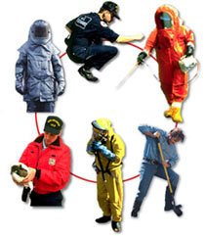
Response CONCEPTS
Tiered Response
Scalable and Flexible
Unity of Effort
Notes:
Response activities need to occur as quickly as possible following an event if lives are to be saved and damage to infrastructure minimized. While these activities generally occur first at the local government level, State agencies and their personnel need to be prepared before an incident so they can provide resources and support to those local governments.
Tiered Response
Fire departments, emergency medical units, and police respond to incidents; local government agencies mobilize to perform activities within their sphere of responsibility; local organizations establish care centers for displaced residents. States and their agencies mobilize to provide resources: material, equipment, supplies, personnel, or funds to the local government and its agencies, if necessary. The Federal government agencies mobilize to be ready to provide support to States if necessary.
Scalable and Flexible
The level of effort during response operations waxes and wanes depending on the level of activity needed at any given time. At the onset, there may be a large amount of activity at the local, State and Federal levels. Once life-saving activities have been accomplished, resources are directed towards caring for displaced people and cleaning up. Then, in later stages, rebuilding begins to occur, which requires less response personnel and more resources, usually from State and Federal levels.
Unity of Effort
Response activities need to occur in a fully integrated and seamless manner to endure the most efficient and effective use of resources. This occurs through Unity of Command – local, State and Federal leaders work together to bring resources to the point where they are most needed.
Let’s look at several documents that further describe these concepts:
National Response Framework (NRF)
National Incident Management System (NIMS)
Incident Command System (ICS)

Slide 14
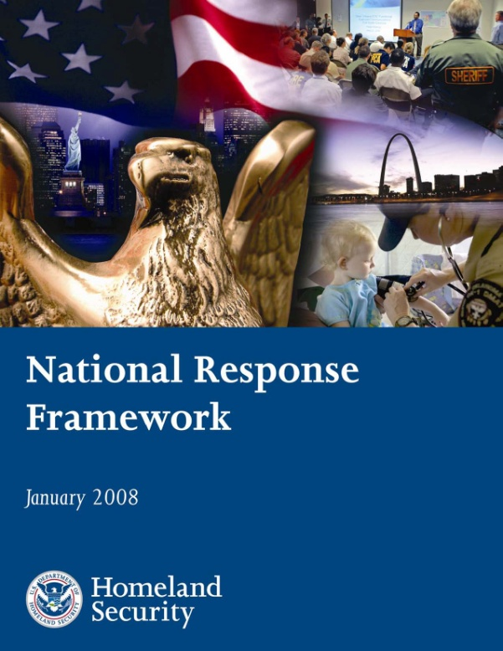
National response framework
Notes:
The National Response Framework (NRF) was published in January 2008 by the Federal government, with input from partner stakeholders: Federal agencies, States, local response organizations, and the private-sector. It is a guide to how the Nation - local, tribal, State, and Federal governments, and the private sector - conducts all-hazards response. It provides guidance on how roles are aligned for efficiency and effectiveness during response operations. It is based on best practices identified following Hurricane Katrina in 2005, and describes specific authorities and relationships for managing incidents that range from the serious, but strictly local, to large-scale terrorist attacks or catastrophic natural disasters. It is not a response plan, but provides a basis for developing response plans at all levels of government.
A critical principle of the NRF is all incidents are managed locally.
The NRF presents the key response principles, identifies the participants and their roles, and describes structures that guide the Nation’s response operations. It provides all response personnel, including you, with guidance and information relating to:
Who is involved with emergency management activities at the local (mayor), tribal, State (Governor and agencies, including the State Department of Transportation), and Federal levels.
What we as a Nation collectively do to respond to incidents; for example, State DOTs will provide resource support to local governments responding to incidents. NOTE: When the local government’s resources are exhausted, the State will provide additional resources, and then the Federal government will provide support to the State as needed.
How, at all levels, the Nation effectively manages all-hazards response; for example, a Joint Field Office with State and Federal personnel in direct support to local responders.

Slide 15
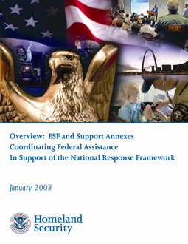
Emergency support functions
What are the 15 Emergency Support Functions identified in the NRF?
Notes:
The Federal Government and many State governments organize much of their resources and capabilities – as well as those of certain private-sector and non-governmental organizations – under 15 Emergency Support Functions (ESFs). ESFs align categories of resources and provide strategic objectives for their use. ESFs utilize standardized resource management concepts such as typing, inventorying, and tracking to facilitate the dispatch, deployment, and recovery of resources before, during, and after an incident. ESF coordinators and primary agencies are identified on the basis of authorities and resources. Support agencies are assigned based on the availability of resources in a given functional area. ESFs provide the greatest possible access to Federal department and agency resources regardless of which organization has those resources.
During a Federal response, the ESFs are coordinated by the Federal Emergency Management Agency (FEMA) through its National Response Coordination Center (NRCC), Regional Response Coordination Center (RRCC), or Joint Field Office (JFO). During a Federal response, ESFs are a critical mechanism to coordinate functional capabilities and resources provided by Federal departments and agencies, along with certain private-sector and non-governmental organizations. They represent an effective way to bundle and funnel resources and capabilities to local, tribal, State, and other responders. These functions are coordinated by a single agency but may rely on several agencies that provide resources for each functional area. The mission of the ESFs is to provide the greatest possible access to capabilities of the Federal Government regardless of which agency has those capabilities.
The ESFs serve as the primary operational-level mechanism to provide Federal assistance in functional areas such as transportation, communications, public works and engineering, firefighting, mass care, housing, human services, public health and medical services, search and rescue, agriculture and natural resources, and energy.

Slide 16
ESF 1-8
ESF | Title
1 | Transportation
2 | Communications
3 | Public Works and Engineering
4 | Firefighting
5 | Emergency management
6 | Mass Care, Emergency Assistance, housing and Human Services
7 | Logistics Management and Resource Support
8 | Public Health and Medical Services
Notes:
The first eight Emergency Support Functions and Primary Federal Agencies for the Federal government are:
ESF 1 – Transportation Department of Transportation
ESF 2 – Communications National Communications System and Federal Emergency Management Agency (FEMA) – both from the Department of Homeland Security (DHS)]
ESF 3 – Public Works and U.S. Army Corps of Engineers, Department of
Engineering Defense (DOD) and FEMA, DHS
ESF 4 – Firefighting Forest Service, Department of Agriculture
ESF 5 – Emergency Management FEMA, DHS
ESF 6 – Mass Care, FEMA, DHS
Emergency Assistance,
Housing, and
Human Services
ESF 7 – Logistics Management FEMA, DHS; General Services Administration
and Resource Support
ESF 8 – Public Health and Department of Health and Human Services
Medical Services

Slide 17
ESF 9-15
ESF | Title
9 | Search and rescue
10 | Oil and Hazardous Materials Response
11 | Agriculture and Natural Resources
12 | Energy
13 | Public Safety and Security
14 | Long-Term Community Recovery
15 | External Affairs
Notes:
The remaining Emergency Support Functions and Primary Federal Agencies for the Federal government are:
ESF 9 – Search and Rescue FEMA, DHS; U.S. Coast Guard (USCG), DHS; DOD
ESF 10 – Oil and Hazardous U.S. Coast Guard, DHS; Environmental Protection Agency
Materials Response
ESF 11 – Agriculture and USDA; Department of Interior
Natural Resources
ESF 12 – Energy Department of Energy
ESF 13 – Public Safety and Department of Justice
Security
ESF 14 – Long-Term FEMA, DHS
Community Recovery
ESF 15 – External Affairs FEMA, DHS
The same ESFs will be identified in most State Emergency Operations Plans (EOP). While the concept of ESFs has been around for a long time, it was primarily a purview of the Federal government. However, with the publishing of the National Response Plan, which was superseded by the NRF, States have begun organizing along the same framework. Some States have identified additional ESFs for their EOPs, so you may hear about ESFs 16, 17 or higher. Some States do not call them by the ESF number; instead, they use the name of the ESF such as Transportation, Communications, or Public Safety. Your state might use some other form of organizing capabilities for response activities.

Slide 18
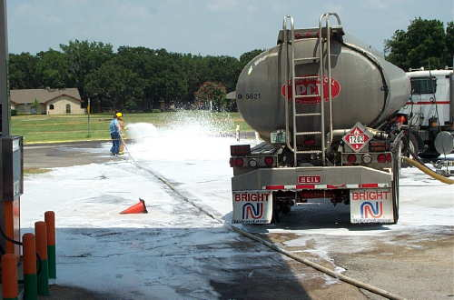
ESF 1, transportation - Federal
What Federal agencies support U.S. DOT in performing ESF 1 responsibilities?
What State agencies might support your DOT in performing its ESF 1 responsibilities?
Notes:
The U.S. Department of Transportation is the Lead Federal Agency for ESF 1, Transportation. In the same manner, the State DOT usually has the leadership role within the state for all matters relating to transportation: infrastructure, including roads, tunnels and bridges; transit systems; airfields; canals; and railroads; as well as for all preparedness activities, response operations, and recovery and mitigation activities related to transportation resources. The ESF lead agency coordinates planning efforts and the use of resources from other State agencies that may be identified to provide support. In the same manner, your State DOT may support some of the other ESF lead agencies.
The following Federal Departments support U.S. DOT in performing ESF 1, Transportation responsibilities:
Department of Agriculture
Department of Commerce
Department of Defense
Department of Energy
Department of Homeland Security
Department of the Interior
Department of Justice
Department of State
General Services Administration
U.S. Postal Service
In the same manner, your State DOT will probably be supported by other State agencies, according to your State’s Emergency Operations Plan.
The Federal Emergency Support Function 1, Transportation, is NOT the primary agency responsible for the movement of goods, equipment, animals or people. However, you have to keep in mind that each state is organized differently, so in some cases your State DOT may be involved in these transportation activities to some degree.

Slide 19
What are esf 1 lead agency missions?
Federal Level
State Level
Notes:
According to the NRF, the U.S. DOT is responsible for:
Monitoring and reporting the status of, and damage to, the transportation system and infrastructure.
Identifying temporary alternative solutions that can be implemented to ensure that the movement of people and materials can be continued during the response.
Performing activities conducted under the direct authority of the DOT.
Coordinating the restoration and recovery of transportation system and infrastructure
Coordinating and supporting preparedness, response, recovery and mitigation activities among transportation stakeholders.

Slide 20
What do esf 1 lead agencies do?
Federal Level
State Level
Notes:
As the State ESF 1, Transportation, primary agency, your DOT might do these types of activities:
Inspect or assist in inspecting bridges, roads, rails and/or airfields after a severe flood or earthquake.
Establish detours and set up alternate route signs on state highways; clear state highways of debris; clear runways for movement of aircraft; and assist with traffic control and contra –flow.
Close or open roads, harbors or airfields.
Replace bridges and railroad tracks; dredge harbors.
Participate in training and exercises; work with local governments to rebuild stronger infrastructure.

Slide 21
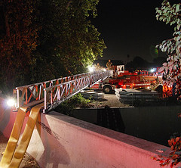
Three major principles to remember
Planning
Execution
Resources
Notes:
It is very important to understand three (3) major principles in the NRF:
Governments and their agencies should follow an “all-hazards” approach when developing Emergency Operations Plans (EOP). This follows the concept that response operations are essentially the same regardless of the hazard, with differences dictated by the specific hazard.
All incidents are local incidents! That means they are managed locally. A large incident is essentially several local incidents, but they are still locally managed. While other communities, the State, and even the Federal government may provide resources during the response, the local government is always in charge unless it is incapacitated.
Additional resources should be obtained at the lowest level possible. This is more cost effective and efficient.

Slide 22
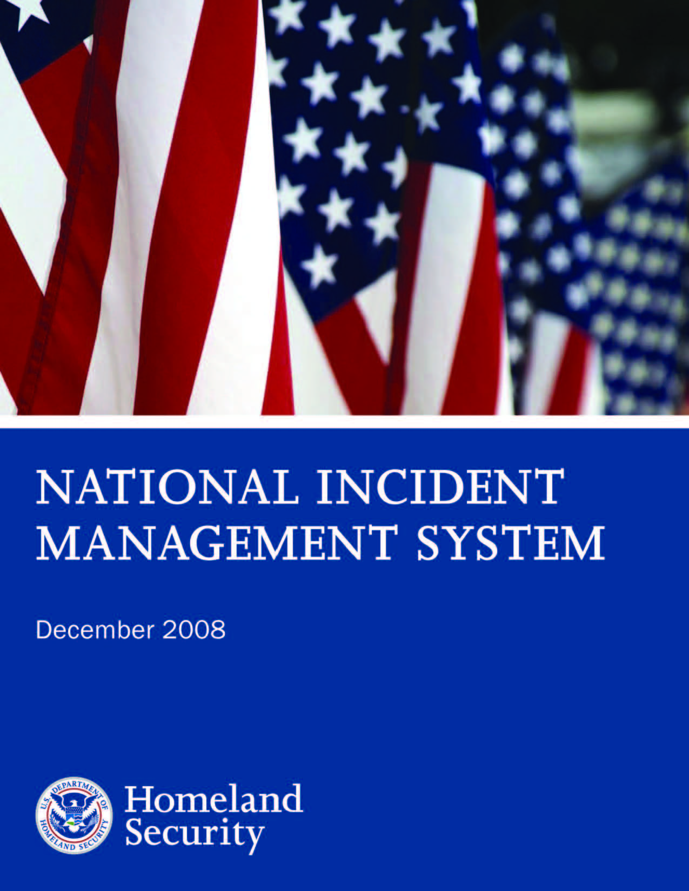
National incident management system
Notes:
The National Incident Management System (NIMS) is a companion document to the National Response Framework (NRF). The NIMS provides a systematic, proactive approach to guide departments and agencies at all levels of government, non-governmental organizations (NGO), and the private sector to work seamlessly to prevent, protect against, respond to, recover from, and mitigate the effects of incidents, regardless of cause, size, location, or complexity, in order to reduce the loss of life and property and harm to the environment.
Together the National Incident Management System (NIMS) and the National Response Framework (NRF) have a common goal – the efficient management of incidents and use of resources. NIMS provides the template for the management of incidents, while the NRF provides the structure and mechanisms for national-level policy for incident management.
The NIMS is intended to:
Be used in response to all types of incidents, hazards and emergencies regardless of cause, size, location or complexity.
Improve coordination and cooperation between public and private entities in a variety of incident management activities.
Provide a common organizational structure and language for incident management.
In other words, the NIMS is intended make sure all organizations are on the same page when responding to all types of emergencies.
The NIMS provides the template for the management of incidents, while the NRF provides the structure and mechanisms for the National policy for providing resources and managing the Federal response.

Slide 23
NIMS
Why NIMS?
Consistent use
Common approach
Working together
Notes:
Why is there a National Incident Management System?
Homeland Security Presidential Directive (HSPD)-5, Management of Domestic Incidents, directed the development and administration of the National Incident Management System (NIMS). Originally issued on March 1, 2004, by the Department of Homeland Security (DHS), NIMS provides a consistent nationwide template to enable Federal, State, tribal, and local governments, non-governmental organizations (NGOs), and the private sector to work together to prevent, protect against, respond to, recover from, and mitigate the effects of incidents, regardless of cause, size, location, or complexity.
NIMS was originally published in March 2004 and received its first true test during the response to and management of the Hurricane Katrina Disaster. Using lessons learned from Hurricane Katrina and other events, a revised NIMS was published in 2008.

Slide 24
NIMS
Why NIMS?
Use consistently
Common approach
Working together
Notes:
Intent
Consistent use of the NIMS lays the groundwork for response to all emergency situations, from a single agency responding to a fire, to many jurisdictions and organizations responding to a large natural disaster or act of terrorism.
An important effect of the NIMS is that it creates a common approach in both pre-event preparedness and post-event response activities that allow responders from many different organizations to effectively and efficiently work together at the scene of an incident.
Under the NIMS, responders from a wide variety of jurisdictions and agencies know what to expect and what to do when they arrive at an incident scene.
The NRF and NIMS are companion documents that were created to improve the Nation’s incident management and response capabilities. Together, the NRF and NIMS provide for the effective integration of the capabilities and resources of various governmental jurisdictions, non-governmental organizations (NGOs), and the private sector incident management and emergency response disciplines into a cohesive, coordinated and seamless national framework for incident response.

Slide 25
Nims components
Preparedness
Communications and Information Management
Resource Management
Command and Management
Ongoing Management and Maintenance
Notes:
NIMS has five (5) components. Four (4) of these and what they mean to a State Department of Transportation (DOT) are:
Preparedness. Preparedness is the collective term for pre-event activities that, literally, prepare individuals and organizations to be able to respond to an incident. Some of the activities are:
developing emergency operations plans that describe how States and their departments and agencies, including the State DOT and its subordinate elements and organizations, should respond to an incident;
providing standards for accreditation, licensure or certification – these are standards that require certain measurable knowledge and other capabilities, for example, having a valid driver’s license; training and drilling individuals and teams in job fundamentals to ensure everyone can accomplish the tasks identified for them in the emergency operations plan; participating in exercises that test and evaluate whether the emergency operations plan is adequate and if everyone can do their job in an emergency response; and,
correcting shortfalls in planning and training identified during exercises or real events.
Communications and Information Management. The concept of using normal words instead of code words helps to ensure that when DOT workers talk to other emergency workers on the job, individuals and teams from one organization will be able to understand the other; that is, State and county or other local transportation workers will be less likely to misunderstand each other; and, provides rules for the easy sharing of important response-related information and for providing a common operating picture to all agencies and teams, so everyone knows the same information at the same time.
Resource Management. Individuals, teams and material are valuable resources during an emergency response. Making sure the right resources are working in the right areas where they are most effective, and making sure responders have the tools to do their assigned task ensures efficient and effective resource management.
Command and Management. Under NIMS, command and control processes are designed to enable efficient and effective management and coordination of resources, including State DOT workers. NIMS identifies a standardized incident management system, consisting of three (3) major parts: Incident Command System (ICS) [see next slide], Multi-agency Coordination Systems and Public Information. Under Command and Management, everyone knows exactly where in the command structure they will be.
The fifth component is Ongoing Management and Maintenance, which is simply the process of ensuring continued coordination and oversight of the program by an element of the U.S. Department of Homeland Security.

Slide 26
Incident command system
Most important NIMS concept
Common IC structure
All levels of government use it
Notes:
The Incident Command System (ICS) is the NIMS element with which you should become most familiar. ICS provides a standardized, yet flexible, management process to ensure all resources committed to a response, whether the resources are provided from different organizations within or outside a single jurisdiction, or, for complex incidents with national implications, are used in the best way possible. When an incident requires response from multiple local response agencies, effective cross-jurisdictional coordination using common processes and systems is critical to an effective response and for the safety of the responders.
ICS allows responders from outside a local jurisdiction or state to volunteer or be sent to another incident scene and still understand the terminology and operations being used. You could be sent to an area other than the one you report to on a daily basis, especially during a regional or statewide incident or when those who would normally respond are affected by the situation and external resources need to be brought in to help.
State and Federal governments and departments/agencies also use principles of ICS. This is generally seen in the organizational structures that have common elements to facilitate coordination both vertically – from local to State to Federal – and horizontally – local to local, State to State and between Federal departments and agencies.

Slide 27
What is ics?
Incident
Commander
Operations
Planning
Logistics
Finance/ Administration
Notes:
What is ICS?
The ICS has been tested and proved effective in more than 30 years of emergency and non-emergency applications, by all levels of government and the private sector.
The ICS is:
A proven management system based on successful business practices.
The result of lessons learned in the organization and management of emergency response to incidents.
The ICS consists of procedures for managing personnel, facilities, equipment, and communications resources. It is a system designed to be used from the beginning to the end of an incident.
The ICS is designed to:
Meet the needs of incidents regardless of cause or size.
Allow you and other personnel from a variety of agencies to meld rapidly into a common operational structure.
Provide logistical and administrative support to you and other operational staff.
Be cost effective by avoiding duplication of effort.

Slide 28
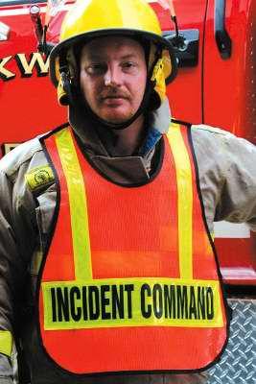
Why ics?
Development
Weaknesses
Notes:
The ICS was developed in the 1970s following a series of catastrophic fires in California's wildlands. What were the lessons learned? Surprisingly, studies found that response problems were far more likely to result from inadequate management than from lack of resources or tactics.
Weaknesses were often due to:
Lack of accountability, including unclear chains of command and supervision.
Poor communication due to both inefficient use of available communications systems and conflicting code words and terminology.
Lack of an orderly, systematic planning process.
Lack of a common, flexible, predesigned management structure that enables commanders to delegate responsibilities and manage workloads efficiently.
Lack of predefined methods to effectively integrate interagency requirements into the management structure and planning process.

Slide 29
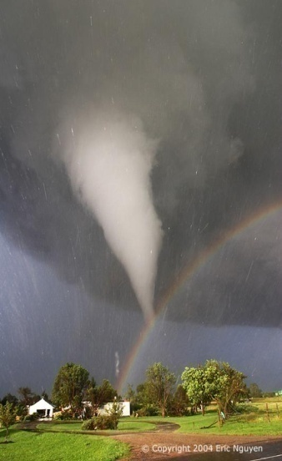
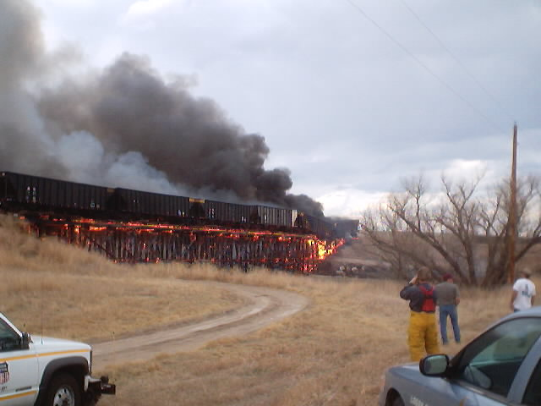
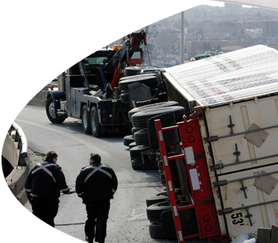
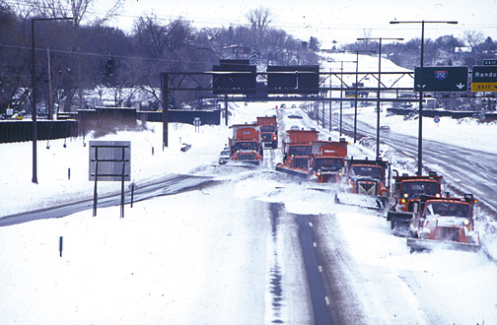
incidents
Definition
Examples
Notes:
Definition: An incident is an occurrence, regardless of cause, that requires response actions to prevent or minimize loss of life, or damage to property and/or the environment.
Examples of incidents include:
Structural and wildland fires.
Incidents, including crashes on roadways, that result in closures, detours, repairs.
Natural disasters, such as hurricanes, tornadoes, floods, ice storms or earthquakes.
Human and animal disease outbreaks.
Search and rescue operations.
Hazardous materials incidents, such as chemical spills.
Criminal acts and crime scene investigations.
Terrorist incidents, including the use of weapons of mass destruction.
National Special Security Events, such as the Olympics, Presidential visits, or the Super Bowl.
Other planned events, parades or demonstrations.

Slide 30
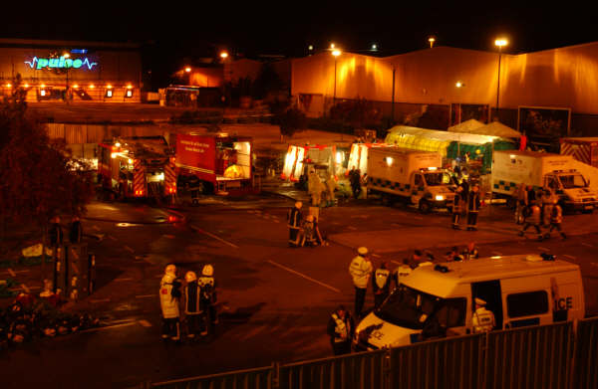
ICS concepts
Working together
Standard approach
Flexibility
Notes:
Given the size of some of these types of events, it's not always possible for any one agency alone to handle management and resource needs.
The ICS is a standard, on-scene, all-hazard incident management approach. It allows responders to use the same organizational structure for a single or multiple incidents regardless of boundaries.
The ICS has considerable internal flexibility, that is, the management organization can grow or shrink to meet different requirements. This flexibility makes it a very cost effective and efficient management approach for both small and large situations.

Slide 31
Features of ICS
Management
Planning
Command
Resources
Information Management
Integrated Communications
Notes:
ICS Features
ICS principles are implemented through a wide range of management features including;
Clear Text
The ability to communicate within the ICS is absolutely critical. That is, everyone uses clear text; they do not use radio codes, agency-specific codes, or jargon.
The ICS establishes common terminology that allows incident management and support groups to work effectively together.
Common terminology, which helps to define:
Organizational Functions. Major functions and functional units with incident management responsibilities are named and defined.
Resource Descriptions. Major resources (personnel, facilities, equipment, and supplies) are given common names and are "typed" or categorized by their capabilities.
Incident Facilities. Common terminology is used to designate incident facilities.
Position Titles. Management or supervisory positions are referred to by titles, such as Officer, Chief, Director, Supervisor, or Leader.
A modular organizational structure.
As response requirements for an incident become more complex, the ICS organization expands from the top down as responsibilities are delegated. When needed, separate functional elements can be established and subdivided to enhance internal organizational management and external coordination. As ICS organizational structure expands, the number of management positions also expands to adequately address the requirements of the incident. In ICS, only those functions or positions necessary for that particular incident will be activated. However, there will always be an Incident Commander and he/she will always be in charge. This is true even if the Incident Commander is the only person at the scene. In emergency operations centers, the individual in charge is often called a Team Leader to prevent confusion because there is only one Incident Commander.
Another basic ICS feature concerns the supervisory structure of the organization.
Span of control involves the number of individuals or resources that one supervisor can manage effectively during emergency response activities. Maintaining adequate span of control throughout the ICS organization is very important. Effective span of control during an incident may vary from three (3) to seven (7), and a ratio of one (1) supervisor to five (5) reporting elements is recommended. If the number of direct reports is less than three (3) or more than seven (7), expansion or consolidation of the organization may be necessary.

Slide 32
Features of ICS
Management
Planning
Command
Resources
Information Management
Integrated Communications
Notes:
ICS Features
The ICS emphasizes effective planning, including:
Management by objectives
All levels of a growing ICS organization must have a clear understanding of the functional actions required to manage the incident. Management by objectives is an approach used to communicate functional actions throughout the entire ICS organization.
Reliance on an Incident Action Plan (IAP).
In ICS, emphasis is placed on developing effective Incident Action Plans (IAP). An IAP is an oral or written plan that identifies general objectives that are part of the overall strategy for managing response activities. Incident Action Plans include the measurable strategic operations to be achieved and are prepared around a timeframe called an Operational Period. The purpose of the IAP is to provide all incident supervisory personnel with direction for actions to be executed during the operational period identified in the plan. A new IAP is written for each operational period.
At the simplest level, all Incident Action Plans must have four (4) elements:
What do we want to do?
Who is responsible for doing it?
How do we communicate with each other?
What is the procedure if someone is injured [Safety]?

Slide 33
Features of ICS
Management
Planning
Command
Resources
Information Management
Integrated Communications
Notes:
ICS Features
ICS features related to command structure include:
Chain of Command – who reports to who
Unity of Command – each individual has only ONE (1) supervisor
Unified Command – various agencies sharing leadership
Transfer of Command – ensuring that responsibility is transferred to the incoming commander in an orderly manner
ICS resources can be divided into two (2) categories:
Tactical Resources. Personnel and major items of equipment that are available or potentially available for assignment to incidents are called tactical resources. Tactical resources generally work outside the Command Post.
Support Resources. These are the personnel, equipment and supplies that feed personnel, provide and maintain communications equipment, provide and set up tents for sleeping and storage, order and deliver supplies, and manage fleet vehicles. Support resources are usually found inside the Command Post or directly supporting the responders.
ICS helps organizations ensure that resources are on hand and ready through:
Mobilization. The process of identifying, activating, accumulating and preparing resources for movement.
Accountability. All resources – personnel, equipment, funds – are totally accounted for during all phases of response operations. [See later discussion.]
NOTE: Resources are generally provided by the lowest level jurisdiction possible – local governments use their resources first,; then States provide additional resources, followed by the Federal government when necessary.

Slide 34
Features of ICS
Management
Planning
Command
Resources
Information Management
Integrated Communications
Notes:
ICS Features
And, finally, ICS supports responders, and decision makers by providing the data needed through effective information management.
Communication equipment, procedures, and systems must be interoperable; that is, they must allow communication between organizations and across jurisdictions. For example, it is important that deployed State DOT personnel are able to communicate with local highway department or airfield personnel as well as the incident supervisor.

Slide 35
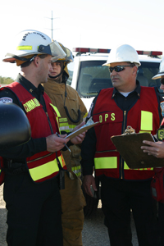
Command
Chain of command
Types of commands
Transfer of command
Notes:
In ICS:
Chain of command means that there is an orderly line of authority within the ranks of the organization, with lower levels subordinate to, and connected to, higher levels.
Unity of command means that every individual working in a response organization will be accountable to only one (1) designated supervisor in that response organization. If you have personnel assigned to work in an emergency operations center or deployed to assist local responders, that individual will report to his/her response organization supervisor, not to you.
Although orders must flow through the chain of command, members of the organization may directly communicate with each other to ask for or share information.

Slide 36
Command
Chain of command
Types of commands
Transfer of command
Notes:
The command function may be carried out in three(3) ways:
As a Single Command in which the Incident Commander will have complete responsibility for incident management. A Single Command may be simple, involving an Incident Commander and single resources, or it may be a complex organizational structure with an Incident Management Team.
As a Unified Command (UC) is an ICS application used when more than one (1) agency has incident jurisdiction or when incidents cross political jurisdictions. Agencies work together through the designated members of the UC, often the senior persons from agencies and/or disciplines participating in the UC, to establish a common set of objectives and strategies and a single Incident Action Plan. It is used for
Multiple jurisdictions.
A single jurisdiction with multiple agencies sharing responsibility.
Multiple jurisdictions with multi-agency involvement.
An Area Command is established to oversee the management of multiple incidents that are each being handled by a separate Incident Command System organization or to oversee the management of a very large or evolving incident that has multiple Incident Management Teams engaged. An Agency Administrator/Executive or other public official with jurisdictional responsibility for the incident usually makes the decision to establish an Area Command. An Area Command is activated only if necessary, depending on the complexity of the incident and incident management span-of-control considerations.

Slide 37
Command
Chain of command
Types of commands
Transfer of command
Notes:
Transfer of Command
The process of moving the responsibility for incident command from one Incident Commander to another is called transfer of command. Transfer of command may take place when:
A more qualified person assumes command.
The incident situation changes over time, resulting in a legal requirement to change command.
Changing command makes good sense, e.g., an Incident Management Team takes command of an incident from a local jurisdictional unit due to increased incident complexity.
There is normal turnover of personnel on long or extended incidents, i.e., to accommodate work and rest requirements of personnel.
The incident response is concluded and incident responsibility is transferred back to the home agency.
The transfer of command process always includes a transfer of command briefing, which may be oral, written, or a combination of both. In the very early stage of an incident response, the first person of authority at the scene becomes the Incident Commander. When another person of authority arrives and will replace that initial Incident Commander, some of the things need to be included in the transfer of command briefing are:
Actions taken and/or accomplished to this point in time.
Identification of the resources currently assigned and available.
Identification of activities in the Incident Action Plan for the current operational period.

Slide 38
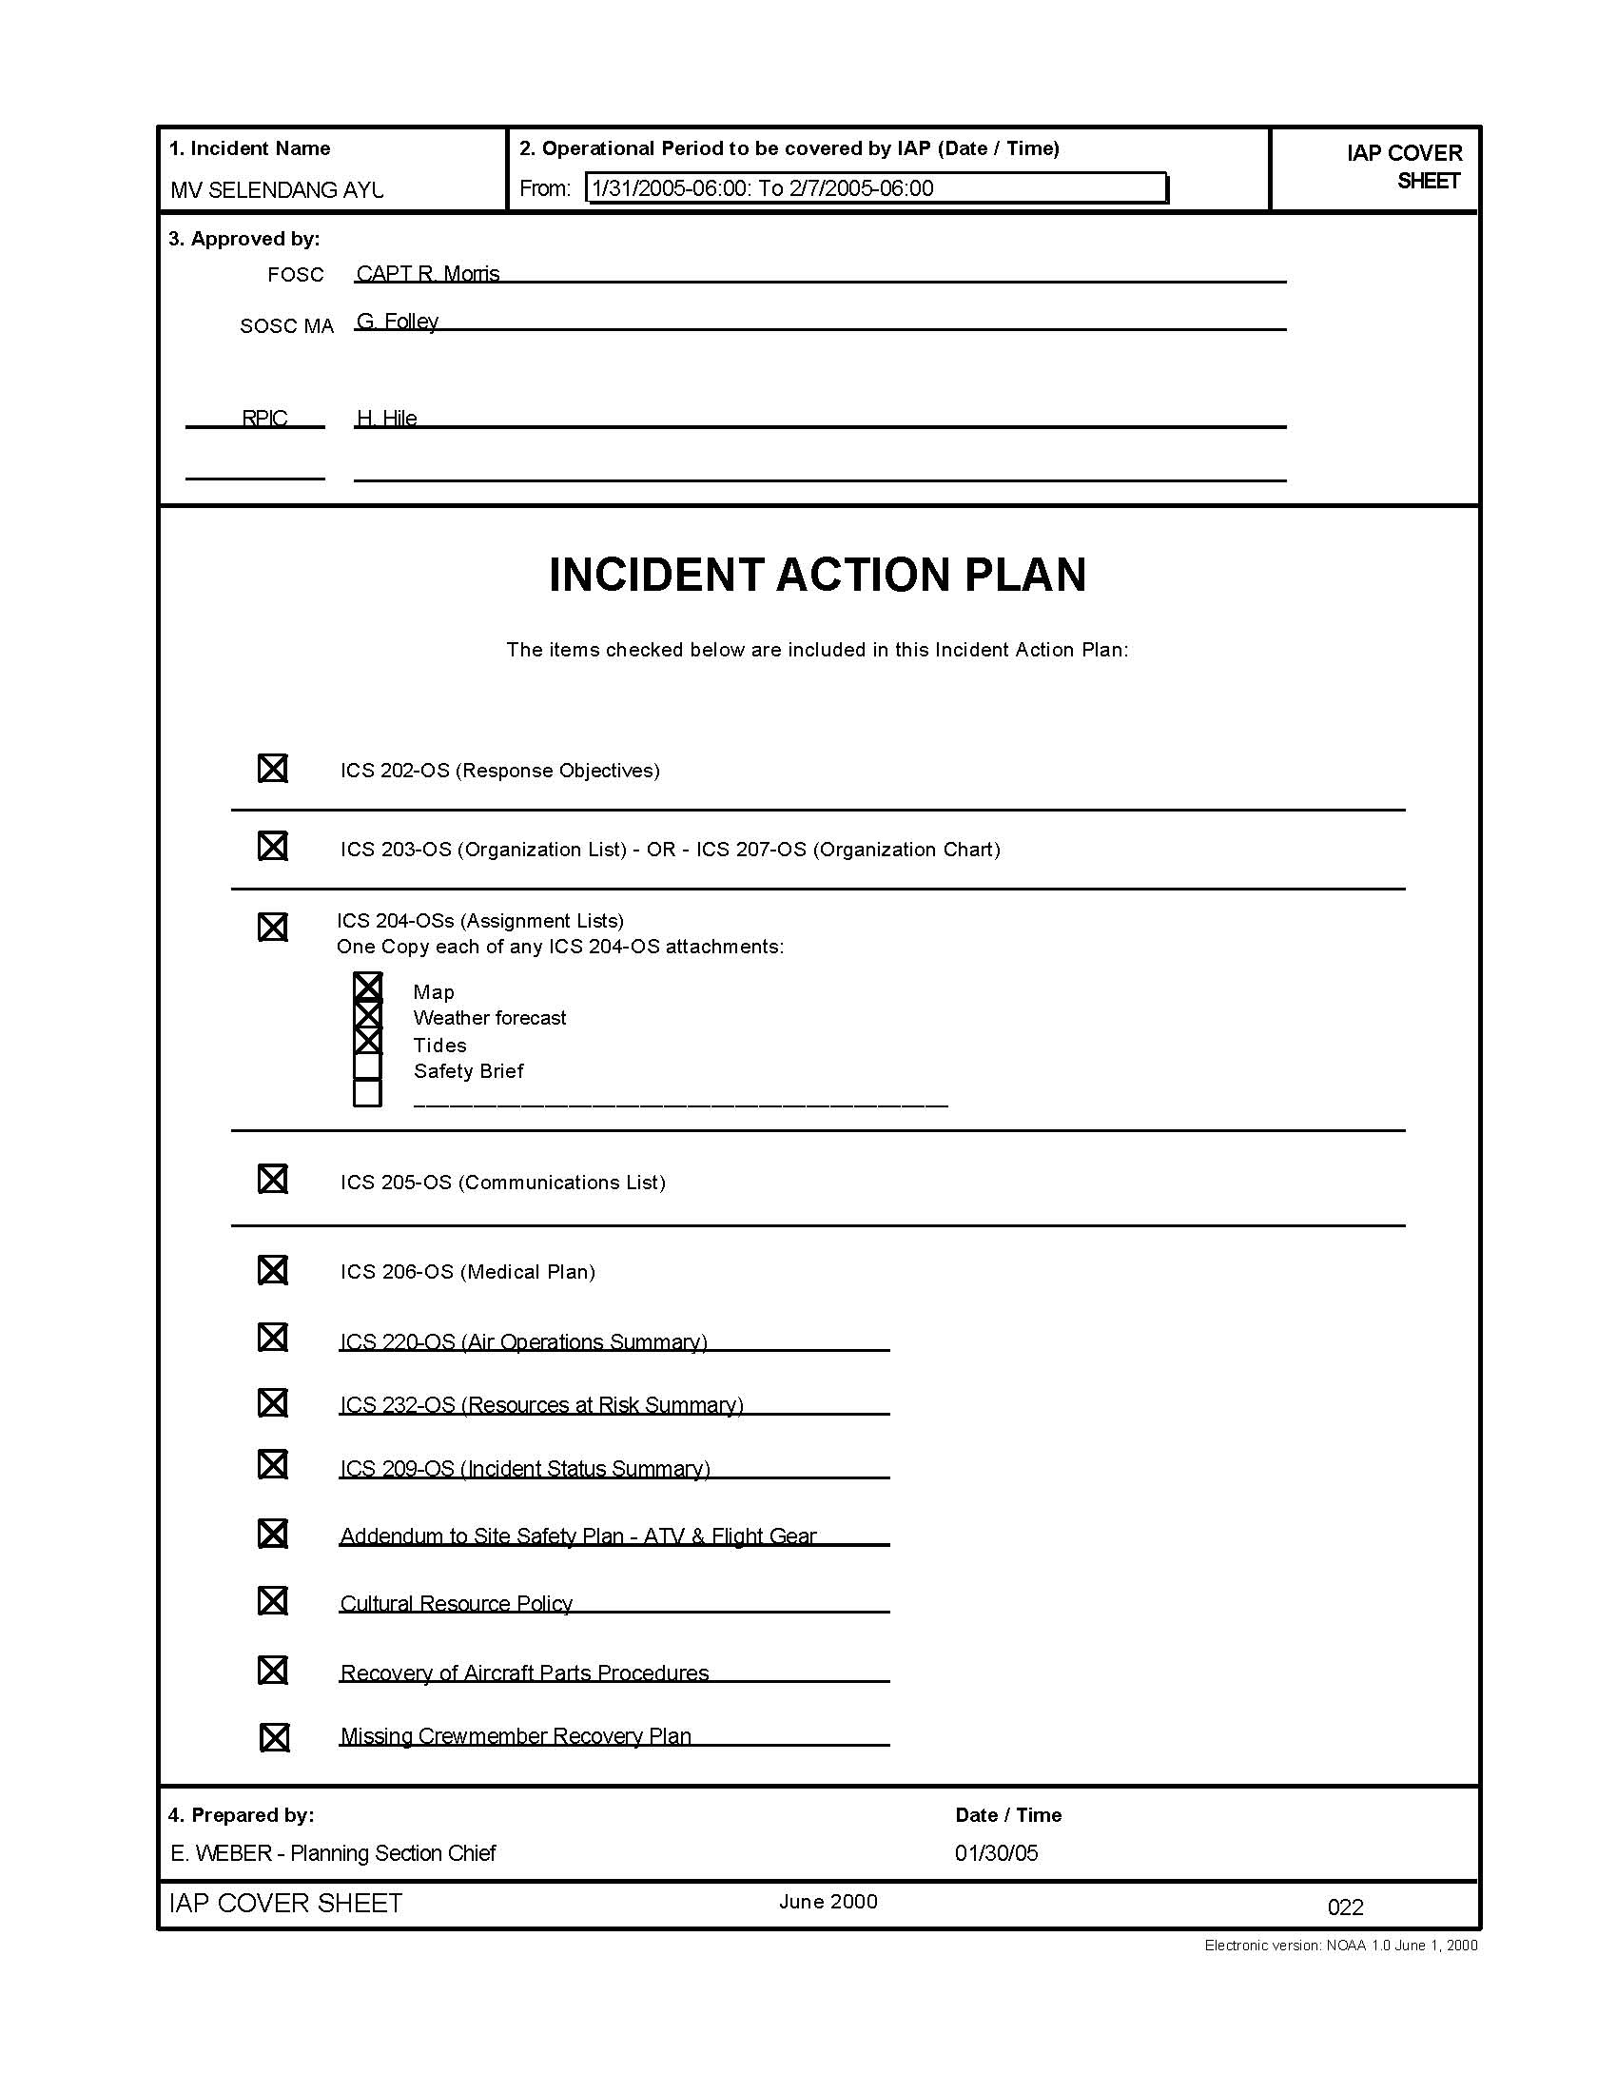
accountability
Accountability
Notes:
Accountability
Effective accountability during incident operations is essential at all jurisdictional levels and within individual functional areas. All State DOT personnel responding to the incident must abide by DOT policies and guidelines, and any applicable local, tribal, State, or Federal rules and regulations. Additionally, the following ICS guidelines must be adhered to:
Check-In. All responders must report in at the scene so the organization knows who is there.
Incident Action Plan. Response operations must be coordinated as outlined in the IAP.
Unity of Command. Every individual involved in incident operations will be assigned to only one (1) supervisor.
Span of Control. Supervisors must be able to adequately supervise and control the individuals assigned to them, as well as communicate with and manage all resources under their supervision. If you were assigned as a Section Chief or Branch Director, you would generally not have less than three (3) nor more than seven (7) people in your immediate work group.
Resource Tracking. Supervisors must record and report resource status changes as they occur; this directly aids effective and efficient resource management.

Slide 39
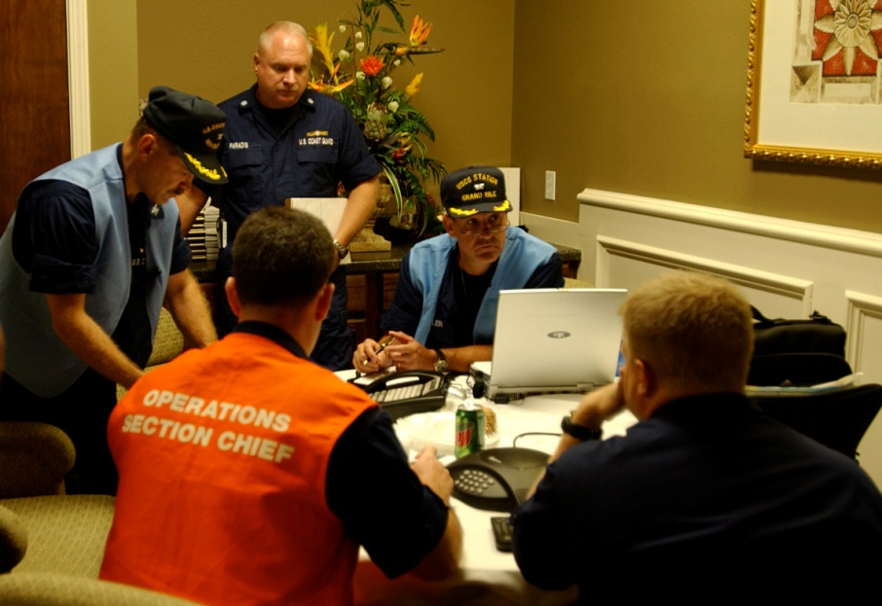
Standardized organization
Organization
for
Incident Command
Notes:
ICS organization is standardized and easy to understand. There is no correlation between the ICS organization used for incident response and the day-to-day administrative structure of any single agency or jurisdiction, with the possible exception of the military. This is deliberate, because confusion over different position titles and organizational structures has been a significant stumbling block to effective incident management in the past.
For example, you may be an Office Manager during day-to-day operations, but will likely not hold that title when working under the ICS structure.

Slide 40
TYPICAL ICS Structure
Incident
Commander
Operations
Planning
Logistics
Finance/ Administration
Notes:
There are major management functions that are the foundation upon which the ICS organization develops. These functions apply whether the incident is a routine emergency, is organizing for a major non-emergency event, or when managing a response to a major disaster. The major management functions are:
Incident Command. The Incident Commander establishes the incident objectives, strategies, and priorities, and has overall responsibility for the incident or event. The four (4) functional areas that report to the Incident Commander are:
Operations: Conducts tactical operations to carry out the plan; that is, develops the tactical objectives and organization, and directs all tactical resources.
Planning: Prepares and documents the Incident Action Plan to accomplish the objectives, collects and evaluates information, maintains resource status, and maintains documentation for the incident.
Logistics: Provides support, resources, and all other services needed to meet the operational objectives.
Finance/Administration: Monitors costs related to the incident; provides accounting, procurement, time recording, and cost analyses.
You may hear these referred to C-FLOP. This is an easy way to remember the first letter of each of the functions: Command, Finance, Logistics, Operations, and Planning.
Organizational Structure: Incident Commander
On small incidents and events, one person, the Incident Commander, may accomplish all management functions. In fact, the Incident Commander is the only position that is always staffed in ICS applications. However, large incidents or events may require that some of these management functions be set up as separate Sections within the organization.
Organizational Structure: ICS Sections
Each of the primary ICS Sections may be subdivided as needed. The ICS organization has the capability to grow or shrink to meet the needs of the incident.

Slide 41
ORGANIZATIONAL titles
Organizational Level | Title | Support Position
Incident Command | Incident Commander | Deputy
Command Staff | Officer | Assistant
General Staff (Section) | Chief | Deputy
Branch | Director | Deputy
Division/Group | Supervisor | N/A
Unit | Leader | Manager
Strike Team/Task Force | Leader | Single Resource Boss
Notes:
A basic ICS operating guideline is that the person at the top of the organization is responsible until the authority is delegated to another person. Thus, on smaller incidents when these additional persons are not required, the Incident Commander will personally accomplish or manage all aspects of the incident organization.
ICS Position Titles
To maintain span of control, the ICS organization can be divided into many levels of supervision. At each level, individuals with primary responsibility positions have distinct titles.
Using specific ICS position titles serves three (3) important purposes:
Titles provide a common standard for all users. For example, if one agency uses the title Branch Chief, another Branch Manager, etc., this lack of consistency can cause confusion at the incident.
The use of distinct titles for ICS positions allows for filling ICS positions with the most qualified individuals rather than by seniority.
Standardized position titles are useful when requesting qualified personnel. For example, in deploying personnel, it is important to know if the positions needed are Unit Leaders, clerks, etc.

Slide 42
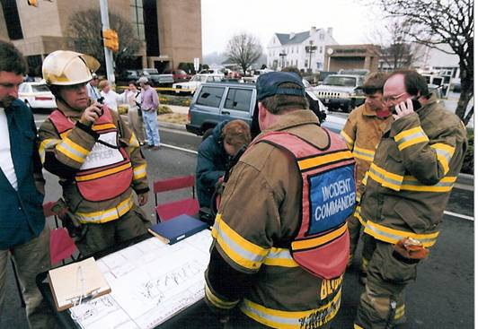
Incident command system
Incident Commander Responsibilities
Notes:
The Incident Commander has overall responsibility for managing the incident by objectives, planning strategies, and implementing tactics. The Incident Commander must be fully briefed and, if possible, have a written delegation of authority. Initially, assigning tactical resources and overseeing operations will be under the direct supervision of the Incident Commander.
Incident Commander Responsibilities
In addition to having overall responsibility for managing the entire incident, the Incident Commander is specifically responsible for:
Ensuring the safety of all personnel
Providing information services to internal and external stakeholders
Establishing and maintaining liaison with other agencies participating in the incident
The Incident Commander may appoint people to advise or perform these functions on his/her behalf. When this occurs, these individuals become the Command Staff.
The Incident Commander may appoint one (1) or more Deputies, if applicable, from the same agency or from other agencies or jurisdictions. Deputy Incident Commanders must be as qualified as the Incident Commander because the Deputy has to be able to take the Commander’s place if the Commander is unable to continue in the position.
Formal transfer of command at an incident always requires a transfer of command briefing for the incoming Incident Commander and notification to all personnel that a change in command is taking place.

Slide 43
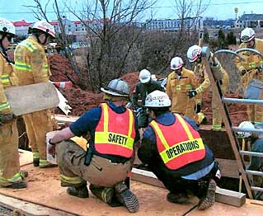
Command staff
Public Information Officer
Safety Officer
Liaison Officer(s)
Notes:
Command Staff
Depending upon the size and type of incident or event, it may be necessary for the Incident Commander to designate personnel to provide information, safety, and liaison services for the entire organization. In ICS, these personnel make up the Command Staff and consist of the:
Public Information Officer who serves as the conduit for information to internal and external stakeholders, including the media or other organizations seeking information directly from the incident or event.
Safety Officer who monitors safety conditions and develops measures for assuring the safety of all assigned personnel.
Liaison Officer(s) that serve as the primary contact for supporting agencies assisting at an incident.
The Command Staff reports directly to the Incident Commander.

Slide 44
General staff
Expanding the staff
Incident
Commander
Operations
Planning
Logistics
Finance/ Administration
Notes:
Expanding the Organization
As incidents grow, the Incident Commander may delegate authority for performance of certain activities to the Command Staff and the General Staff. The Incident Commander will add positions only as needed.
Expansion of the incident may also require the delegation of authority for other management functions. The people who perform the other four (4) management functions are designated as the General Staff. The General Staff is made up of four (4) Sections, representing the four (4) functional areas:
Operations
Planning
Logistics
Finance/Administration.
The General Staff reports directly to the Incident Commander.

Slide 45
SECTION CHIEFS AND DEPUTIES
Operations
Planning
Logistics
Finance/ Administration
Notes:
ICS Section Chiefs and Deputies
As mentioned previously, the person in charge of each Section is designated as a Chief. Section Chiefs have the ability to expand their Section to meet the needs of the situation. Each of the Section Chiefs may have one (1) or more Deputies, if necessary. The Deputy:
May assume responsibility for a specific portion of the primary position, work as relief, or be assigned other tasks.
Should always be as proficient as the person for whom he or she works.
In large incidents, especially where multiple disciplines or jurisdictions are involved, the use of Deputies from other organizations can greatly increase interagency coordination. The Deputy:
May assume responsibility for a specific portion of the primary position, work as relief, or be assigned other tasks.
Should always be as proficient as the person for whom he or she works.

Slide 46
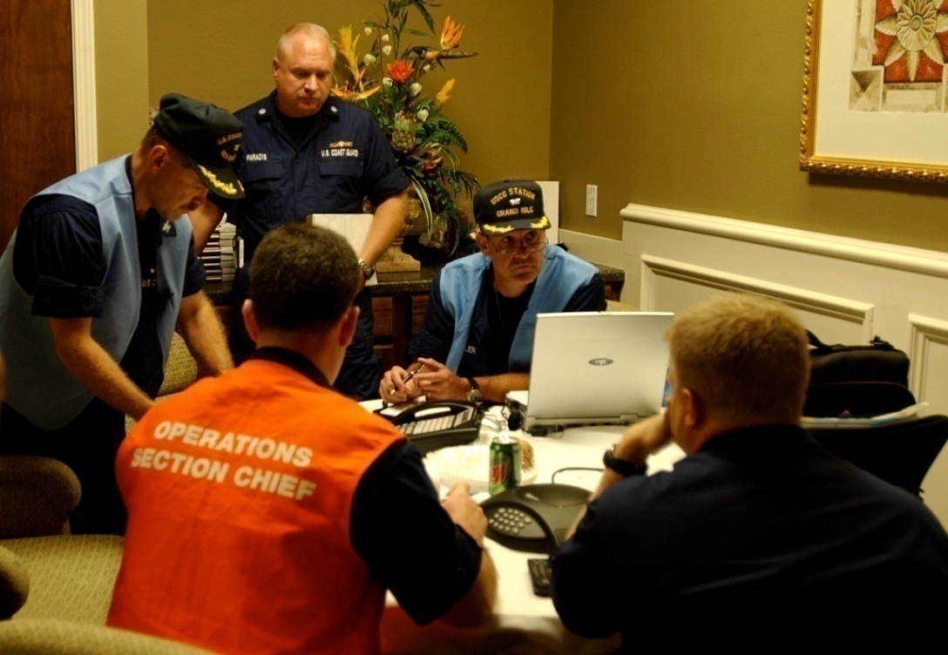
operations
Operations Section
Notes:
Operations Section
Until Operations is established as a separate Section, the Incident Commander has direct control of tactical resources. The Incident Commander will determine the need for a separate Operations Section. When the Incident Commander activates an Operations Section, he or she will assign an individual as the Operations Section Chief.
The Operations Section is not shown here with branches, groups or divisions or other sub-elements; the Operations Section is tailored for a specific response operation.
Operations Section Chief
The Operations Section Chief will develop and manage the Operations Section to accomplish the incident objectives set by the Incident Commander. The Operations Section Chief is normally the person with the greatest technical and tactical expertise in dealing with a specific incident type.

Slide 47
Planning Section
Planning
Section
Resource
Unit
Documentation
Unit
Technical
Specialists
Situation
Unit
Demobilization
Unit
Notes:
Planning Section
The Incident Commander will determine if there is a need for a Planning Section and designate a Planning Section Chief. If no Planning Section is established, the Incident Commander will perform all planning functions. It is up to the Planning Section Chief to activate any needed additional staffing.
The major activities of the Planning Section may include:
Collecting, evaluating, and displaying incident intelligence and information.
Preparing and documenting Incident Action Plans.
Conducting long-range and/or contingency planning.
Developing plans for demobilization.
Maintaining incident documentation.
Tracking resources assigned to the incident.
The Planning Section can be further staffed with five (5) Units. Technical Specialists such as engineers, surveyors, and encroachment permit coordinators, may be assigned to work in the Planning Section. Depending on the needs, Technical Specialists may also be assigned to other Sections in the organization.
Resources Unit: Conducts all check-in activities and maintains the status of all incident resources. The Resources Unit plays a significant role in preparing the written Incident Action Plan.
Situation Unit: Collects and analyzes information on the current situation, prepares situation displays and situation summaries, and develops maps and projections.
Documentation Unit: Provides duplication services, including the written Incident Action Plan; maintains and archives all incident-related documentation.
Demobilization Unit: Assists in ensuring that resources are released from the incident in an orderly, safe, and cost-effective manner.
Technical Specialists: Tech specialists are individuals with specialized knowledge that is pertinent to response operations.

Slide 48
Logistics Section: Branches and Units
Logistics
Section
Service
Branch
Support
Branch
Communication
Unit
Supply
Unit
Medical
Unit
Facilities
Unit
Food
Unit
Ground Support Unit
Notes:
Logistics Section
The Incident Commander will determine if there is a need for a Logistics Section at the incident, and designate an individual to fill the position of the Logistics Section Chief. If no Logistics Section is established, the Incident Commander will perform all logistical functions. The size of the incident, complexity of support needs, and the incident length will determine whether a separate Logistics Section is established. Additional staffing is the responsibility of the Logistics Section Chief.
Logistics Section: Major Activities
The Logistics Section is responsible for all of the services and support needs, including:
Ordering, obtaining, maintaining, and accounting for essential personnel, equipment, and supplies.
Providing communication planning and resources.
Setting up food services.
Setting up and maintaining incident facilities.
Providing support transportation, that is, the movement of resources.
Providing medical services to incident personnel.
The Logistics Section can be further staffed by two (2) Branches and six (6) Units. Not all of the Units may be required; they will be established based on need. The titles of the Units are descriptive of their responsibilities.

Slide 49
Finance/Administration Section
Finance/Administration
Section
Procurement
Unit
Time Unit
Cost Unit
Compensation/ Claims Unit
Notes:
Finance/Administration Section: Major Activities
The Finance/Administration Section is set up for any incident that requires incident-specific financial management. The Finance/Administration Section is responsible for:
Contract negotiation and monitoring.
Timekeeping.
Cost analysis.
Compensation for injury or damage to property.
The Incident Commander will determine if there is a need for a Finance/Administration Section at the incident and designate an individual to fill the position of the Finance/Administration Section Chief. If no Finance/Administration Section is established, the Incident Commander will perform all finance functions.
The Finance/Administration Section may staff four (4) Units. Not all Units may be required; they will be established based on need.
Procurement Unit: Responsible for administering all financial matters pertaining to vendor contracts, leases, and fiscal agreements.
Time Unit: Responsible for incident personnel time recording.
Cost Unit: Collects all cost data, performs cost effectiveness analyses, provides cost estimates, and makes cost savings recommendations.
Compensation/Claims Unit: Responsible for the overall management and direction of all administrative matters pertaining to compensation for injury and claims related activities kept for the incident.

Slide 50
Typical EOC structure
Public Information Officer
Command Staff: The Command Staff provides information, safety and liaison services for the entire organization.
EOC Leader
Safety Officer
Liaison Officer(s)
General Staff: The General Staff provides management functions for the EOC and coordinates with other EOCs and its own field organizations.
Operations
Section
Planning
Section
Logistics
Section
Finance/ Administration
Section
Notes:
NOTE: The structure depicted is based on ICS, is NIMS-compliant, and is intended to be representative of many State EOCs. Your State EOC may be organized differently.
Your State will have an EOC that is managed by the State Emergency Management Agency. The purpose is to coordinate for and deploy State resources to support local governments. The EOC will also coordinate with other States and with the Federal government for resources.
Federal departments and agencies establish EOCs to manage its resources that are deployed to support incident response operations. The U.S. DOT not only provides ESF 1, Transportation personnel to the NRCC, the RRCC and the JFO, it manages all aspects of ESF 1, Transportation responsibilities as delineated by the NRF. These Federal ESF 1, Transportation representatives may seek to coordinate directly with your DOT representatives in the State EOC, and maybe directly with your DOT EOC.
Federal resources are deployed to the vicinity of the incident and managed tactically by the Joint Field Office (JFO). The JFO is organized like an EOC, but instead of an EOC Leader, it has a Unified Coordination Group representing the Federal and State, and sometimes local, agencies that work together to ensure the right resources get to the right place.

Slide 51
How is an incident managed?
Management Levels, Operations Centers, and Responsible Individual
Local
Incident Command Post – Incident Commander
EOC – Local elected official
State
EOC - Governor
Federal
NRCC – FEMA Administrator
RRCC – FEMA Regional Administrator
JFO – Unified Coordination Group
Notes:
Now that you have been exposed to the concepts, how does this all play out?
As mentioned previously, all incidents are managed locally. A city or county fire chief, police chief, or other local official will lead the community’s response efforts as the Incident Commander. The Commander will establish a Command Post in the vicinity of the incident. A local government Emergency Operations Center (EOC) will be established to coordinate the provision of resources to the Incident Commander. In the local EOC, the highest elected official will normally be present, although most of the operations will be directed by the Operations Section Chief and/or the local Emergency Manager.
If the scope of the incident is large enough, the State will activate an EOC, bringing State agencies together to coordinate the mobilization and deployment of State resources to reinforce the capabilities of the local government. Most State EOCs have a direct representative of the Governor working directly with the EOC Team Leader.

Slide 52
How is an incident managed?
Management Levels, Operation Centers, and Responsible Individual
Local
Incident Command Post – Incident Commander
EOC – Local elected official
State
EOC - Governor
Federal
NRCC – FEMA Administrator
RRCC – FEMA Regional Administrator
JFO – Unified Coordination Group
Notes:
If the State indicates to the Federal government that they may need additional resources or the Federal government itself believes the State may need additional resources, the Federal Emergency Management Agency (FEMA) Regional Office will establish a Regional Response Coordination Center (RRCC) and the FEMA Headquarters establishes its National Response Coordination Center (NRCC). The FEMA Regional Administrator is the senior Federal official at the RRCC, and the FEMA Administrator is the senior official at the NRCC – both of which generally have a senior staff individual act as the Team Leader.
Coordination of Federal resources occurs forward of the RRCC at the Joint Field Office (JFO), generally located in the vicinity of either the State EOC or nearer to the incident, depending on the desires of the State. The JFO is led by a Unified Coordination Group – Federal Coordinating Officer, representing FEMA; the State Coordinating Officer, representing the Governor; and other senior Federal, State and/or local officials as appropriate for the type of incident. The JFO conducts operations in direct support of the State’s efforts.

Slide 53
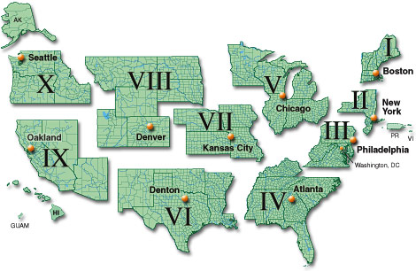
FEMA Regional offices
Source: FEMA’s Website
Notes:
There are 10 FEMA Regions. Each FEMA Region provides direct support to the States in its Region:
They conduct day-to-day coordination with the State Emergency Managers
They establish a Regional Response Coordination Center (RRCC) when a significant incident – e.g., flood, tornado, wildland fire, earthquake, hurricane – occurs in a State.
They may deploy a response team to the vicinity of the State EOC and establish direct coordination with the State Emergency Manager.
The RRCC is established in the Regional Office or a nearby facility. Regional ESF and other regional Federal agency representatives arrive and begin to:
identify what resources may be available to assist the State.
activate/mobilize resources as appropriate.
establish a mobilization center at a (preferably) Federally-owned installation.
deploy resources – supplies, equipment, personnel – to the Mobilization Center.
perform direct coordination with the National Response Coordination Center (NRCC) in Washington.
Now, let’s see how resources get to the Incident Commander.

Slide 54
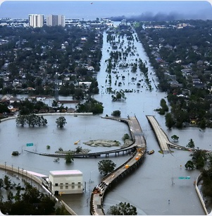
Provision of resources
Resources should be obtained at the lowest level possible.
There are two more terms to consider:
Mutual Aid
The Emergency Management Assistance Compact (EMAC).
Notes:
Provision of Resources
Earlier in the discussion, we mentioned that resources should be obtained at the lowest level possible. There are two (2) more ways to obtain them:
Mutual Aid
The Emergency Management Assistance Compact (EMAC).
Mutual Aid is a standing agreement between local governments and agencies to provide resources during an incident response. The best known of this type of assistance is when a fire department from a neighboring town assists a nearby department battling a large fire.
State resources are provided directly by the State to the local government – then the local government coordinates with the Incident Commander for tactical deployment.
EMAC is a formal agreement managed by the National Emergency Management Association (NEMA) that facilitates sharing resources between States. During the response to Hurricanes Katrina and Rita in 2005, many States sent resources to Louisiana, Mississippi and Texas. The EMAC was the conduit through which these resources were coordinated.
Resources may also be provided by the Federal government following a Presidential Major Disaster Declaration or Emergency Declaration – see next slide.

Slide 55
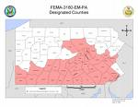
The declaration Process
First Response
Presidential Major Disaster Declaration
Emergency Declaration
Notes:
The Declaration Process
There is a formal process by which Federal resources are activated, mobilized and deployed to support incident response operations, as generally described below. However, these resources are usually not free – they are provided on a cost-share basis: 75 percent Federal, 25 percent State responsibility.
First Response to a disaster is the job of local government's emergency services with help from nearby municipalities, the State and volunteer agencies. In a catastrophic disaster, and if the Governor requests, Federal resources can be mobilized through the U.S. Department of Homeland Security's Federal Emergency Management Agency (FEMA) for search and rescue, electrical power, food, water, shelter and other basic human needs.
It is the long-term Recovery phase of disaster that places the most severe financial strain on a local or State government. Damage to public facilities and infrastructure, often not insured, can overwhelm even a large city.
A Governor's request for a major disaster declaration could mean an infusion of Federal funds, but the Governor must also commit significant state funds and resources for recovery efforts.

Slide 56
The declaration Process
First Response
Presidential Major Disaster Declaration
Emergency Declaration
Notes:
A Major Disaster could result from a hurricane, earthquake, flood, tornado or major fire which the President determines warrants supplemental federal aid. The event must be clearly more than state or local governments can handle alone. If declared, funding comes from the President's Disaster Relief Fund, which is managed by FEMA, and disaster aid programs of other participating federal agencies.
A Presidential Major Disaster Declaration puts into motion long-term Federal recovery programs, some of which are matched by State programs, and designed to help disaster victims, businesses and public entities.
An Emergency Declaration is more limited in scope and without the long-term Federal recovery programs of a Major Disaster Declaration. Generally, Federal assistance and funding are provided to meet a specific emergency need or to help prevent a major disaster from occurring.
The Major Disaster Process
A Major Disaster Declaration usually follows these steps:
Local Government Responds, supplemented by neighboring communities and volunteer agencies. If overwhelmed, turn to the State for assistance;
The State Responds with State resources, such as the National Guard and State agencies;
Damage Assessment is performed by local, State, Federal, and volunteer organizations determines losses and recovery needs;
A Major Disaster Declaration is requested by the Governor, based on the damage assessment, and an agreement to commit State funds and resources to the long-term recovery;
FEMA Evaluates the request and recommends action to the White House based on the disaster, the local community and the State's ability to recover;
The President approves the request or FEMA informs the Governor it has been denied. This decision process could take a few hours or several weeks depending on the nature of the disaster.
An Emergency Declaration follows much the same process.

Slide 57
FEMA Disaster aid programs
Public Assistance
Individual Assistance
Hazard Mitigation
Notes:
Disaster Aid Programs
There are three (3) major categories of disaster aid:
Public Assistance [of most importance to State DOTs] Public Assistance is aid to State or local governments to pay part of the costs of rebuilding a community's damaged infrastructure. Generally, public assistance programs pay for 75 percent of the approved project costs. Public Assistance may include debris removal, emergency protective measures and public services, repair of damaged public property, loans needed by communities for essential government functions and grants for public schools.
Individual Assistance Immediately after the declaration, disaster workers arrive and set up a central field office to coordinate the recovery effort. A toll-free telephone number is published for use by affected residents and business owners in registering for assistance. Disaster Recovery Centers also are opened where disaster victims can meet with program representatives and obtain information about available aid and the recovery process.
Hazard Mitigation Disaster victims and public entities are encouraged to avoid the life and property risks of future disasters. Examples include the elevation or relocation of chronically flood-damaged homes away from flood hazard areas, retrofitting buildings to make them resistant to earthquakes or strong winds, and adoption and enforcement of adequate codes and standards by local, State and Federal government. FEMA helps fund damage mitigation measures when repairing disaster-damaged structures and through the Hazard Mitigation Grant Program.

Slide 58
Federal Resource flow
FEMA
State
EOC
Resources
Fed
Agencies
Requests
Local
EOC
Command
Post
Staging
Area
Mob
Center
Notes:
The Incident Commander requests additional resources through the Local EOC.
The request then goes to the State EOC and depending on the amount of time that has elapsed to either the RRCC or the JFO. Early in the response effort, the Operations Section in the RRCC will prepare a Mission Assignment and send that to a Federal agency.
Later in the response effort, the Operations Section in the JFO validates the request and coordinates with the RRCC and NRCC. If the JFO can fill the request, they send a Mission Assignment to the appropriate Federal Agency, working through the ESF representatives. If the JFO cannot fill the request, they coordinate with the NRCC to transmit the Mission Assignment, again working through the ESF representatives.
A Mission Assignment directs the Federal agency to provide the resource – and provides a fund code to reimburse the agency providing the resource.
The Federal agency deploys the resource to the Mobilization Center (Mob Center) if it is not immediately needed, or directly to the Staging Area for immediate use. The Incident Command Post then does the tactical employment of the resource. Some resources may be employed by the Local EOC, for example, support for care centers.

Slide 59
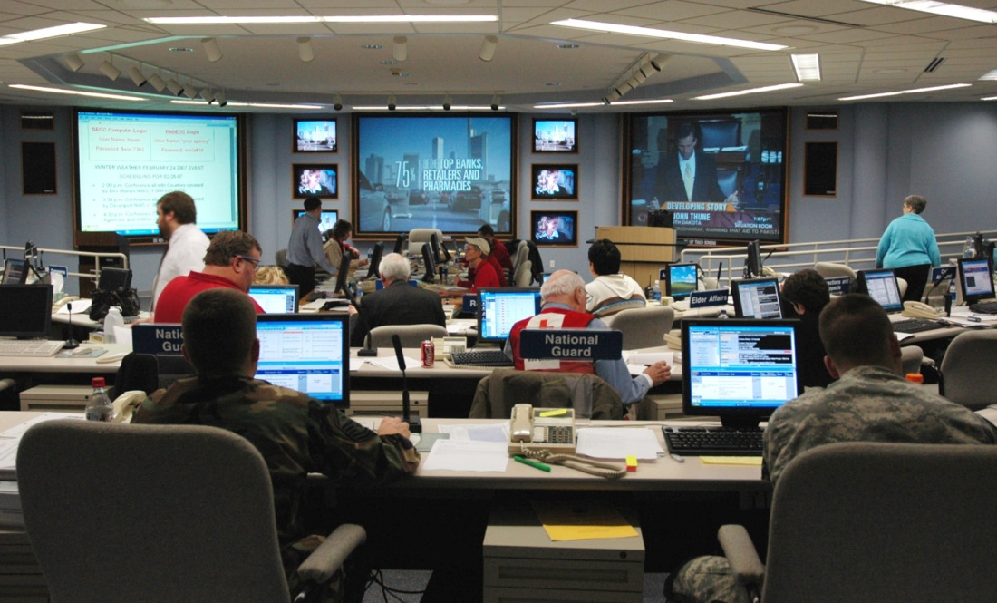
Duties of ESF 1 representatives
Federal, State, local
Coordination activities
Notes:
In the previous slide, the discussion surrounded how Federal resources are requested and flow to an incident for use by the local government and responders.
In the area of Transportation, there should be ESF 1, Transportation personnel in each Operations Section:
U.S. DOT provides representatives for the National Response Coordination Center, Regional Response Coordination Center, and Joint Field Office.
State DOT provides a representative for the State EOC.
local highway departments normally provide an ESF 1, Transportation representative at the local EOC.
However, the ESF representatives at all EOCs are constantly coordinating with other ESF representatives internally and with external ESF 1, Transportation representatives to identify:
potential resource needs based on the what is happening or may happen in the future.
amount of resource types available at agencies.
time required to get resources into the Staging Area.
how long resources can be maintained on site before replacement and refitting may be required.
when resources may no longer be needed and can be returned to normal operations.

Slide 60
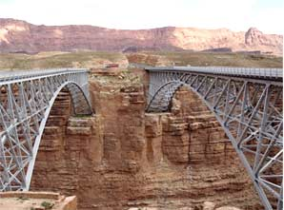
recovery
What is it?
When does it occur?
Notes:
What is Recovery?
Following a fire in a person’s house, the family rebuilds and tries to return to a normal life – this is recovery. Following an automobile accident, a person gets another car and carries on – this is recovery.
When used as an emergency management term, recovery is that time following an incident where governments undertake activities to restore infrastructure to a usable state. Buildings are rebuilt, just as houses are after a fire. Bridges, roads and other infrastructure will be repaired, relocated or rebuilt as conditions dictate.
When does it occur?
Recovery starts shortly after the initial life-saving response activities have occurred. Recovery begins with planning – identifying priorities and answering questions:
what are the most critical pieces of infrastructure?
will a piece of infrastructure be relocated or rebuilt in the same location?
will a bridge be repaired or completely rebuilt?
Recovery activities also comprise planning for continuation of essential services even though infrastructure has been destroyed, e.g., establishing temporary education facilities in modular buildings because a school was destroyed by a tornado.
Recovery can be a long-term activity depending on the amount of damage sustained, although restoration of public infrastructure is generally accomplished in a timely manner because of its importance to commerce.

Slide 61
What Does All This Mean to You?
Notes:
Now, we will look into what all this means to you.

Slide 62
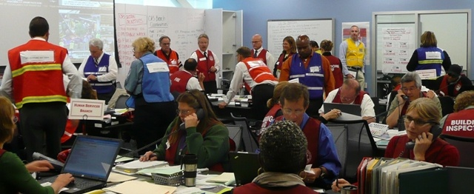
How does what you learned Impact you?
Do you have a role in your DOT’s emergency response?
Basis for emergency assignment
Preparing for an assignment
Notes:
Now that you have learned about emergency management, you may be wondering what your role may be. You may have a direct or supporting role in your DOT’s preparedness, response and recovery activities. An example of a direct role may be as a key individual in the DOT Emergency Operations Center (EOC), as an ESF 1, Transportation representative to the State EOC, or to the Joint Field Office (JFO). If you manage a field organization, you might be deployed, with your section, to the scene of an incident to support local incident management activities.
Your exact role will be based on several factors:
What you do on a day-to-day basis, e.g., if you are the manager of the contracting office you might be assigned to the Finance and Administration Section.
Your knowledge of a specific mission/role of the DOT, e.g., if you manage an organization in the Operations Directorate, you could be assigned as the Operations Section Chief.
Your background, e.g., if you have expertise or background in logistics, you could be assigned as the Section Chief or a Branch Director in the Logistics Section.
If you have a solid general knowledge of DOT roles/missions, you might be tapped for your management skills and assigned as the Section Chief or a Unit Leader in the Planning Section. In the same capacity, you could be assigned to represent ESF 1, Transportation at the State EOC. Likewise, even though your current position is “supervisor” or “manager,” your position in support of an emergency response might be as a staff member with no supervisory or managerial role.

Slide 63
How does what you learned Impact you?
Do you have a role in your DOT’s emergency response?
Basis for emergency assignment
Preparing for an assignment
Notes:
The first step is to find out who the DOT Emergency Coordinator is and ask if you are being considered for an emergency assignment. If you find out you are going to be given an assignment, ask what will be expected of you; if you aren’t being considered, you could volunteer – you might like the challenge.
So, you find out you are going to have an emergency assignment. How will you be expected to prepare for your assignment? There are several things you can do:
Locate and read your DOT’s Emergency Operations Plan (EOP).
Locate and read your State’s EOP, specifically the responsibilities assigned to ESF 1, Transportation.
Take on-line Independent Study (IS) courses offered by FEMA. There are three (3) specific ones that all persons with emergency management assignments should take:
IS-100.a, Introduction to Incident Command System
IS-700.a, National Incident Management System (NIMS), An Introduction
IS-800.b, National Response Framework, An Introduction
Ask if your DOT, or another organization, is sponsoring ICS courses and ask to attend them.

Slide 64
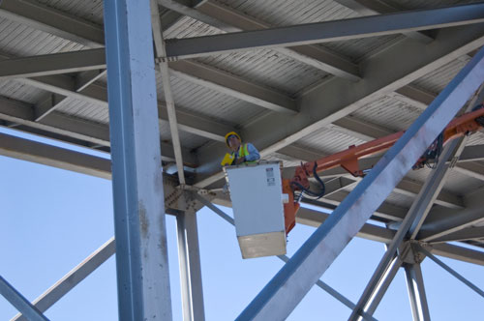
How does what you learned Impact Your office?
Emergency assignments
Out of office time
Continuing normal functions
Notes:
You now have a role in emergency response. You find yourself contributing more and more time to activities outside your office: writing plans, taking training courses, participating in exercises.
And, you find that some of your staff members also being assigned to General Staff sections in the DOT EOC. This can often be the case in the Planning Section, as the other sections generally have some direct link to offices, such as: Human Resources, Finance, Contracting, Operations and Supply (Logistics). You will have to make sure they are given time to take courses and attend training and to participate in exercises. This has the potential to create temporary shortfalls in the coverage of essential functions.
There are times during a response that your office may be short personnel, as they go to the EOC or other emergency assignments. You will need to have a good understanding of the priorities of your day-to-day functions, so the personnel remaining can concentrate on completing the most important work. A good way to prepare for this is to ensure everyone is cross-trained on office functions.
In some offices, the functions may be aligned so closely to the EOC that emergency support becomes a first priority, e.g., the Contracting Office may have to switch priorities to execute contracts supporting emergency response operations.
Also, consider office succession planning. Who will be in charge if you are assigned to a position during an emergency?

Slide 65
summary
Supervisors and Managers
May or may not be personally involved in emergency management
May or may not be required to support emergency response and recovery operations
Need to understand emergency management roles, missions, organizational structures, plans, concepts, and terminology
Notes:
This briefing has provided you information about:
The phases of emergency management,
Emergency operations/response plans,
NRF and NIMS principles and concepts, and
The Incident Command System
To learn more and conduct additional research, some references are provided on the next slide. If you have comments or questions, contact webmaster@dot.gov.

Slide 66
references
NRF http://www.fema.gov/emergency/nrf/.
NIMS http://www.fema.gov/emergency/nims/
On-Line Courses: http://training.fema.gov/IS/
Highway Infrastructure Security and Emergency Management (HIS/EM) Professional Capacity Building (PCB): http://www.fhwa.dot.gov/security/emergencymgmt/profcapacitybldg/
Notes:
These are on-line reference sources. You should also contact your DOT Emergency Coordinator who can give you DOT-specific information. When you start talking, your interest may well be interpreted as a desire to work more closely in the area of Emergency Management – go for it!

